Slide 1
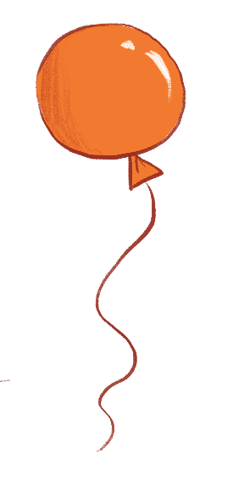
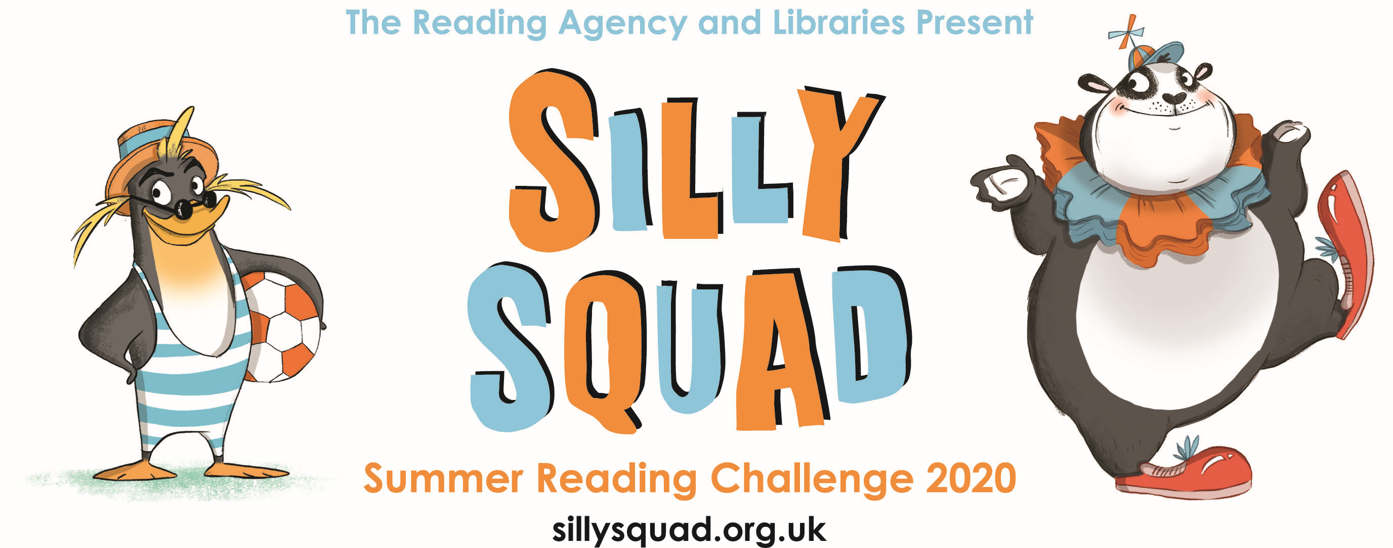
sillysquad.org.uk
Illustrations © Laura Ellen Anderson 2020 for The Reading Agency
Notes:
Information for teachers: Summary of presentation & Summer Reading Challenge
This PowerPoint presentation explains Silly Squad– the 2020 Summer Reading Challenge. It can be used in classrooms to let children know about the challenge.
What is the Summer Reading Challenge? The Summer Reading Challenge is an annual event aimed at 4-11 year olds. Each summer children are encouraged to read six (or more) books of their choice with collectable incentives and rewards, plus a certificate for every child who completes the Challenge. Taking part in the challenge can help to reduce the dip in reading levels that can occur over the long break.
How do children take part? Usually children sign up and take part in libraries. This year due to Covid-19 and the ongoing social distancing measures in schools and public libraries, the Challenge will be all-digital and is available now until September. Children sign up at www.sillysquad.org.uk
How are libraries involved? Libraries will still be supporting children to take part and there are ebooks & eaudiobooks to loan online available www.inspireculture.org.uk/online. As library buildings start to reopen we hope some families will be able to access physical books from the library too. Inspire will also be offering a range of supporting online activities over the summer too including; a writing challenge from author Alan MacDonald, cartoon strip ‘how-to’ from Beano cartoonist Marc Jackson, a Share a Joke competition plus a new digital book and online activities from our Inspire author and artist in residence.
Key points:
It’s free to join the Silly Squad website and take part in the Summer Reading Challenge 2020
Children will need permission from a parent/carer to complete the online registration
Children using the website choose a screen name and their personal details are never shared with other users on the site
All book reviews submitted to the site are checked by a moderating team before publication
All messages posted to the Chat page are checked by a moderating team before publication. Children cannot message each other independently of the moderated forum
In 2019-20 722,731 children took part in our Space Chase reading challenge. Over 9,000 in Nottinghamshire via Inspire Libraries.
Copyright notice: The artwork included in this PowerPoint can only be used to promote and support the Summer Reading Challenge 2020. The artwork should not be extracted or adapted.

Slide 2
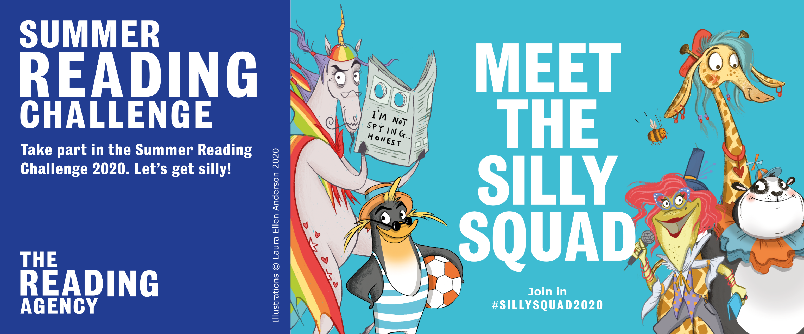
sillysquad.org.uk
Illustrations © Laura Ellen Anderson 2020 for The Reading Agency
Notes:
The Summer Reading Challenge 2020 is here!
It’s called Silly Squad and is all about funny books, happiness and having a laugh.
The Silly Squad is a loveable bunch of animals who run a fantastic fun house. But beware: a mysterious baddy is waiting to spoil the fun! (Who do you think that is? Anyone look suspicious in the picture?)
Usually you go into your local library to join and take part in the Summer Reading Challenge . Some of you may have taken part before? (Last year was called Space Chase)
This year is different. Because libraries have been closed and will be opening slowly over the summer. This year’s challenge is an ALL NEW, ALL DIGITAL challenge
This means you join in online and you can read books, comics or magazines you already have at home, at school, as well as reading books from the library.

Slide 3
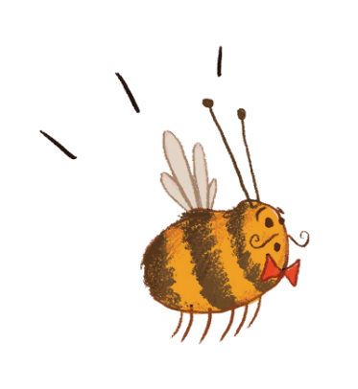
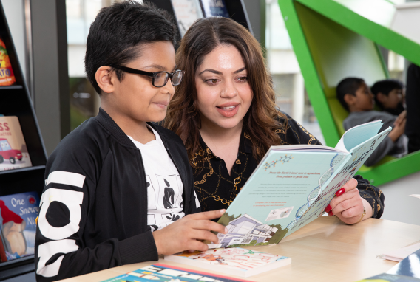
Sign up to the challenge on the Silly Squad website – IT’S FREE!
Create your profile and set your reading goal.
Read your books over the holidays – aim for at least 6!
Rate and review your books to unlock badges
Play the games and download the free activities from the website
Complete the Challenge and you’ll get your own certificate
sillysquad.org.uk
Illustrations © Laura Ellen Anderson 2020 for The Reading Agency
Photographs © Dave Warren 2019 for The Reading Agency
Notes:
HOW DOES IT WORK?
You can join the Silly Squad on a new adventure by signing up at the Silly Squad website www.sillysquad.org.uk
This year you set your own personal reading challenge to complete this summer. Inspire Libraries recommend at least 6 books! But it is up to you! How many do you think you could read before September?
The Silly Squad website will help you keep track of the books you have read & you can rate and review your books to let others know what you thought of them.
You will unlock digital rewards & badges along the way.
If you complete your Challenge, you’ll also get a special certificate to print off and keep.
What books can I read on the Challenge?
Anything you want! You choose the books you want to read on their Challenge; novels, fact books, joke books – all reading counts.
Usually for the Reading Challenge you are asked to borrow and read books from the library. This year, as libraries might be closed or not open as much as usual – that might make things too difficult. So you can read books, comics or magazines you already have at home, at school, as well as reading books from the library.

Slide 4
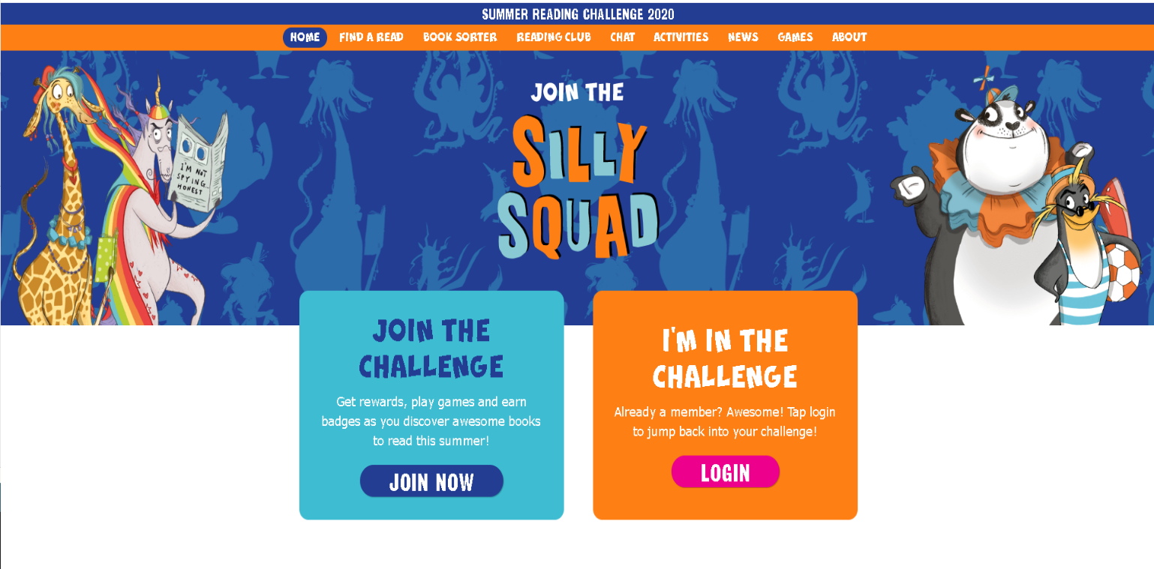
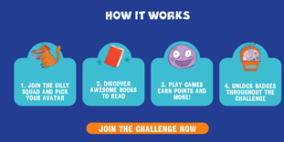
sillysquad.org.uk
Illustrations © Laura Ellen Anderson 2020 for The Reading Agency
Notes:
This is what the website looks like
On the website you can also
Find loads of brilliant book suggestions to get you started on your challenge, and tips on how you can keep reading.
Play games and enter competitions
Get tips on finding books to read especially helpful when libraries might be closed.
Watch special videos from your favourite authors and illustrators
Take part in mini-challenges, quizzes and activities
This year’s Challenge is available now and runs until September, so there’s plenty of time to take part and get silly this summer.
Teacher notes - you can click on the hyperlink to explore the website. Also….
Inspire Libraries will keep our website www.inspireculture.org.uk/summerreadingchallenge up to date with all the latest information about the challenge. We will be available throughout the summer to answer any questions families have about the challenge.

Slide 5
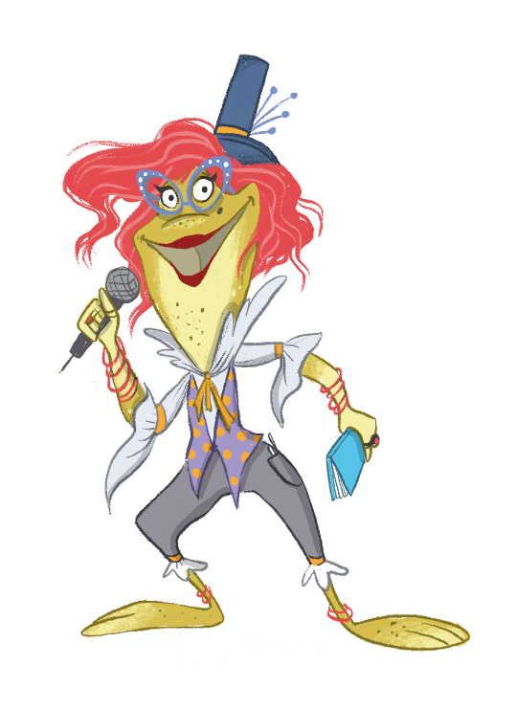
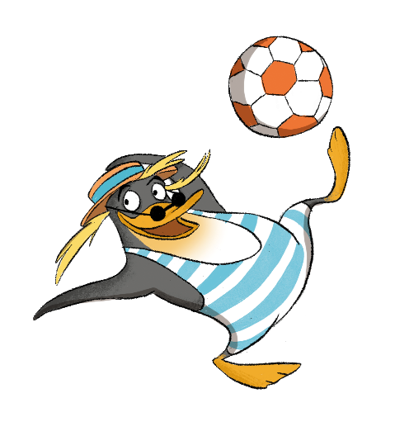
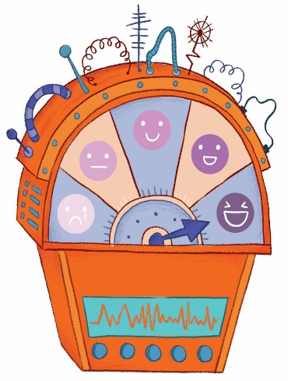
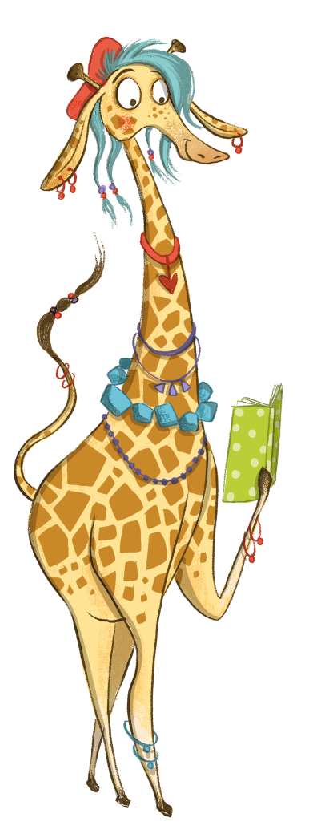
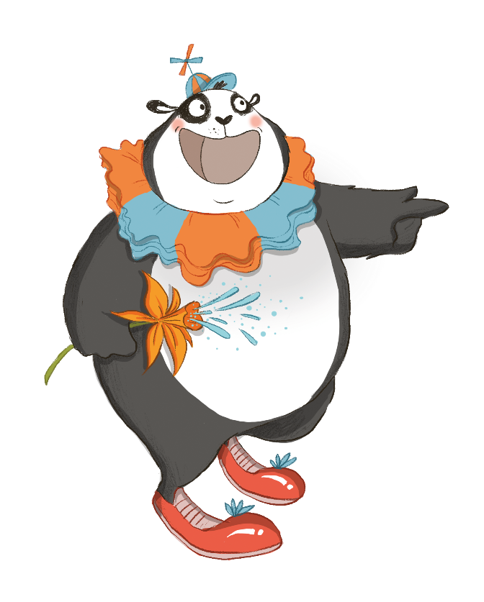
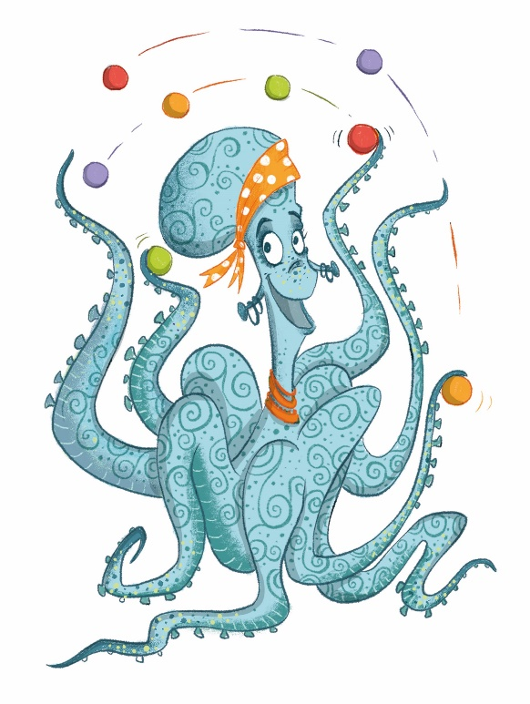
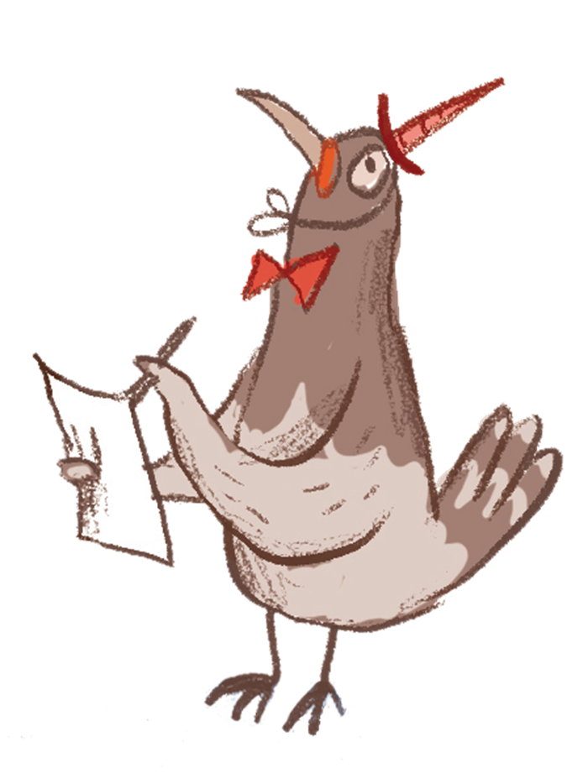
sillysquad.org.uk
Illustrations © Laura Ellen Anderson 2020 for The Reading Agency
Notes:
MEET THE SQUAD: This year, our Challenge features extra special characters designed by the award-winning author and illustrator Laura Ellen Anderson, who you’ll know from amazing reads like Amelia Fang and Evil Emperor Penguin!
Introducing ….
Snook the penguin ( Snŵc in Welsh)
Snook is the coolest member of the team. He’s a fish-guzzling fiend who can’t resist a funny novel!
Snook looks after the Comedy Closet and the Silly Squad’s amazing collection of fancy dress outfits, from rainbow capes and giant spotted trousers to princess dresses and carrot costumes. Any outfit can be a funny one if you’ve got the right attitude.
Izzie the octopus (Awen in Welsh)
Izzie is a wily MC! She can make up all kinds of wicked rhymes right off the top of her head (and she can juggle too!). She loves poetry.
Izzie is the boss of Slime Station, a giant room full of brightly coloured slime where fun house visitors can get active and go for a swim or jump into the tube slide.
Merry the giraffe (Sonia in Welsh)
Merry has a talent for telling tall tales and loves to relax with a spot of non-fiction.
Merry’s favourite room is the LOL Library, which is full of lots of wonderful books just waiting for readers to discover them! Merry loves to chat and is great at recommending books that the rest of the Silly Squad and their friends will enjoy.
Lily the frog (Lili in Welsh)
Lily is the stand-up comic with perfect timing, never to be seen without her trusty joke book.
In the fun house Lily is the host at the Giggle Factory, where you’ll often find her telling the most hilarious jokes! Everyone is welcome to hop on stage and share the things that make them laugh, from jokes to songs to funny stories and silly dances.
Bamboozle the panda (Bambwsl in Welsh)
Bamboozle is the clown of the bunch, and always has a trick or two up his furry sleeve! Book-wise, he’s obsessed with graphic novels and comics.
Bamboozle runs the One Stop Prop Shop, which is filled from floor to ceiling with wacky items to make you chuckle, like flowers that squirt water, giant glasses with fake noses, and spinning bow ties. Bamboozle is very creative and likes to make crafts and new props from objects he finds around the fun house.
But what is that pigeon doing?
Which member of the Silly Squad will make the loudest noise on the laugh-o-meter? The laugh-o-meter, a clever device that lets the Silly Squad measure happiness levels and keep kids entertained.
Who do you think is the funniest?

Slide 6
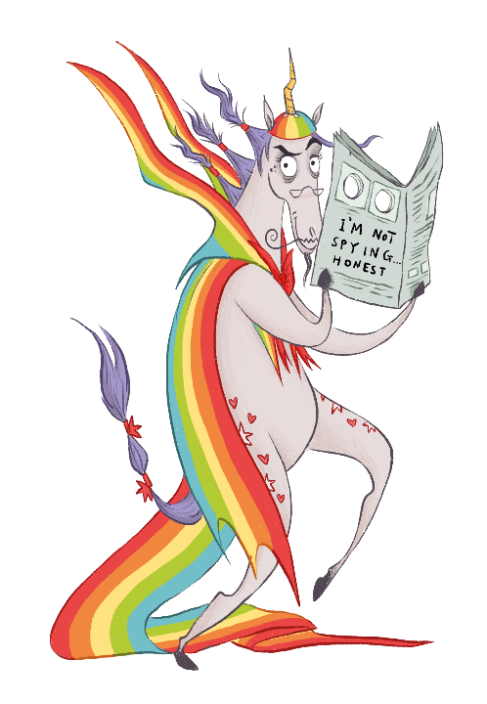
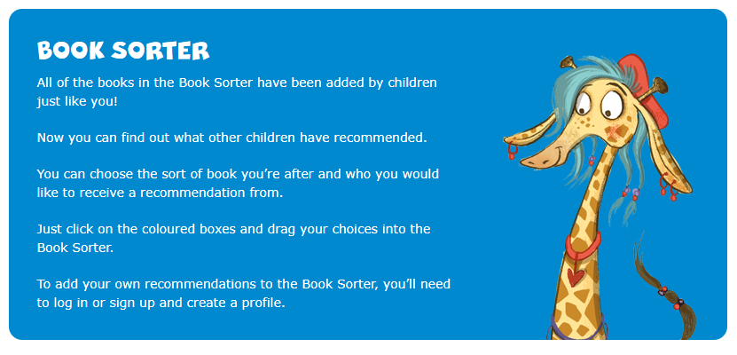
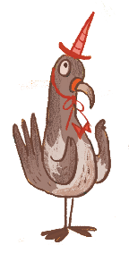
Visit our Book Sorter for book ideas!
sillysquad.org.uk
Illustrations © Laura Ellen Anderson 2020 for The Reading Agency
Notes:
Silly Squad Book sorter
The Silly Squad website also has a book sorter with masses of reading ideas.
All generated by children like you
There’s that pesky pigeon again! He works for Brian the pony.
Brian is a total grump with no friends and no sense of humour. He’s too busy plotting against the Silly Squad to read any books and hopes his unicorn costume will throw them off the scent.
No one would suspect a unicorn of getting up to mischief, would they?
This naughty pony uses a flock of pigeon minions to spy on the Silly Squad and spends his days thinking up ways to spoil their fun. His chief minion and right-hand pigeon is called Norman. Brian could really do with reading a book or two and having a laugh this summer!
If you are not sure what to read during the summer like Brian then visit the Book Sorter on the Silly Squad website (sillysquad.org.uk). Nearly a million books have been added by other children on the Book Sorter so you can find out what books children have recommended and use the sorter to receive a some recommendations.

Slide 7
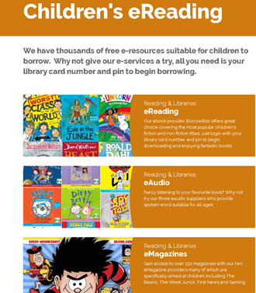
Help from the library
Books to read and listen to electronically.
There are also comics & magazines to download too
There are reading recommendations too if you are ever stuck what to read.
sillysquad.org.uk
Illustrations © Laura Ellen Anderson 2020 for The Reading Agency
Photographs © Dave Warren 2019 for The Reading Agency
Notes:
The library can help you find books to read
Even if your local library is not open yet you can find books to read and listen to on our website. A grown up can help you get started – you just need your library card
If you don’t have a library card yet – we can help you with that too!
Remember you choose the books you want to read
Teacher notes:
Any queries be directed to https://www.inspireculture.org.uk/contact-us/
You can also contact
Carolyn Gallagher, Libraries and Culture Officer
carolyn.gallagher@inspireculture.org.uk direct with queries

Slide 8
What’s Online at the library Inspire libraries are busy planning a very silly summer. Available from July.
Share a Joke Competition – share your favourite joke for the chance to have it transformed into a comic strip created by cartoonist Marc Jackson (he’s worked for the Beano!).
Turn a joke into a comic - Marc will also let you know how to create your own comic strip.
Author, Alan MacDonald, asks ‘What happens next?’ in a story making challenge based on his Dirty Bertie books.
Summer of Silly Challenges – starting 13th July, we’ll set you 3 silly reading challenges a week for 6 weeks. Who can achieve them all?
PLUS…we are working with an author and artist to create a new book that you could read on the challenge.
inspireculture.org.uk/summerreadingchallenge
Illustrations © Laura Ellen Anderson 2020 for The Reading Agency
Photographs © Dave Warren 2019 for The Reading Agency
Notes:
Inspire will have lots of activities available online. Throughout July & August
Teacher notes:
All events and activities will be listed at www.inspireculture.org.uk/summereadingchallenge
Next steps?
Please share information about the Summer Reading Challenge with parents & carers - suggested newsletter text is available at www.inspireculture.org.uk/srcresources
Share a Joke is available from 1 July 2020 - www.inspireculture.org.uk/jokes We are happy to receive a class submission – email: direct to christopher.jones@inspireculture.org.uk
Please contact
Carolyn Gallagher, Libraries and Culture Officer
carolyn.gallagher@inspireculture.org.uk direct with queries

Slide 9
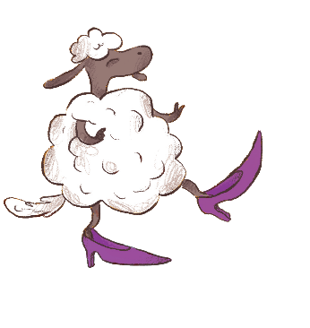
Get silly this summer and join the
sillysquad.org.uk
Illustrations © Laura Ellen Anderson 2020 for The Reading Agency
Notes:
Get reading and join our Silly Squad!
Information for teachers
The Reading Agency have more information and assets for teachers in our Teachers’ Toolkit saved in the Dropbox: https://www.dropbox.com/sh/oq1lmtu50abqcb1/AABtDxQOWcIkaSZKY0oRVy8la?dl=0
If you want to join in with the fun please use the hashtags #SummerReadingChallenge and #SillySquad2020
Please tag @ReadingAgency and if you’re on Facebook tag @SummerReadingChallengeUK so we can share your posts!
You may also wish to tag our illustrator, Laura Ellen Anderson. Laura is on Twitter @Lillustrator and her Instagram page is @laura_ellen_anderson

