Slide 1


Listen to this piece of music.
Think about what the music might describe.
If you like you can close your eyes while you listen.

Slide 2
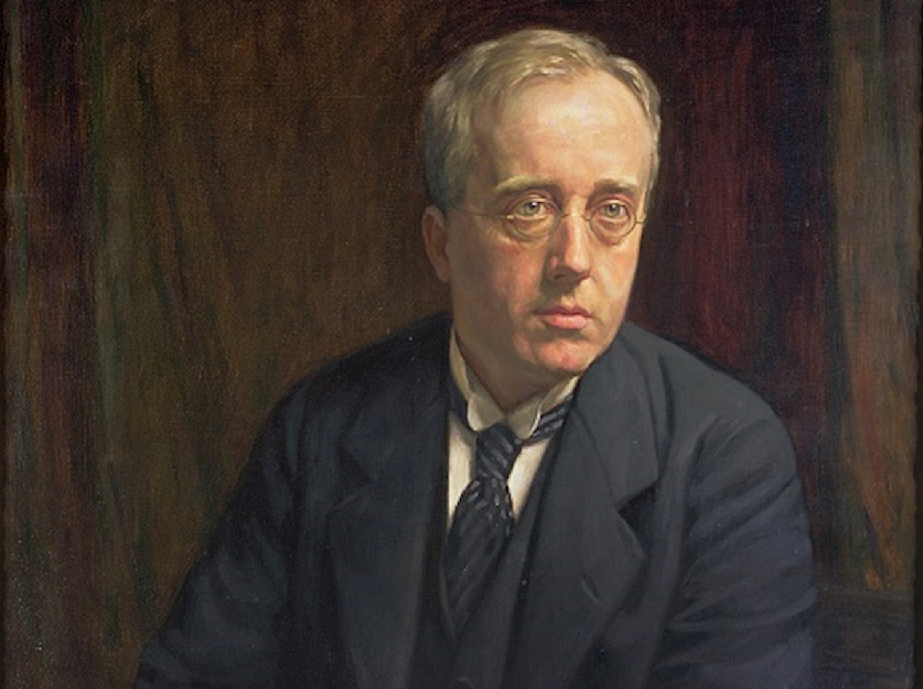
Did you like it?
The music is from The Planet Suite by a composer called Gustav Holst.
You were listening to number 1 of 7 pieces, or movements, which make up the whole Suite.
The one you listened to was called Mars, the Bringer of War.
What do you think it could have been describing?
What did you like or dislike about it?
How did the music make you feel?

Slide 3
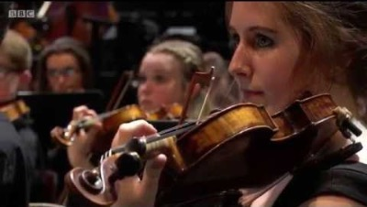
Now watch some of this performance of ‘Mars’ by the National Youth Orchestra of Great Britain.
Can you
name any of the
musical instruments being played?

Slide 4
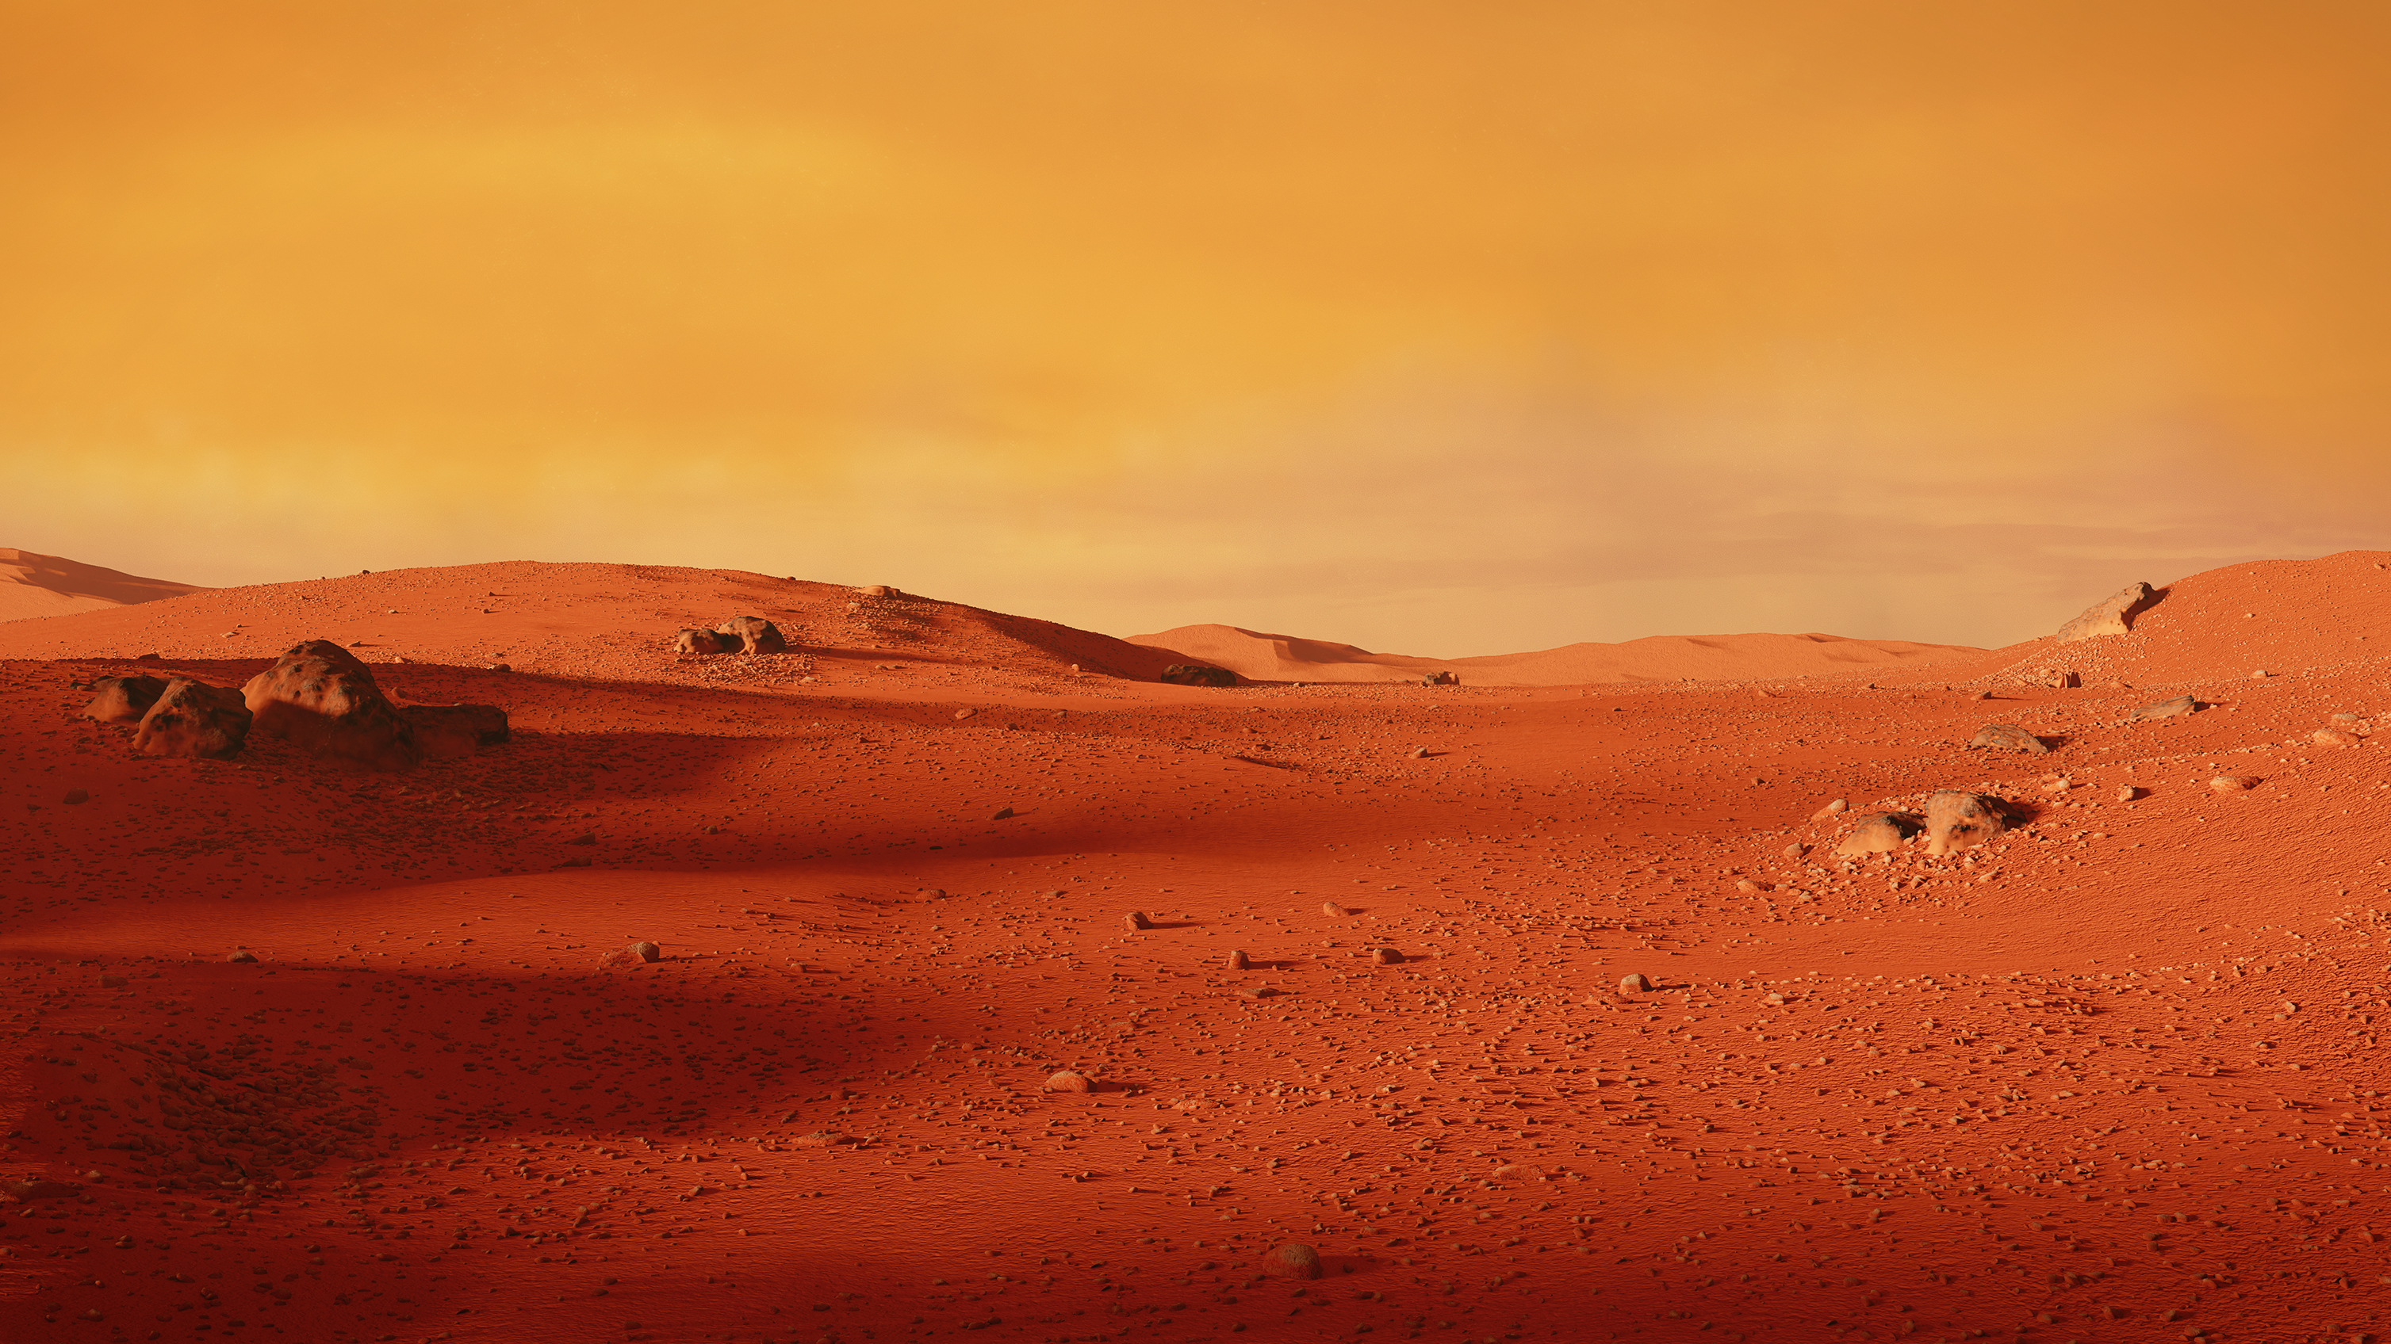

The movement Mars is based around a repeated, rhythmic pattern. This is called an ostinato.
See if you can learn the Mars ostinato pattern using these words and percussion track:

Slide 5

Holst wrote The Planet Suite between 1914 and 1916.
He wrote one movement for each of the planets in our solar system, except Earth.
Our solar system contains the SUN and everything that travels around,
or orbits, it.
This includes the 8 planets and their moons, dwarf planets, asteroids and comets.
Holst gave all the movements in The Planets Suite sub-headings which describe the
characters of the Roman Gods each planet is named after.

Slide 6
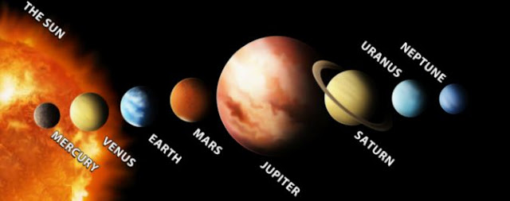
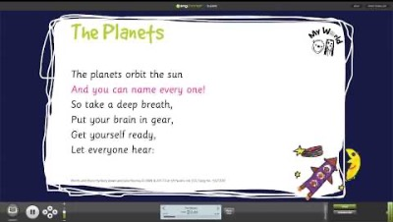
We don’t know why Holst chose his order of the movements in The Planet Suite,
but can you learn the order of the planets in our Solar System by their distance from the Sun?
This song from
Out Of The Ark
will help you!

Slide 7
Listen to these extracts from all 7 movements of The Planet Suite. Can you think of some
words to describe the music for each one?
Planet name (movement)
1. Mars, the Bringer of War
2. Venus, the Bringer of Peace
3. Mercury, the Winged Messenger
4. Jupiter, the Bringer of Jollity
5. Saturn, the Bringer of Old Age
6. Uranus, the Magician
7. Neptune, the Mystic
Examples of words that describe the music
Loud, aggressive, repeated rhythm
Soft, calm, smooth
Quick, light, jumpy
Fast, happy, loud
Slow, quiet, plodding
Scary, lively, playful
Mysterious, spooky, quiet

Slide 8


Nottinghamshire Music Hub are looking forward to meeting you all on
Thursday 17th March 2022 for The Planets LIVE! at the
Albert Hall, Nottingham.
We will all be singing a song together, and you can find this
on the next page……….

Slide 10
End of Session 1

Slide 12
Movement 1 of The Planets Suite, Mars, the Bringer of War, is based around an ostinato.
Can you remember what ostinato means?
Practice the Mars ostinato pattern with the words and percussion track.
Can you tap this pattern using the first two fingers of one hand on the palm of your other hand whilst you repeat the words?
Can you keep tapping the pattern whilst you only say the words in your head, not out loud?

Slide 13
Now test out your ostinato skills along with the National Youth Orchestra!
Here is a list of the first few
instruments we see close up:
Violin
Bassoon
Cello
French Horn
Harp
Trombone
Trumpet

Slide 14

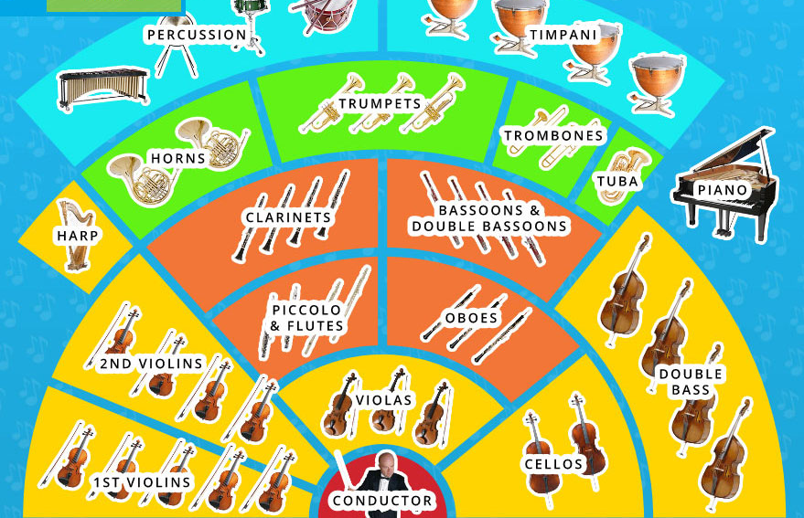
Take a minute to look at the sections in this picture.
Did you know that there are 4 sections of different types of instruments in an orchestra?
STRINGS
WOODWIND
BRASS
PERCUSSION
What is the Conductor’s job in an orchestra?
The stick they use is called a baton.

Slide 15
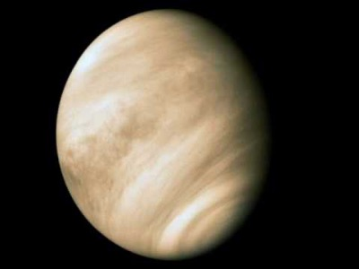
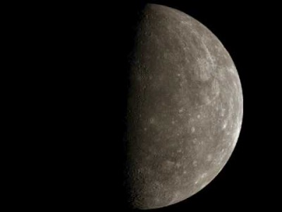
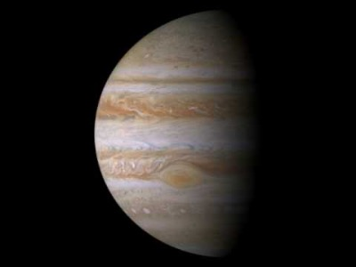
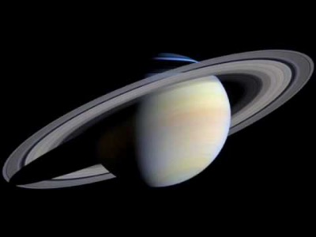
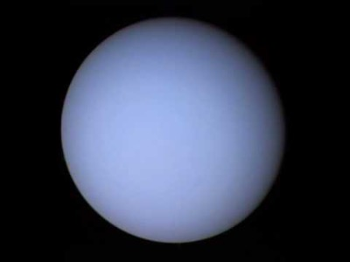
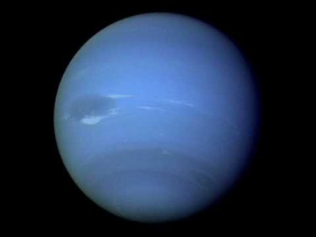
Let’s remind ourselves of the other 6 movements of the Planet Suite:
Venus,
The Bringer of Peace
Mercury,
The Winged Messenger
Jupiter,
The Bringer of Jollity
Saturn,
The Bringer of Old Age
Uranus,
The Magician
Neptune,
The Mystic

Slide 16
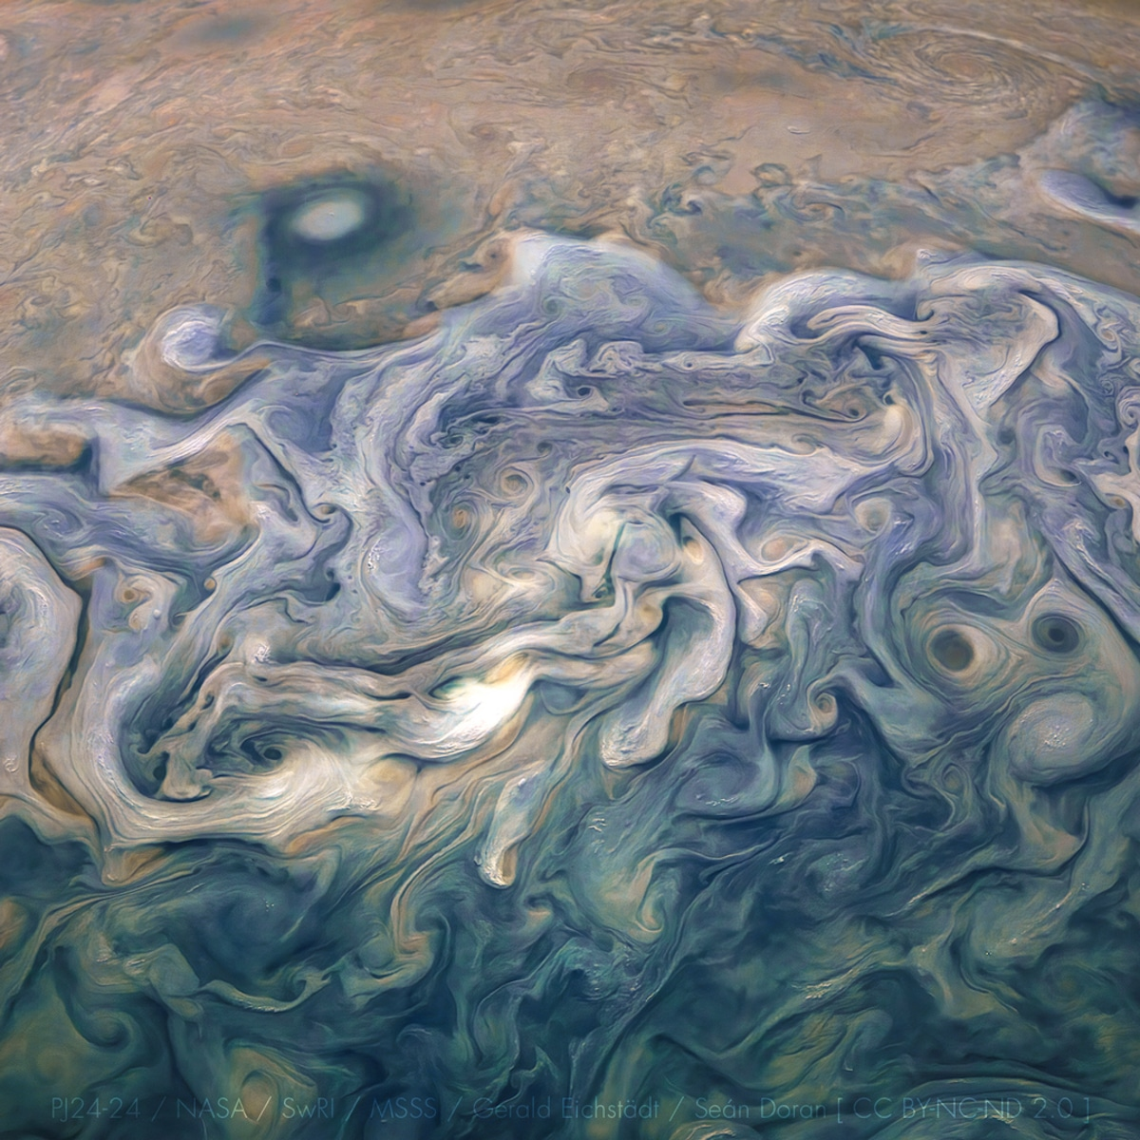
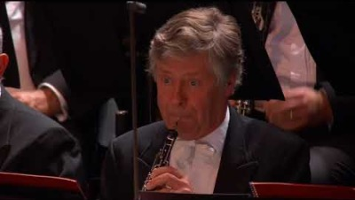
Do you have a favourite movement of Holst’s Planet Suite yet?
Mine is Jupiter. Let’s watch the BBC Symphony Orchestra performing it.
The conductor is Susanna Mälkki.
Can you try conducting the orchestra yourself as you watch and listen?

Slide 17
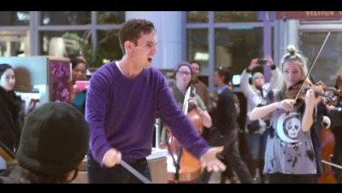
Jupiter has a beautiful, slower, song-like part in the middle of it (at around 3.00 minutes).
You might have heard it somewhere before.
Here are some music students from Berklee College in America performing that part in a flash mob!

Slide 18
Did you know…….
The planets Mars and Jupiter have both been the subject of space exploration by NASA.
Explore this link to watch some short films about the Juno spacecraft mission to Jupiter.
https://www.missionjuno.swri.edu/origin/
Explore this link to find out about the 2020 Mars rover, Perseverance, and its helicopter, Ingenuity.
https://mars.nasa.gov/mars2020/

Slide 19
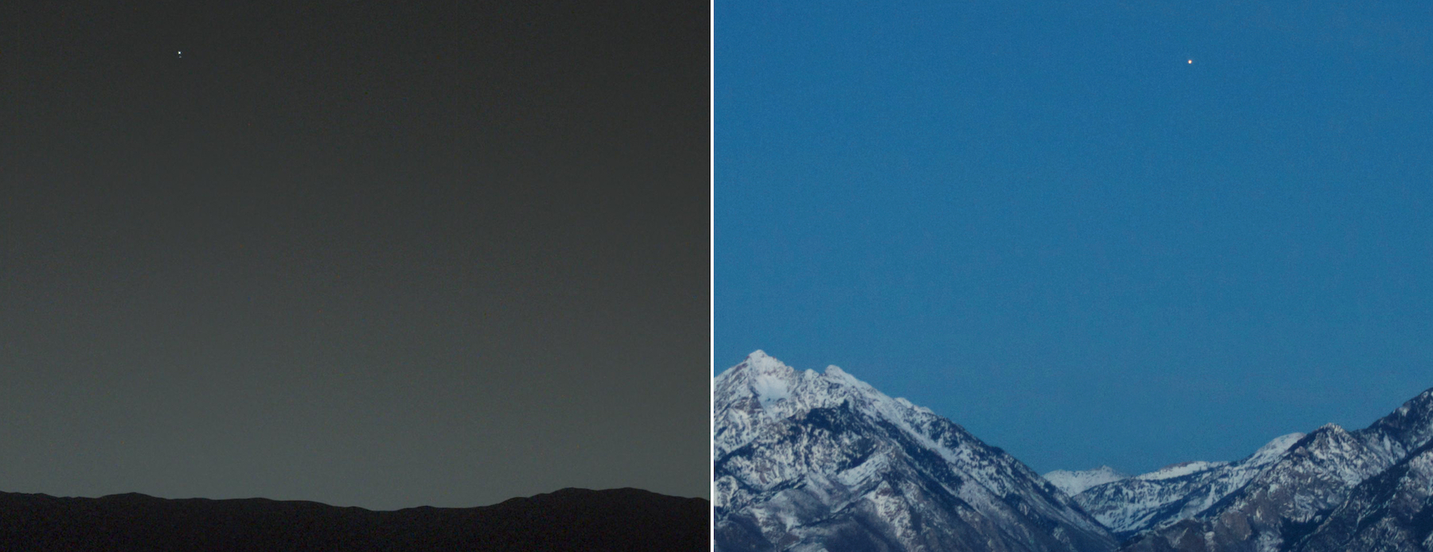
Which planets do you think we can see in the sky in these two pictures?
The left picture is Earth from Mars!
The right picture is Mars from Earth!
Source: Mars: NASA/JPL-Caltech/MSSS/TAMU | Earth: Bill Dunford

Slide 20
Time to practice Reaching For The Stars for
The Planets LIVE!
Thursday 17th March 2022
at the
Albert Hall, Nottingham

Slide 22
End of Session 2

Slide 24

Here is an animation to give you some more information about Gustav Holst and The Planet Suite.

Slide 25
On the next page you will find all the movements of The Planets Suite.
As a class, pick two movements to listen to.
As you listen, draw two different pictures (one for each planet) that might describe the planet and the music you are listening to.
Some ideas for your pictures could be:
A mix of different shapes or colours that represent the music
Circular (spherical) pictures like the shape of a planet
Drawings of alien plants or animals you might imagine living there
A drawing of the planet surface and sky (you could add moons too)

Slide 26
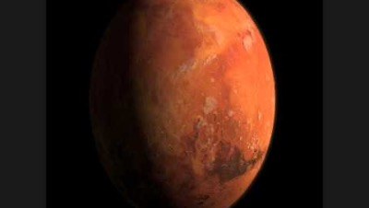
Mars,
The Bringer of War
Venus,
The Bringer of Peace
Mercury,
The Winged Messenger
Jupiter,
The Bringer of Jollity
Saturn,
The Bringer of Old Age
Uranus,
The Magician
Neptune,
The Mystic

Slide 27
Can you still remember the order of the planets from the sun? Practice with the song!

Slide 28
Not long now until we see you all for
The Planets LIVE!
Thursday 17th March 2022
at the
Albert Hall, Nottingham
We hope you are as excited as we are!
REACHING FOR THE STARS
is on the next page for you to practice.

Slide 30
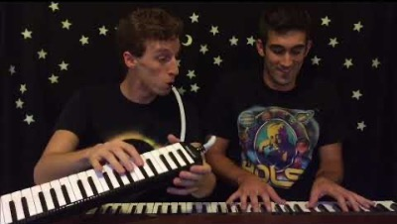
See you soon!

