Slide 1
Notes:
Teacher notes:
This PowerPoint presentation explains Gadgeteers – the 2022 Summer Reading Challenge. It can be used in assembly or classrooms to let children know about the challenge. The Summer Reading Challenge happens in libraries across the country every year (it started in 1999). In 2021 over 7,400 children in Nottinghamshire joined in but we want even more to sign up this year. This year we’ve teamed up with the Science Museum Group for a science and innovation themed challenge.
www.inspireculture.erg.uk/summerreadingchallenge
The Challenge has been proven to help encourage children to keep reading throughout the long summer break and prevent the tendency for children’s reading to dip.
Key facts:
Aimed at Children aged 4 – 11
Children are challenged to read 6 library books over the holidays [they choose the books – can be story, fact, joke, graphic novel – as long as it is library book all reading counts]
For every book read children receive a sticker (some are smelly) plus other rewards.
Every child who completes by reading 6 books gets a medal and certificate (children come back to the library to let us know a bit about the book they have read)

Slide 2
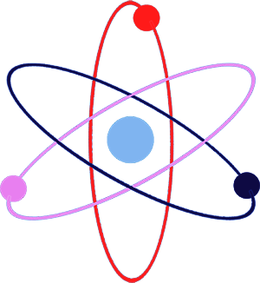
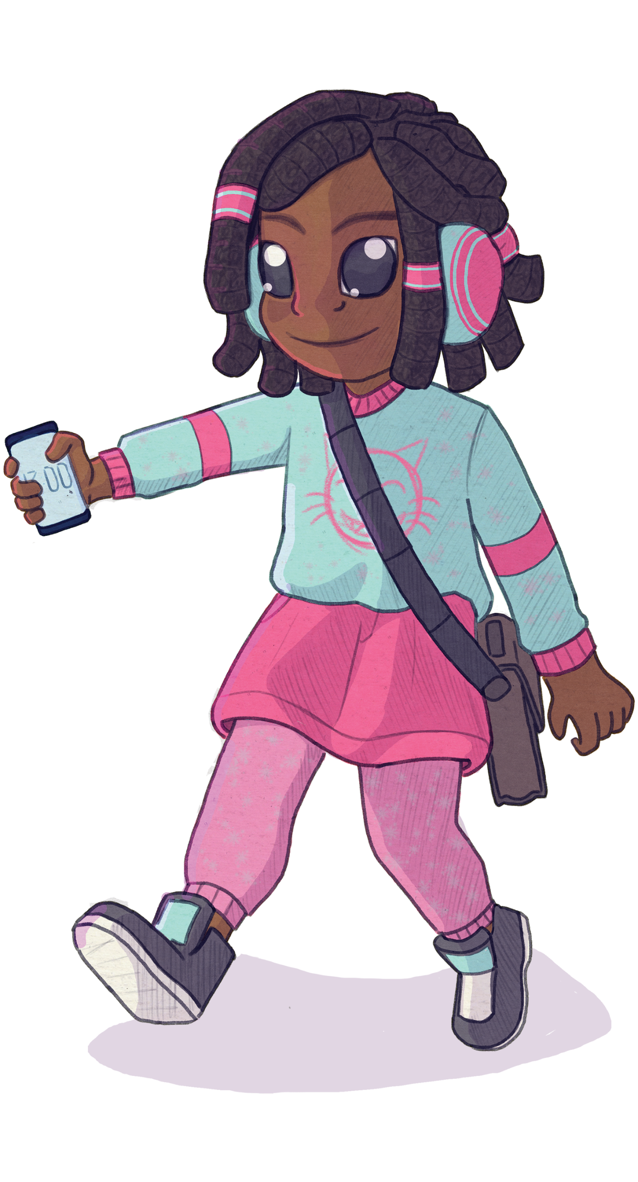
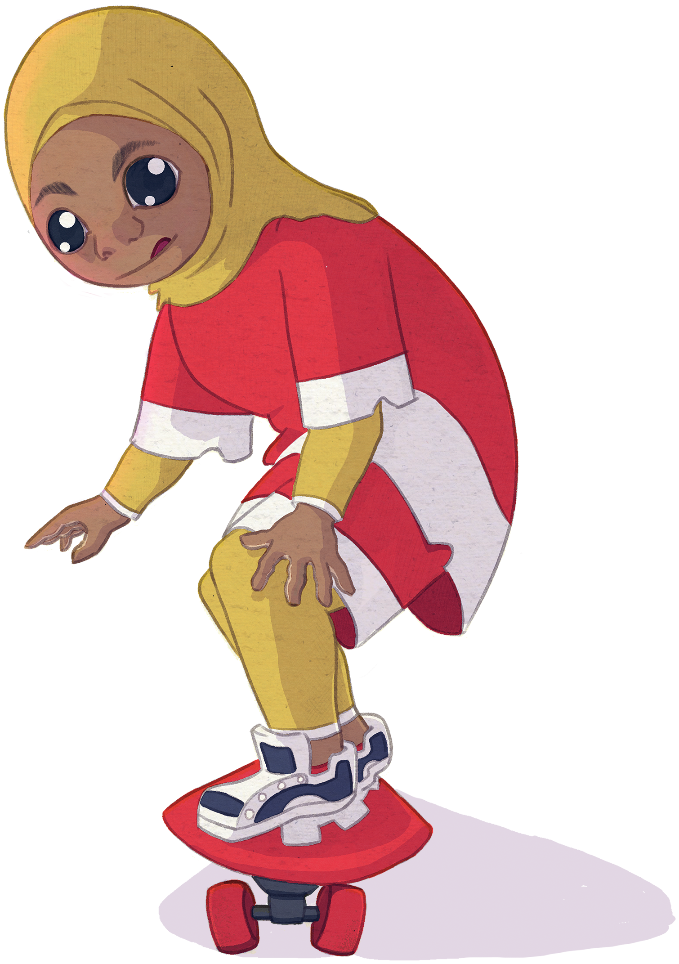
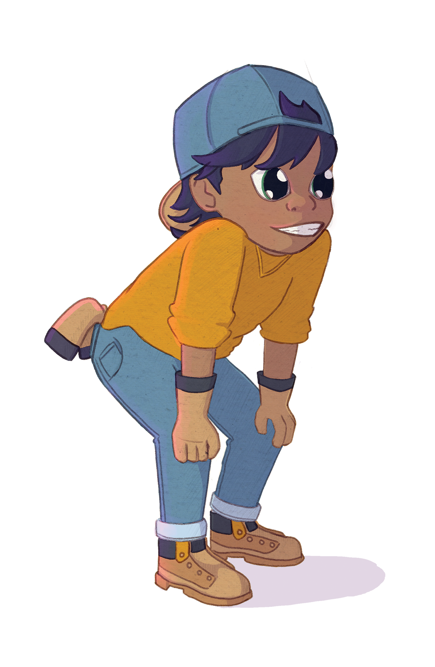
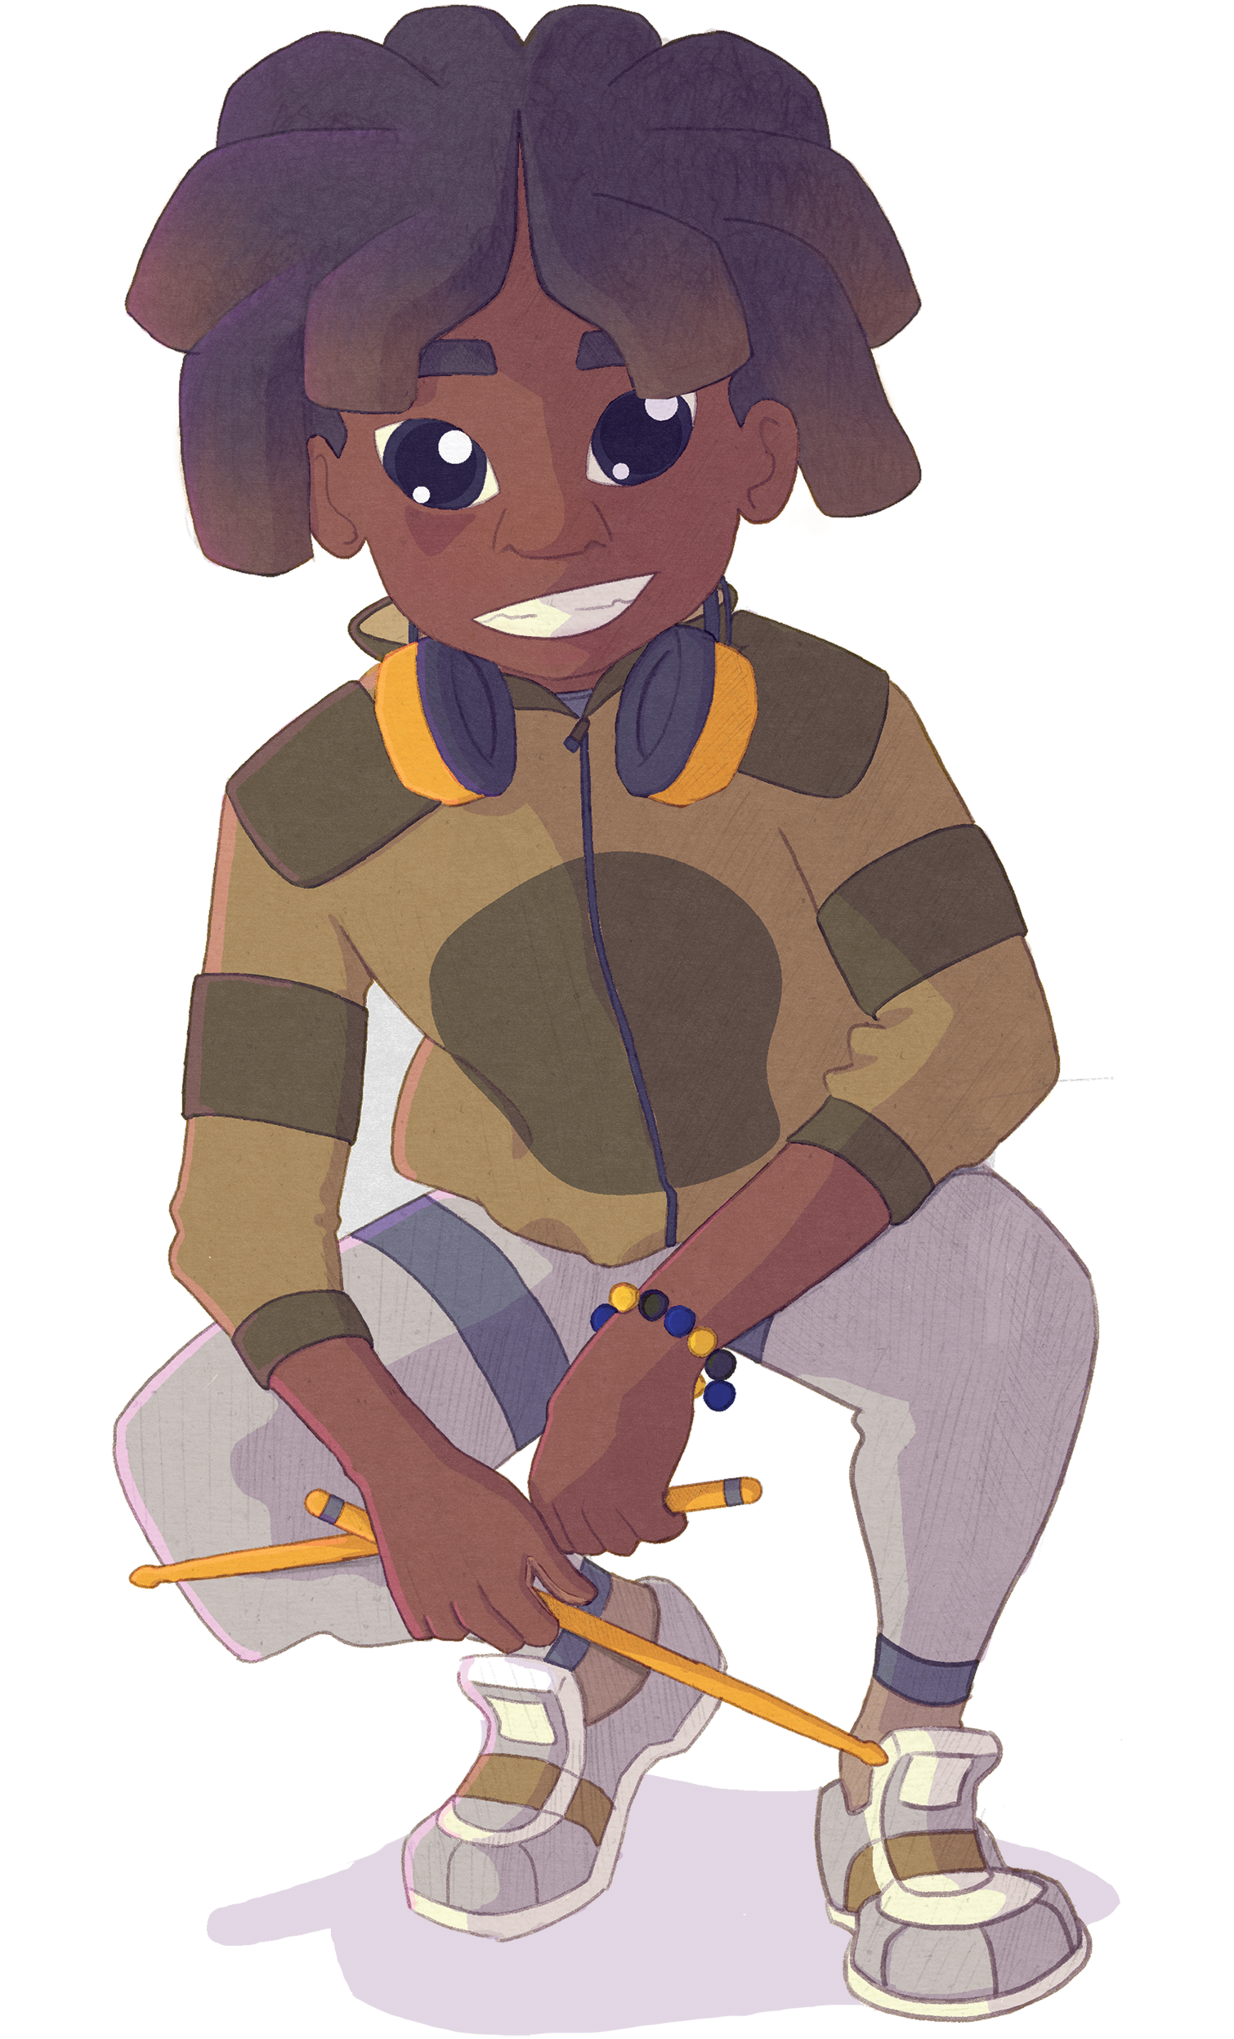
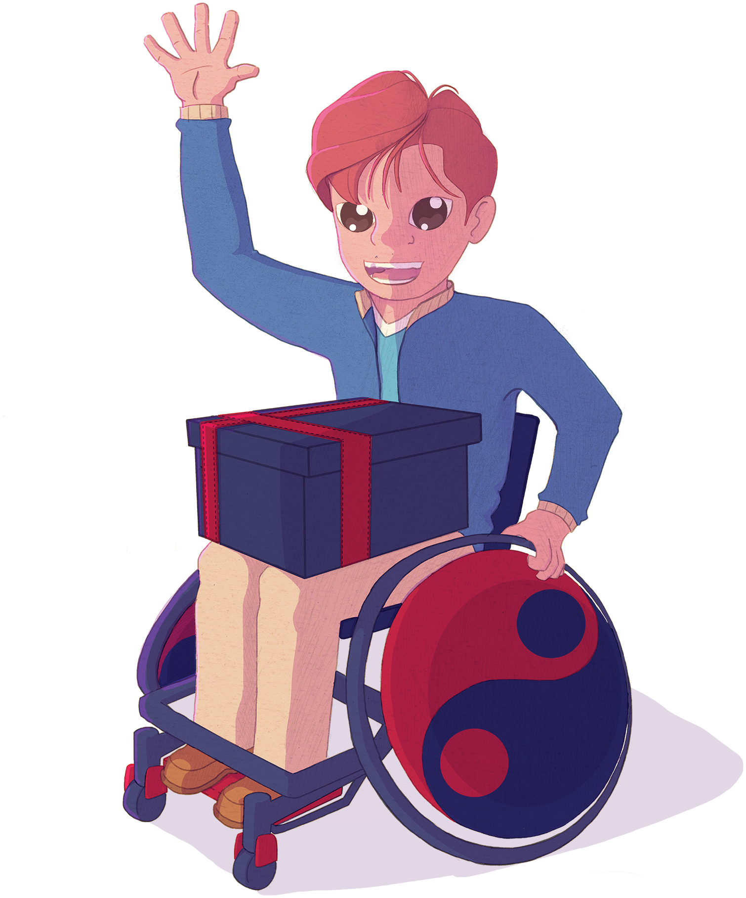
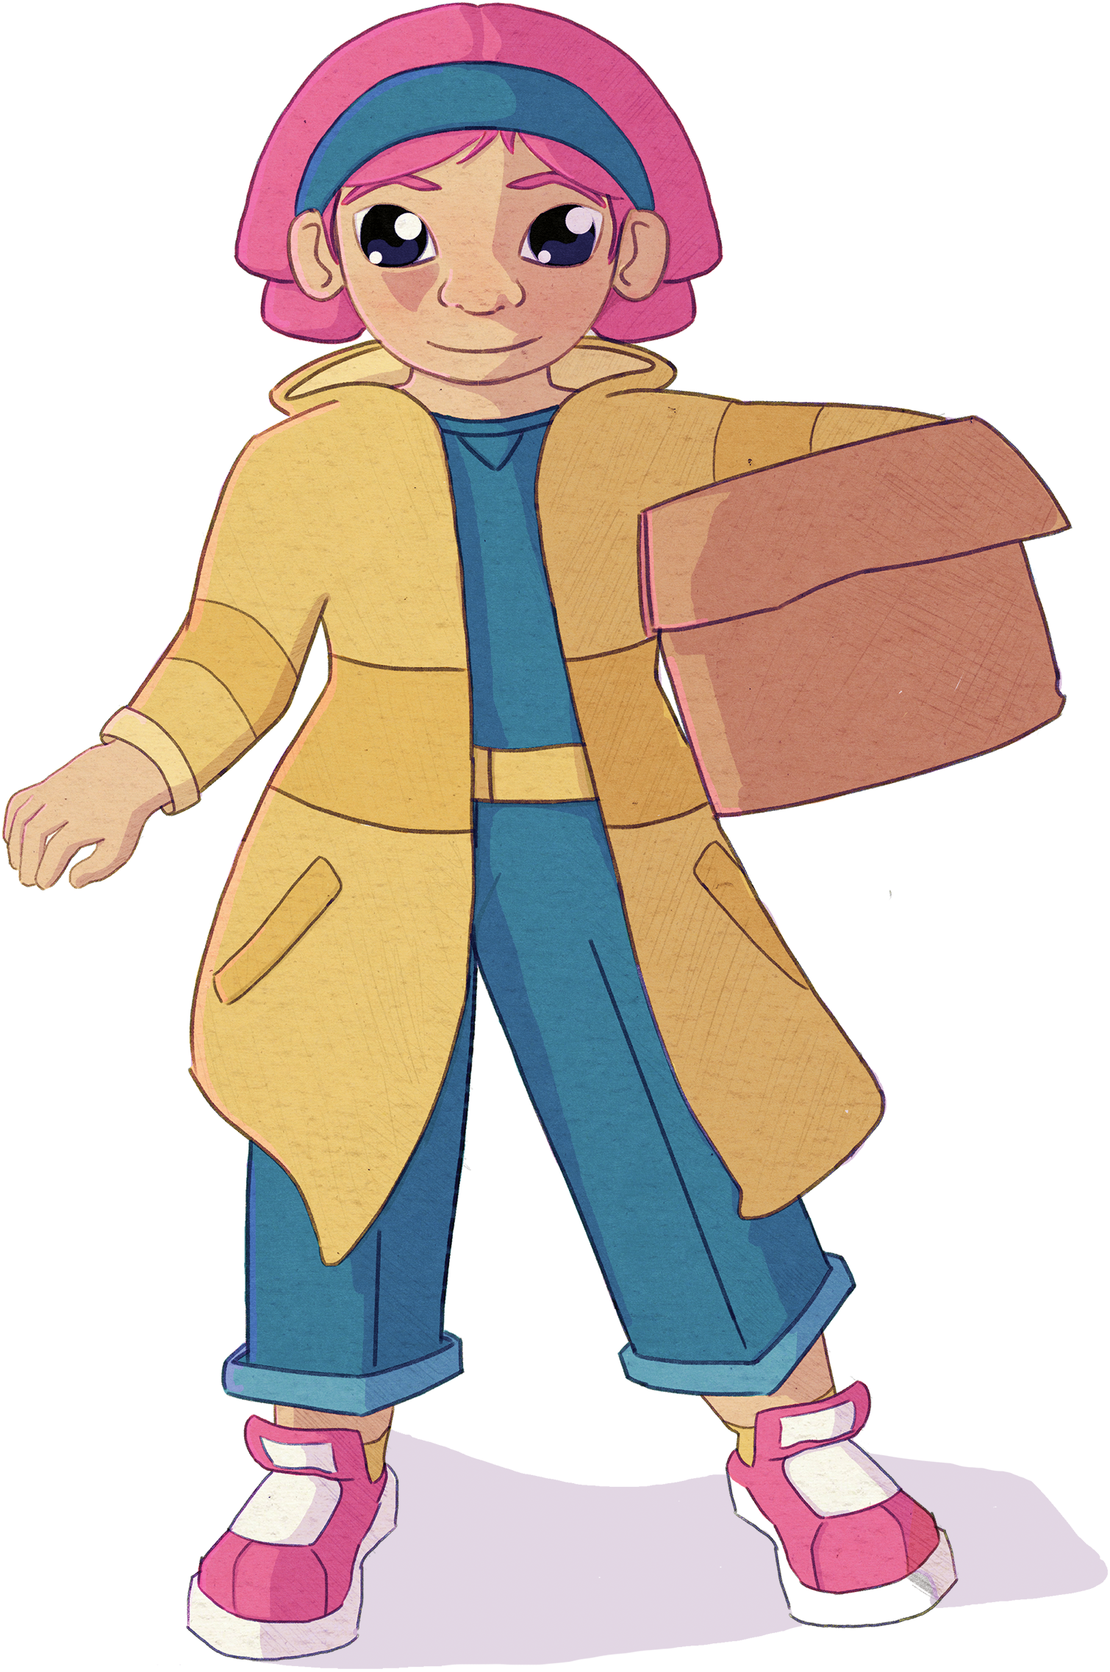
Illustrations by Julian Beresford and © The Reading Agency 2022
Notes:
Meet the Gadgeteers! Aisha, Ajay, James, Eddie, Leo, and Maggie.
The Gadgeteers love creating new inventions and working together to solve problems.
They spend their days using their curiosity, creativity and innovation to come up with lots of awesome inventions.
They are planning an epic summer party at their community centre.

Slide 3
Illustrations by Julian Beresford and © The Reading Agency 2022
Notes:
The Gadgeteers have a whole range of interests. Let's discover the science behind them!
Aisha loves sport and before the party is making safety gear out of non-Newtonian fluid.
James loves fashion and enjoys drawing. James is helping people choose clothes for the party with his amazing hologram generator.

Slide 4
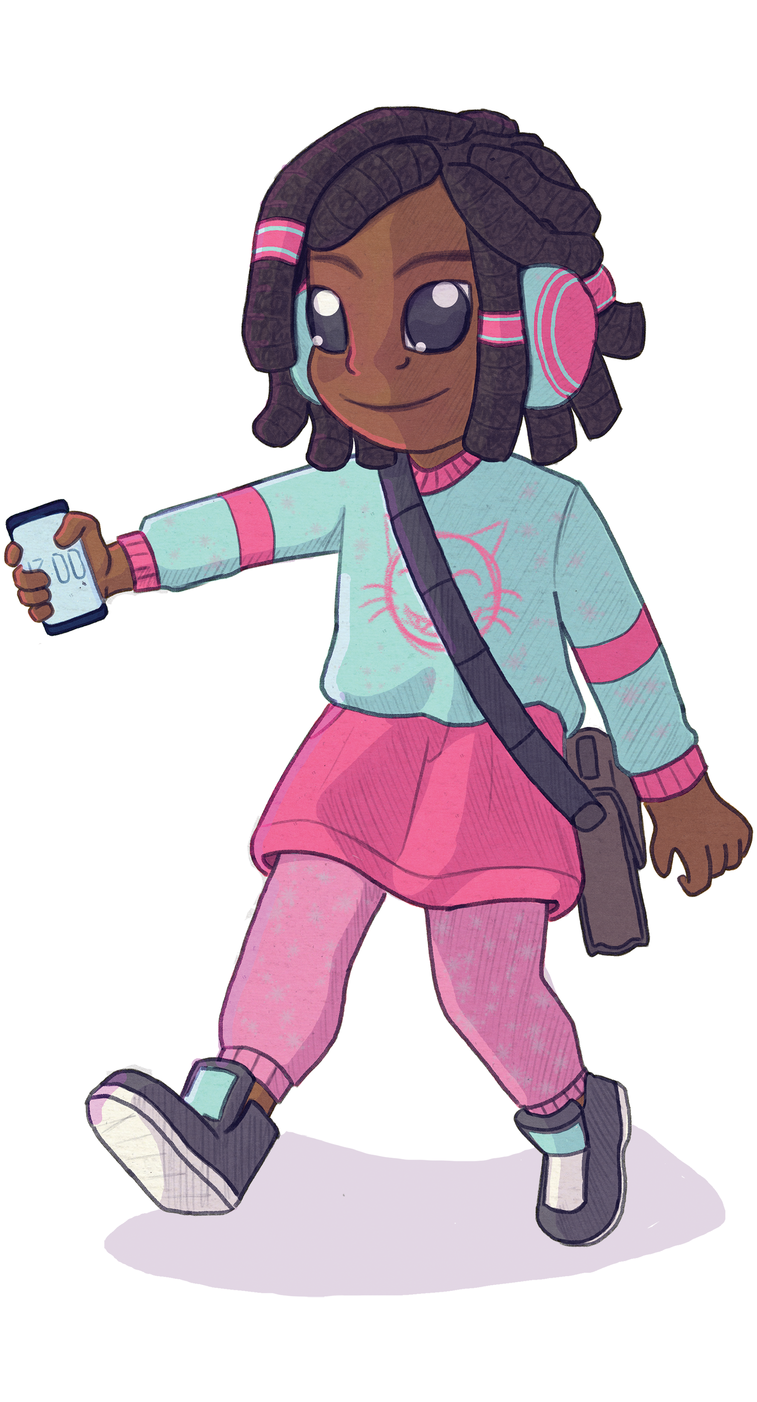
Illustrations by Julian Beresford and © The Reading Agency 2022
Notes:
Ajay knows a lot about gardening and the environment. He is even growing food for the party, and has created a way to grow vegetables with very little soil!
Maggie likes to cook tasty treats for her friends, and she hates wasting food. She wants to turn vegetable scraps into tasty treats for the party!

Slide 5
Illustrations by Julian Beresford and © The Reading Agency 2022
Notes:
Eddie loves to play games and dance when she's not reading about famous inventors. Eddie wants to use everyone’s cool dance moves to generate energy!
Leo is obsessed with music! Leo has found a handy way to amplify the sound from his phone to provide music for the party.

Slide 6
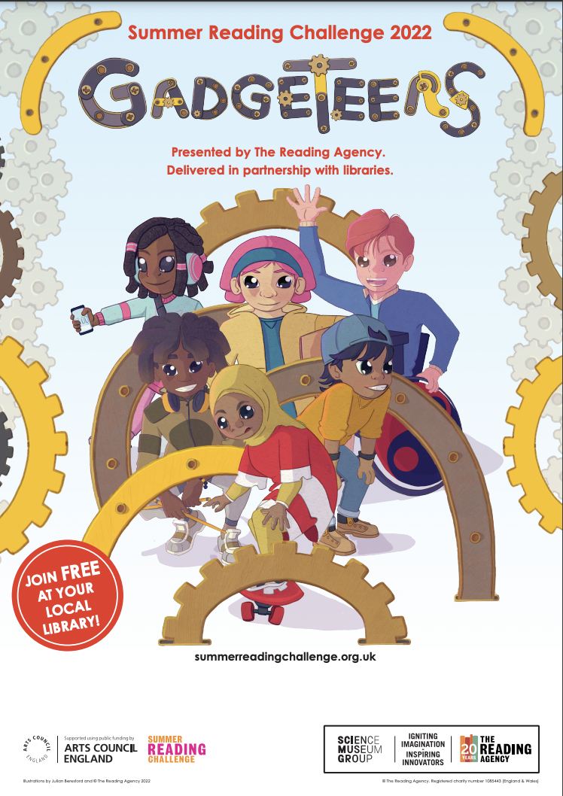
How to take part
Go to your library this summer to join the Challenge – IT’S FREE!
Sign up to receive your special Gadgeteers collectors poster.
Choose books to read over the holidays.
Collect stickers for each book you read.
Add the stickers to your poster to complete the Challenge and become a Gadgeteer!
Illustrations by Julian Beresford and © The Reading Agency 2022
Notes:
Gadgeteers is FREE to join at your Local Library.
Read any 6 books from your library from Saturday 9th July to Sunday 4th September
As you read your books you will receive stickers and other rewards. Some of the stickers are smelly!
Teacher notes:
Children choose how they want to complete the challenge – they might read 1 book at a time or visit the library after every 2 they have read – or read all six and return to collect their incentives.
Children choose what they would like to read on the challenge - story book, fact books, poetry, jokes, graphic novels – as long as it is a library book all reading counts!
[The aim of the Summer Reading Challenge is to inspire a love of reading and encourage children to keep reading over the summer holidays. Library staff and volunteers will chat to children about the books they read for the Challenge]

Slide 7
Reading 2 books means you receive
Your first set of stickers to start filling up your poster.
These will have the smell of cupcakes…. Mmm delicious!
You’ll also get a Gadgeteers bookmark.
Reading 4 books means you receive
Your second set of stickers.
These will have the smell of slime…. Eek!
You’ll also get a Gadgeteers pencil.
Illustrations by Julian Beresford and © The Reading Agency 2022
Notes:
Teachers notes: Children will receive an incentive for each book they read.

Slide 8
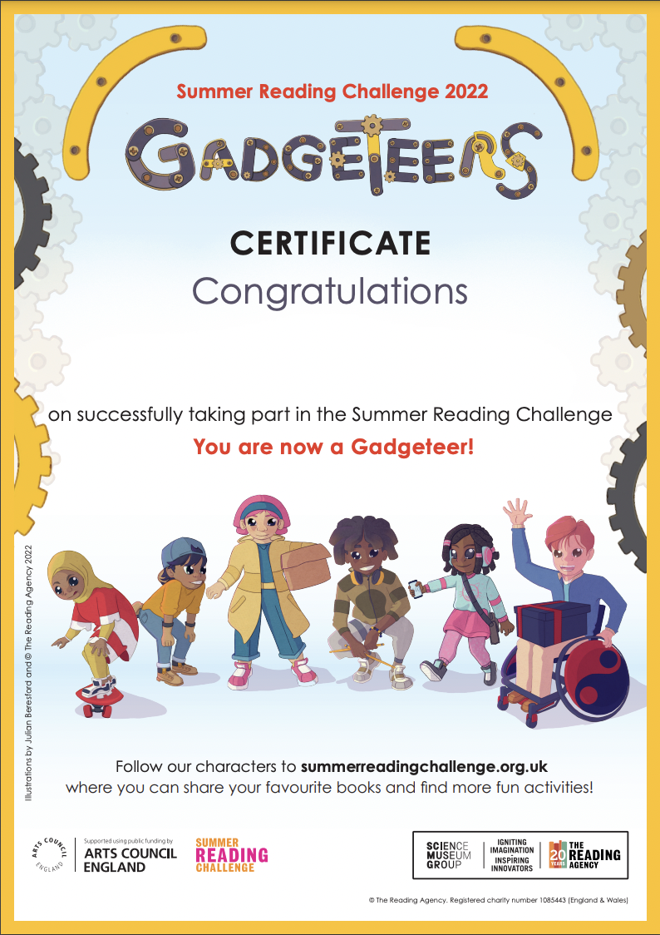
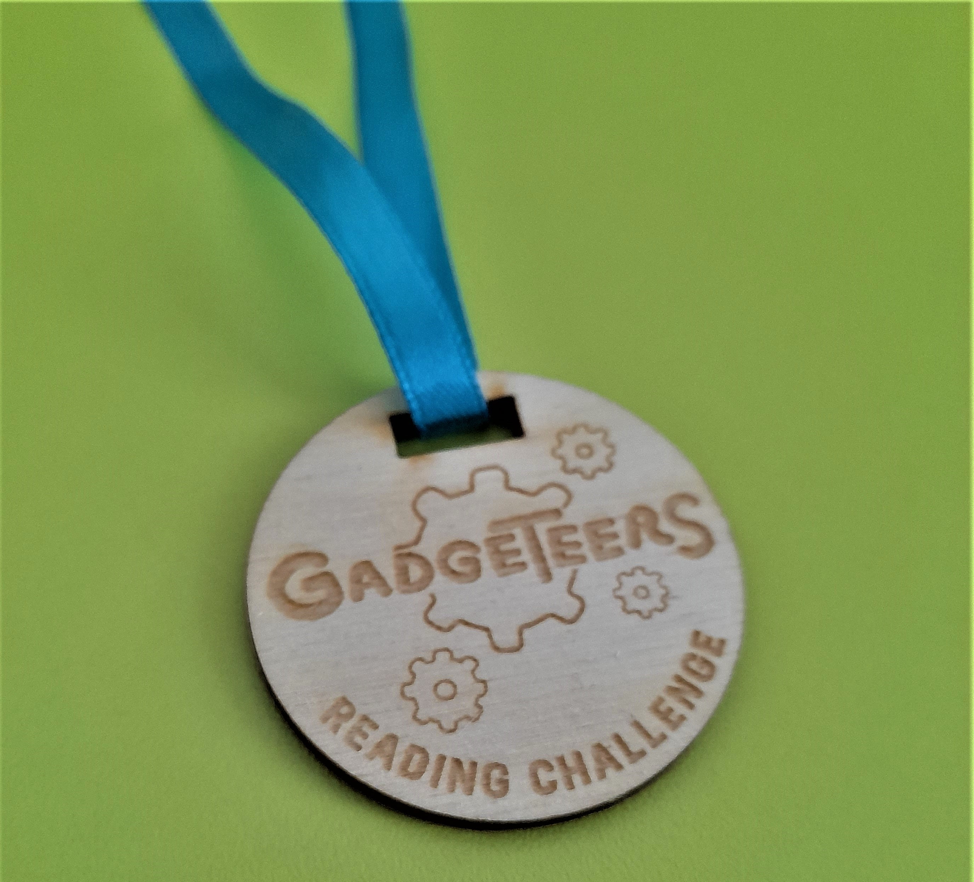
Reading 6 books means you have completed the challenge!
You receive
Your final set of stickers. These will have the smell of …..salad…. ?!!
You’ll also get a medal and a certificate.
Illustrations by Julian Beresford and © The Reading Agency 2022

Slide 9
The Challenge Begins…
Join in at any Nottinghamshire library.
Gadgeteers starts on
Saturday 9 July
Illustrations by Julian Beresford and © The Reading Agency 2022
Notes:
Are you ready to become a Gadgeteer?

Slide 10
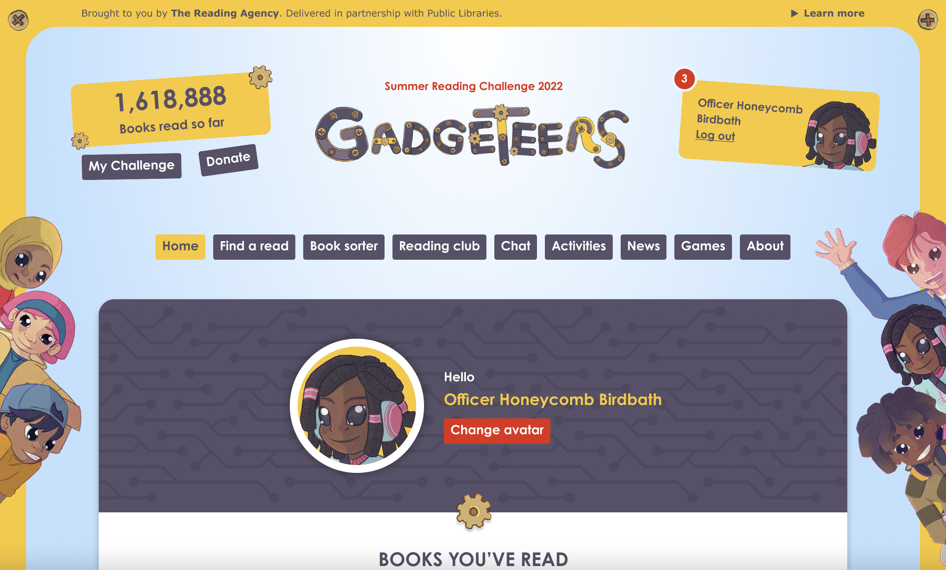
Visit the website
summerreadingchallenge.org.uk
Set your own summer reading goal
Rate and review your books to unlock badges
Play games and enter competitions
Enter the codes printed on your stickers to unlock extra rewards
Use the Book Sorter to find books recommended by other children
Illustrations by Julian Beresford and © The Reading Agency 2022
Notes:
The fun continues at home too! Visit the Gadgeteers website to play games, review your latest reads and enter competitions to win amazing Summer Reading Challenge prizes. You can share your favourite books with other children taking part in the Challenge and even unlock extra rewards for your reading.
Teacher note: Children can join also the challenge online to earn digital rewards. To get hard copy resources – poster, bookmark, pencil, medal and certificate. Children need to join in person at the library.

Slide 11
See you at the library!
Illustrations by Julian Beresford and © The Reading Agency 2022

