Slide 1
SHERWOOD FOREST
INTERPRETATION THEMES

Slide 2
INTERPRETATION THEMES
 | Theme | Focus | Impact
1 | It’s what’s underneath that counts | Geology and geography | A sense of awe
2 | Rich habitats | Biodiversity | Deeper interest
3 | The land as resource | Land management for resources | Local distinctiveness
4 | Power, conflict and change | Political events | A sense of agency
5 | Free thinking Sherwood | Creativity, innovation & myth | Inspiration
6 | A place called home | Lives of Sherwood residents | A sense of connectedness
7 | Outstanding value | Global importance | Sustainability

Slide 3
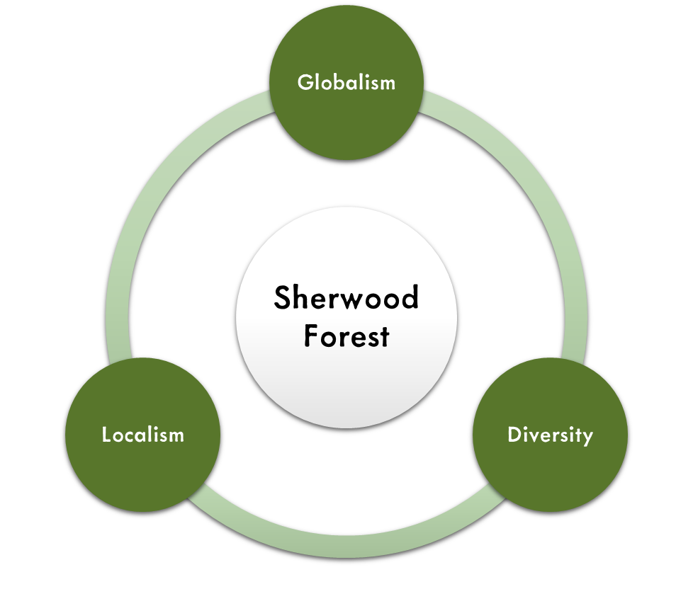
INTERPRETATION PRINCIPLES
Image by Charlie Pratley, NTU Museum Studies Lecturer
Image by Bethany Coulson, NTU placement student

