Slide 1
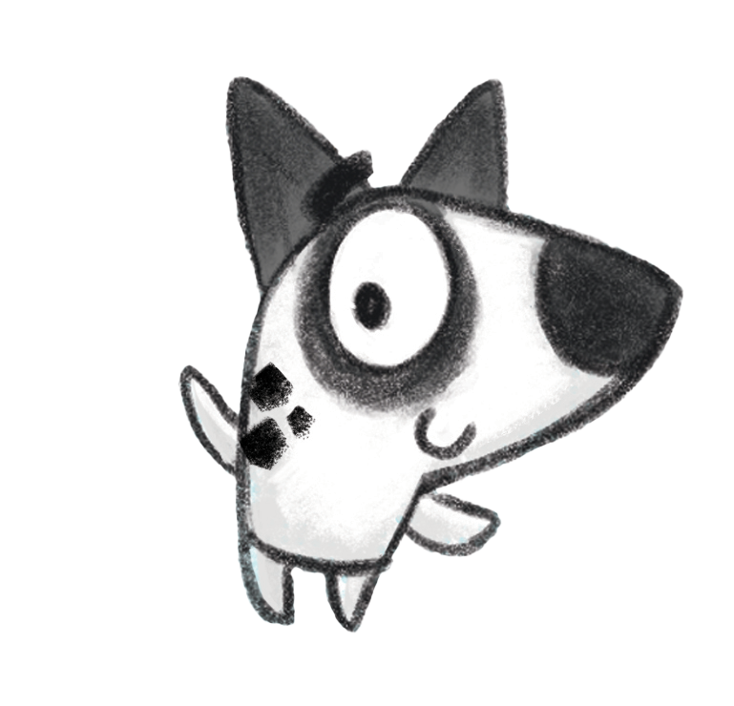
Notes:
Teacher notes:
This PowerPoint presentation explains Ready, Set, Read – the 2023 Summer Reading Challenge. It can be used in assembly or classrooms to let children know about the challenge. The Summer Reading Challenge happens in libraries across the country every year (it started in 1999). In 2022 over 9,400 children in Nottinghamshire joined in but we want even more to sign up this year. This year we’ve teamed up with the Youth Sport Trust for a sport and games themed challenge.
www.inspireculture.erg.uk/summerreadingchallenge
The Challenge has been proven to help encourage children to keep reading throughout the long summer break and prevent the tendency for children’s reading to dip.
Key facts:
Aimed at Children aged 4 – 11
Children are challenged to read 6 library books over the holidays [they choose the books – can be story, fact, joke, graphic novel – as long as it is library book all reading counts]
For every book read children receive a sticker (some are smelly) plus other rewards.
Every child who completes by reading 6 books gets a medal and certificate (children come back to the library to let us know a bit about the book they have read)

Slide 2
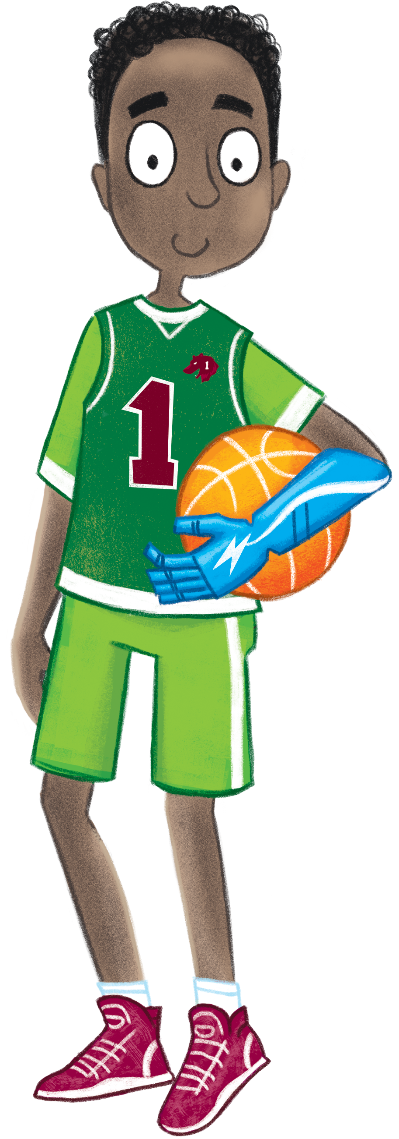
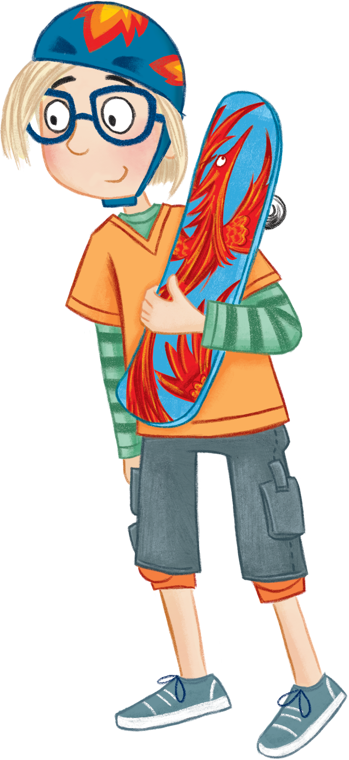
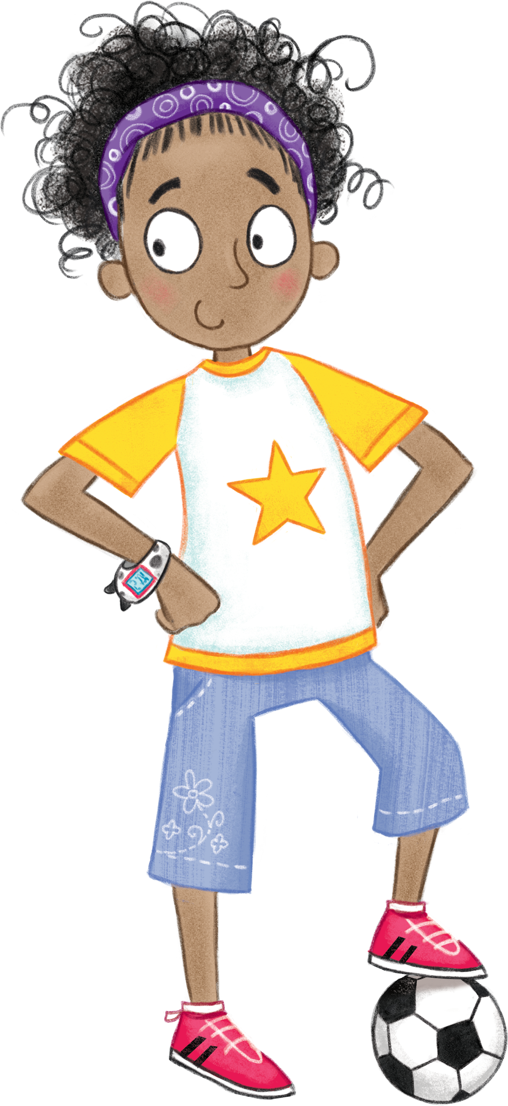
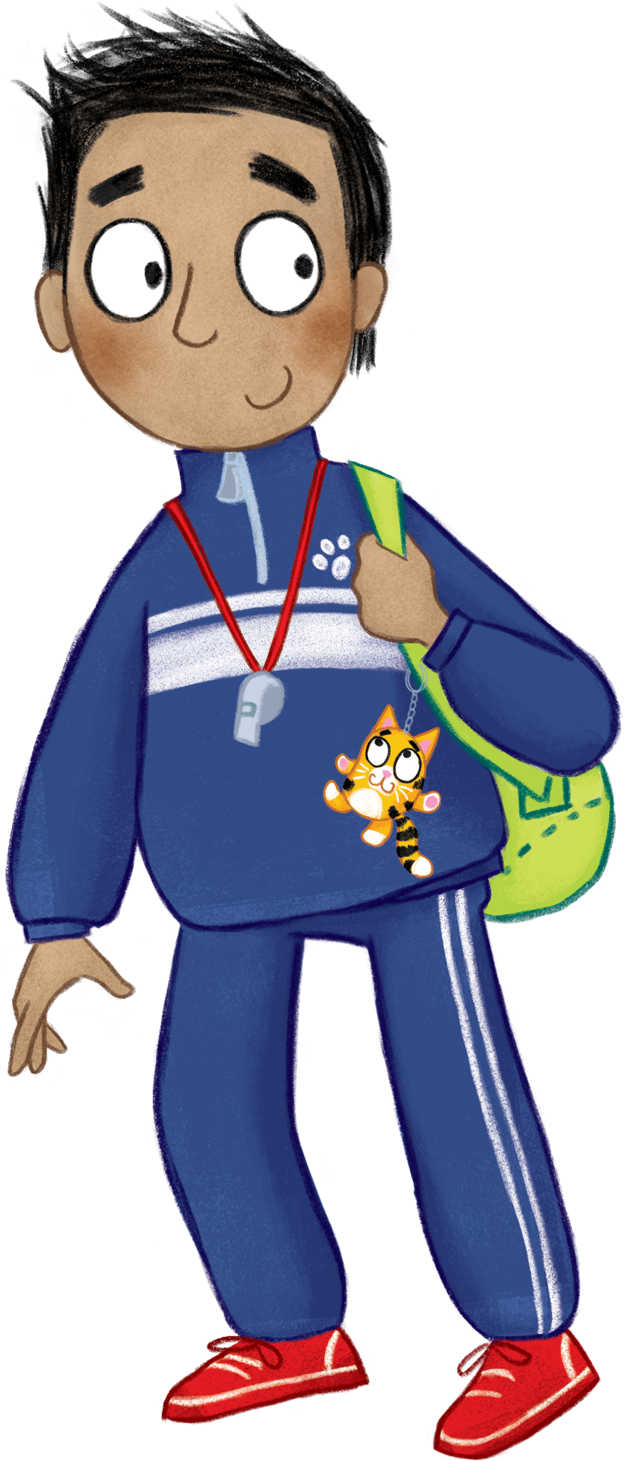
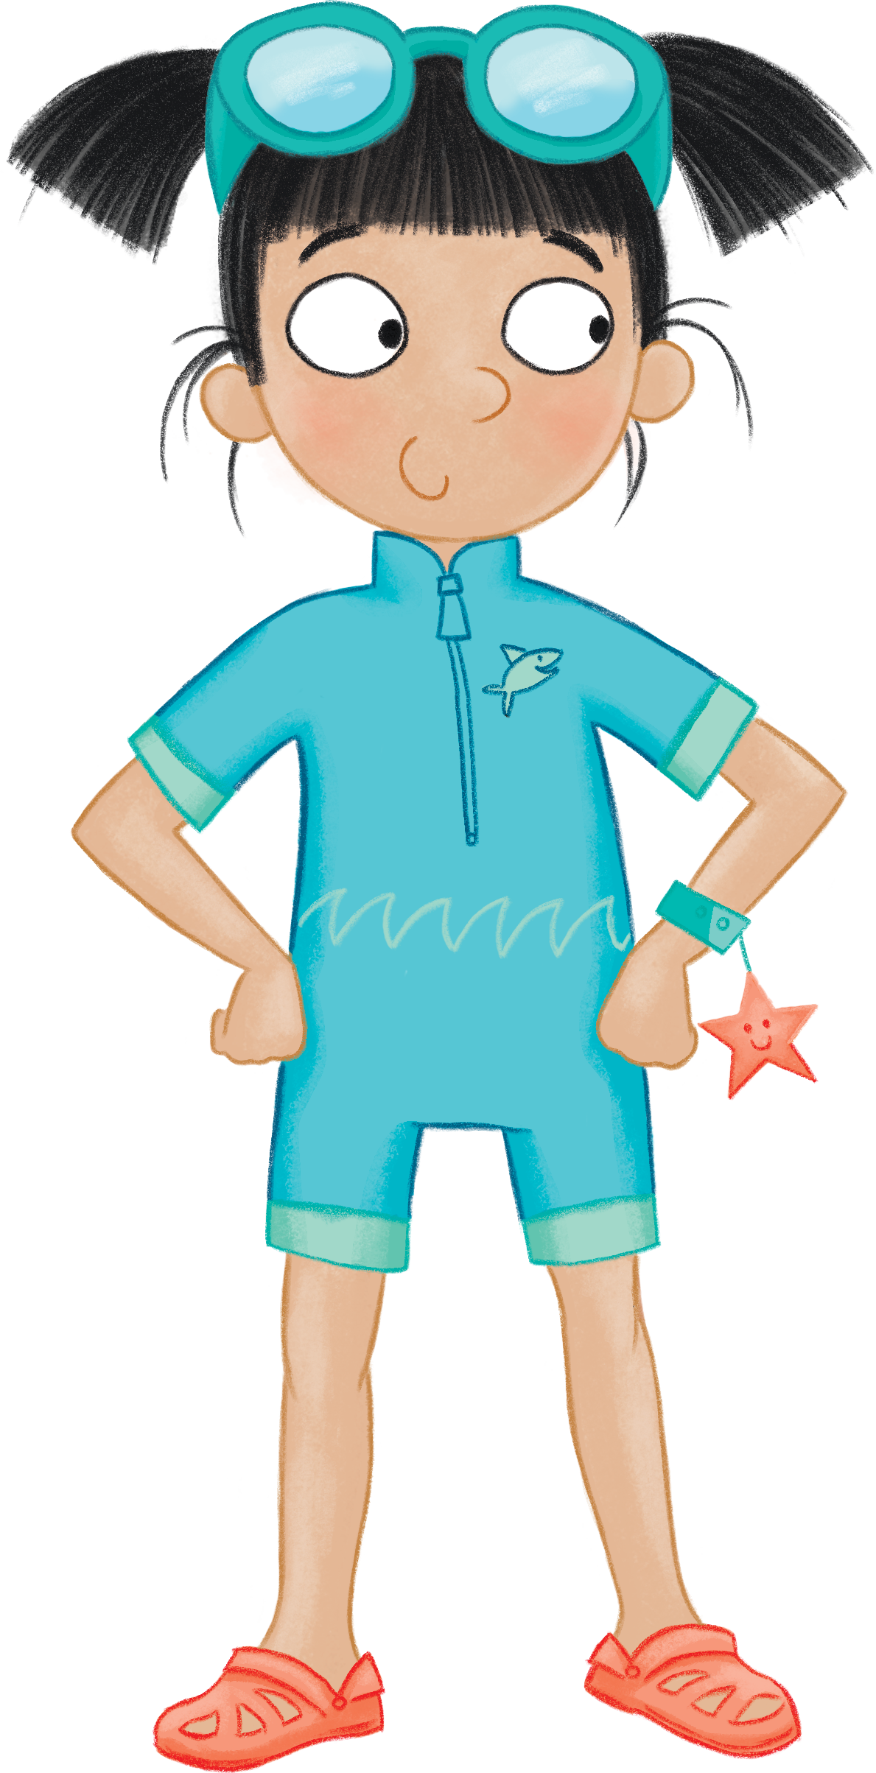
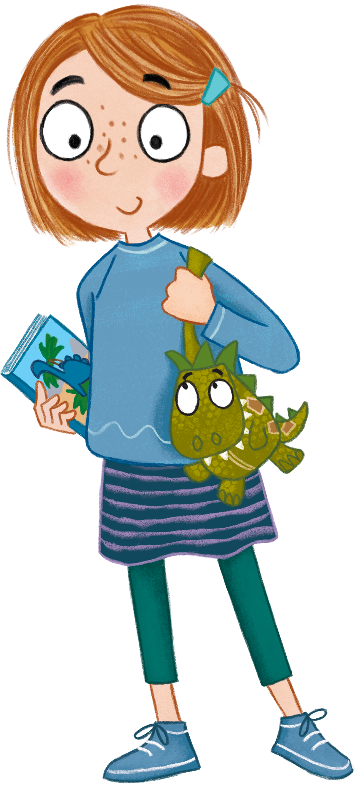
Notes:
Meet your team! Naveen, Naomi, Noah, Ollie, Alesha, Sophia
Join them as they use their skills to weave their way through a summer obstacle course.
Inspire Libraries would you to join the team too . Read 6 library books to help our characters complete the obstacle course.
Developed in collaboration with the Youth Sport Trust, the 2023 Summer Reading Challenge will celebrate play and participation, encouraging children to engage in games and sports in any way that best suits them.

Slide 3
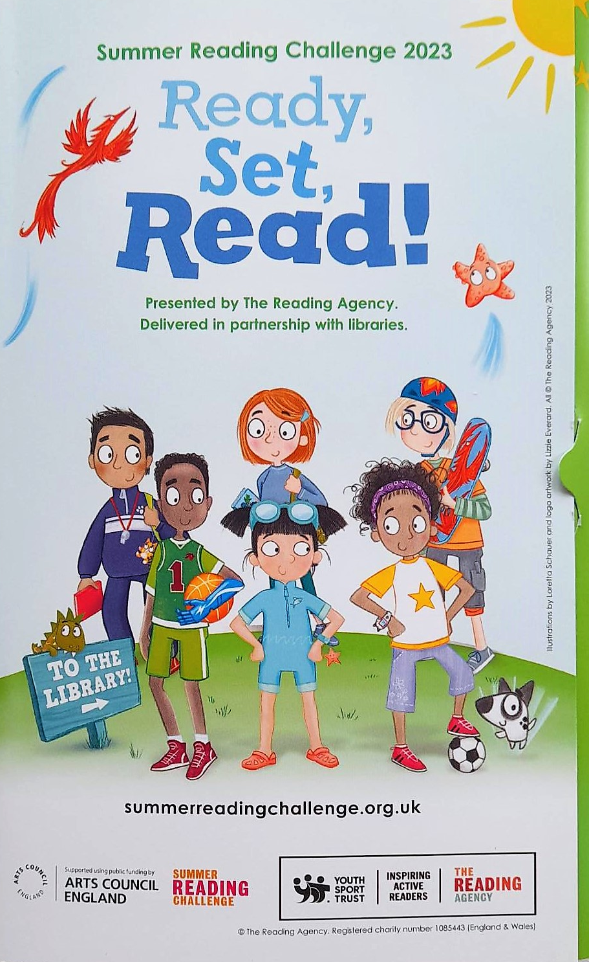
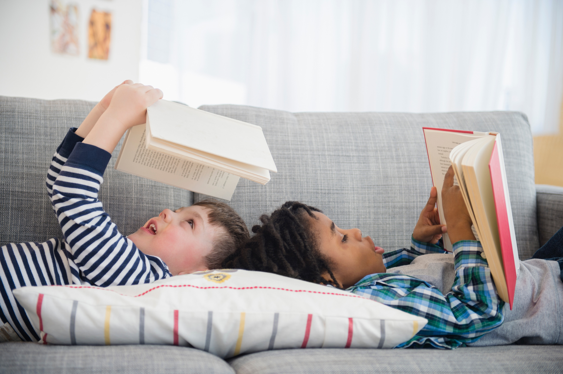
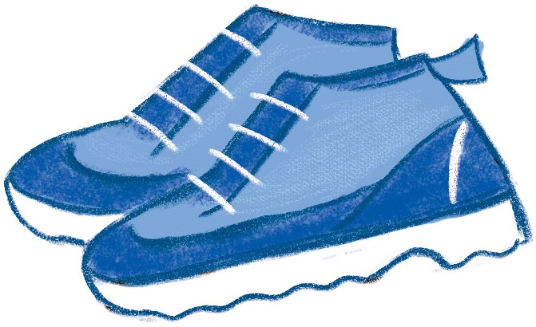
How to take part
Go to your library this summer to join the FREE Challenge!
Sign up to receive your Ready, Set, Read collector folder
Choose books to read over the holidays
Collect stickers and other rewards for each book you read
Add the stickers to your folder to complete the Challenge!
Image from Microsoft 365 2023
Notes:
Ready, Set, Read is FREE to join at your local library.
Read any 6 books from your library from Saturday 8th July to Sunday 3rd September
As you read your books you will receive stickers and other rewards. Some of the stickers are smelly!
Teacher notes:
Children choose how they want to complete the challenge – they might read 1 book at a time or visit the library after every 2 they have read – or read all six and return to collect their incentives.
Children choose what they would like to read on the challenge - story book, fact books, poetry, jokes, graphic novels – as long as it is a library book all reading counts!
[The aim of the Summer Reading Challenge is to inspire a love of reading and encourage children to keep reading over the summer holidays. Library staff and volunteers will chat to children about the books they read for the Challenge]

Slide 4
Reading 2 books means you receive
Your first set of stickers to start filling up your folder
These will have the smell of strawberries…. Mmm delicious!
You’ll also get a Ready, Set, Read! bookmark.
Reading 4 books means you receive
Your second set of stickers.
These will have the smell of tropical mangoes….
You’ll also get a Ready, Set, Read doorhanger.
Notes:
Teachers notes: Children will receive an incentive for each book they read.

Slide 5
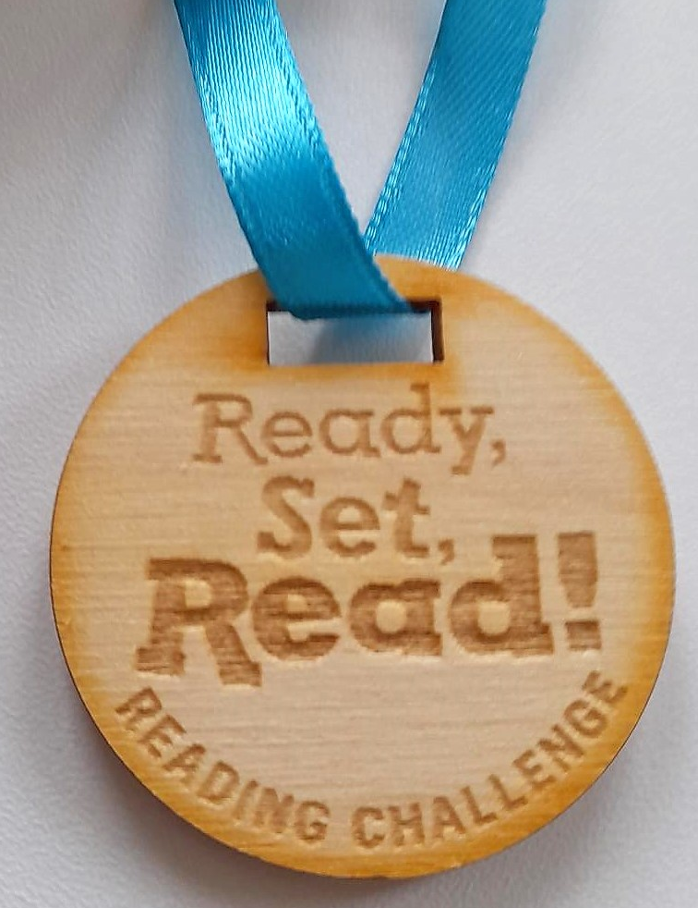
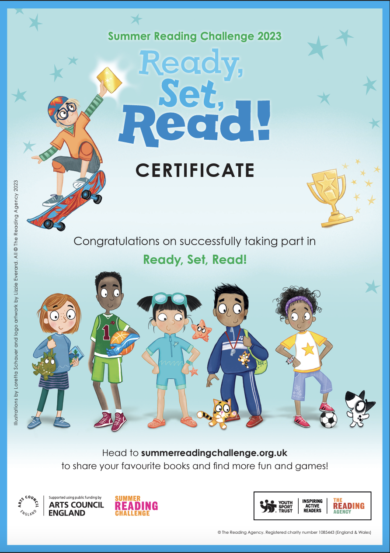
Reading 6 books means you have completed the challenge!
You receive
Your final set of stickers. These will have the smell of …..green grass!!
You’ll also get a medal and a certificate.

Slide 6
The Challenge Begins…
Join in at any Nottinghamshire library.
Ready, Set, Read! starts on
Saturday 8 July
Notes:
Are you ready for Get, Set, Read!!

Slide 7
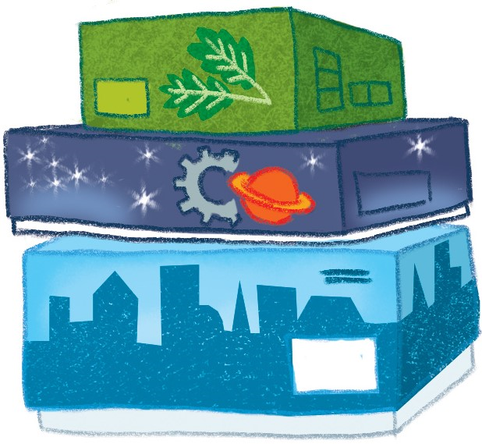
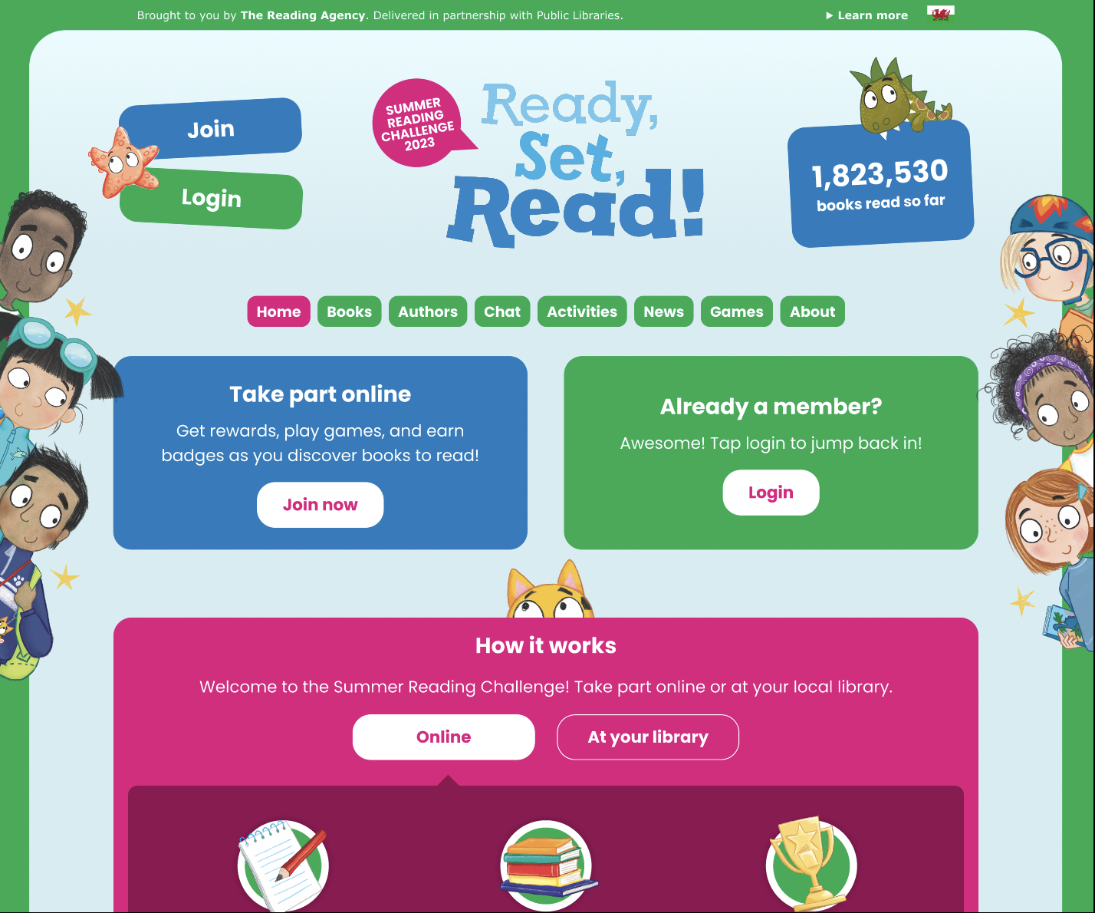
Visit the website
summerreadingchallenge.org.uk
Set your own summer reading goal
Rate and review your books to unlock badges
Play games and enter competitions
Enter the codes printed on your stickers to unlock extra rewards
Use the Book Sorter to find books recommended by other children
Notes:
The fun continues at home too! Visit the Ready Set Read! website to play games, review your latest reads and enter competitions to win amazing Summer Reading Challenge prizes. You can share your favourite books with other children taking part in the Challenge and even unlock extra rewards for your reading.
Teacher note: Children can join also the challenge online to earn digital rewards. To get hard copy resources folder, bookmark, doorhanger, medal and certificate. Children need to join in person at the library.

Slide 8
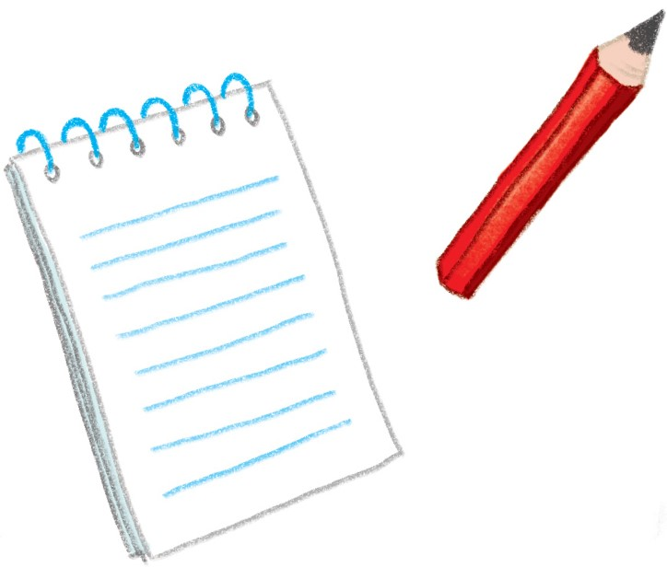
See you at the library!

