Slide 1

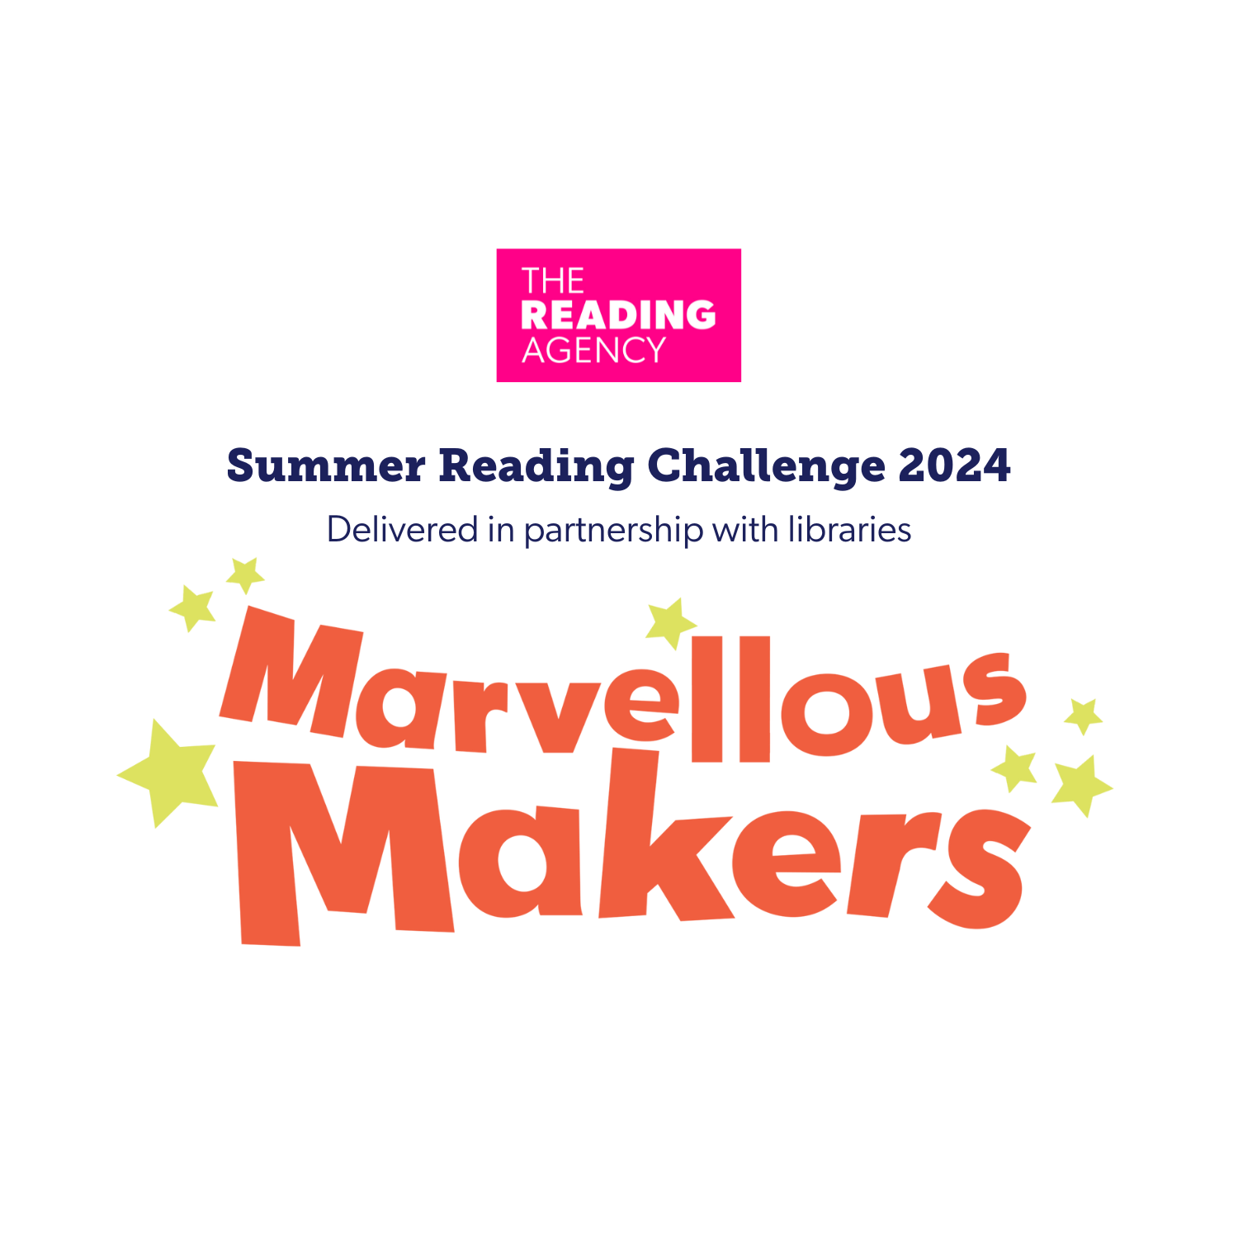





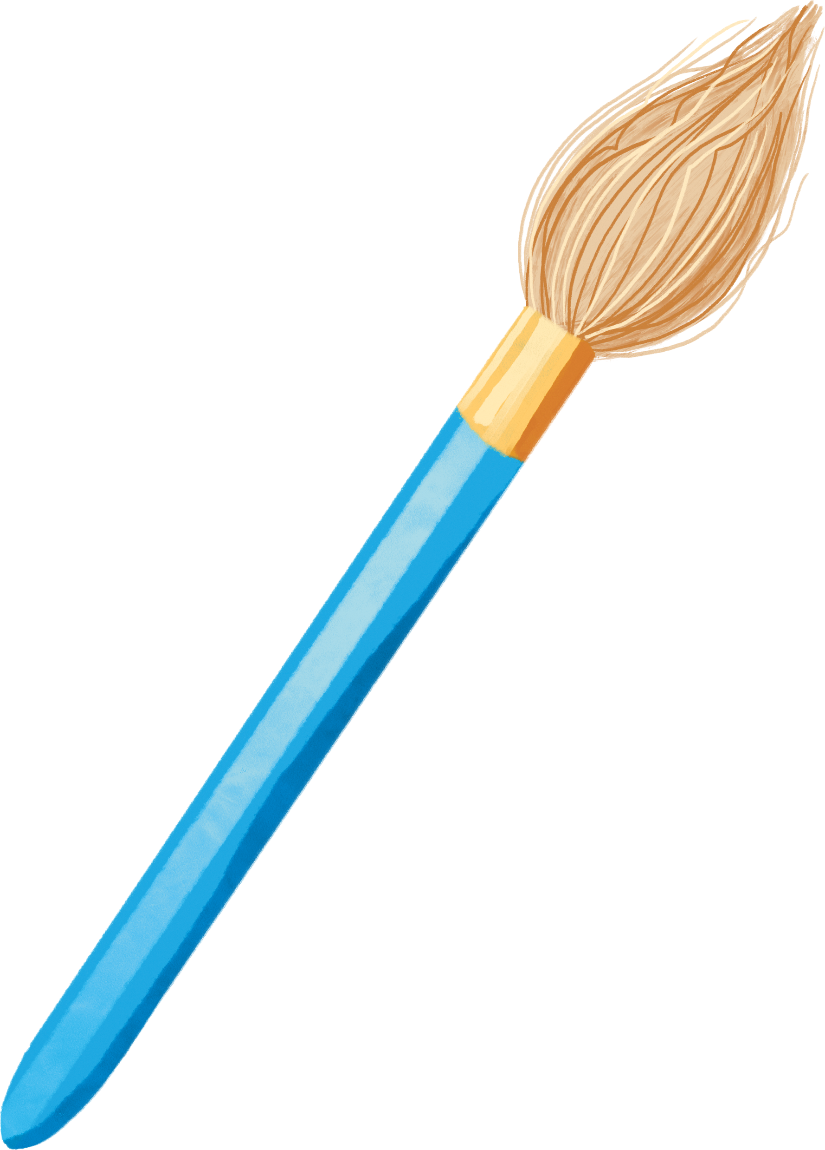


www.summerreadingchallenge.org.uk
Notes:
Teacher Notes: This PowerPoint presentation explains Marvellous Makers – the 2024 Summer Reading Challenge. It can be used in assembly or classrooms to let children know about the challenge.
The Summer Reading Challenge happens in libraries across the country every year (it started in 1999). In 2023 over 10,000 children in Nottinghamshire joined in but we want even more to sign up this year. This year were tapping into our imaginations, telling amazing stories, and coming up with lots of fun new creations as we celebrate the creative arts.
www.inspireculture.erg.uk/summerreadingchallenge
The Challenge has been proven to help encourage children to keep reading throughout the long summer break and prevent the tendency for children’s reading to dip.
Key facts:
Aimed at Children aged 4 – 11
Children are challenged to read 6 library books over the holidays [they choose the books – can be story, fact, joke, graphic novel – as long as it is library book all reading counts]
For every book read children receive a sticker (some are smelly) plus other rewards.
Every child who completes by reading 6 books gets a medal and certificate (children come back to the library to let us know a bit about the book they have read)

Slide 2

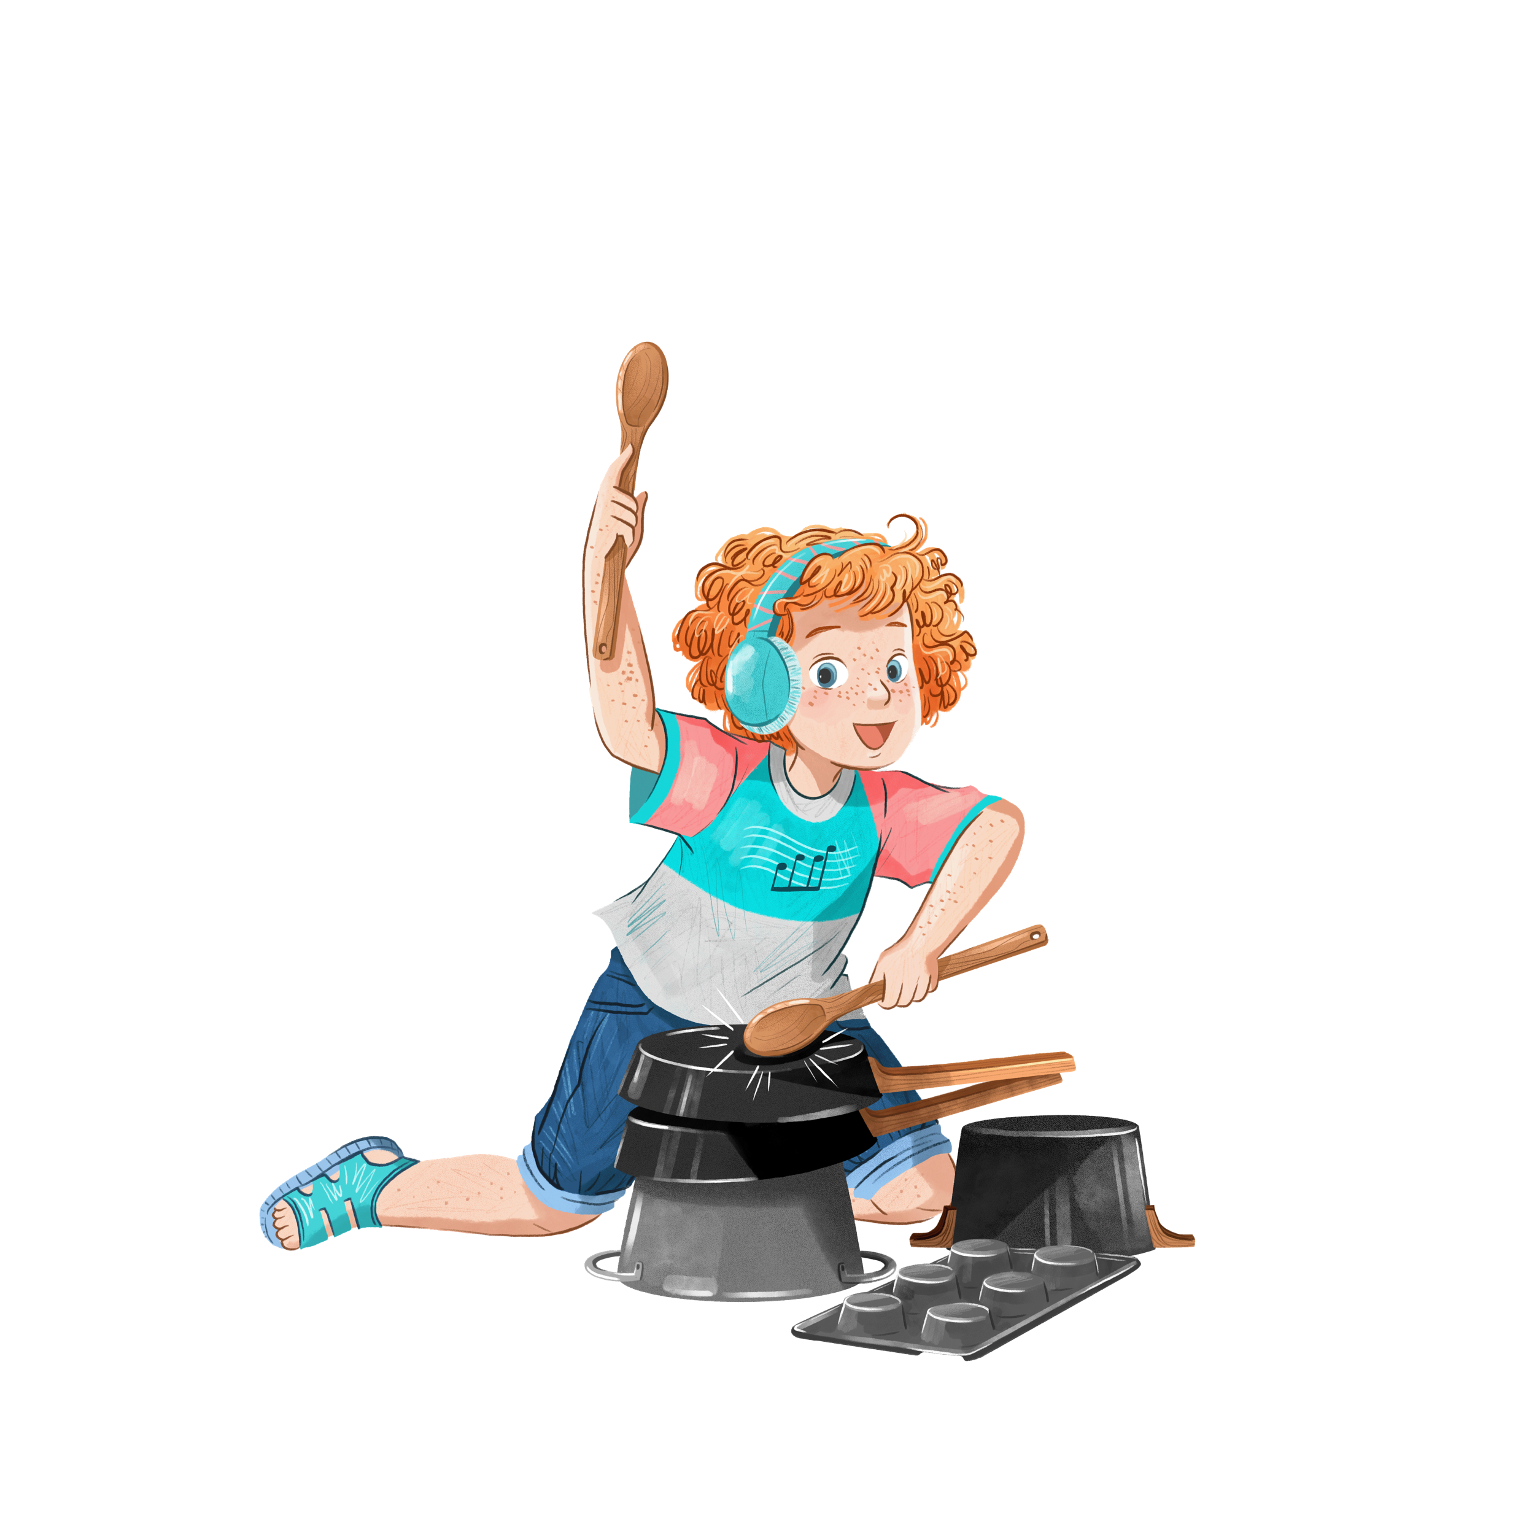
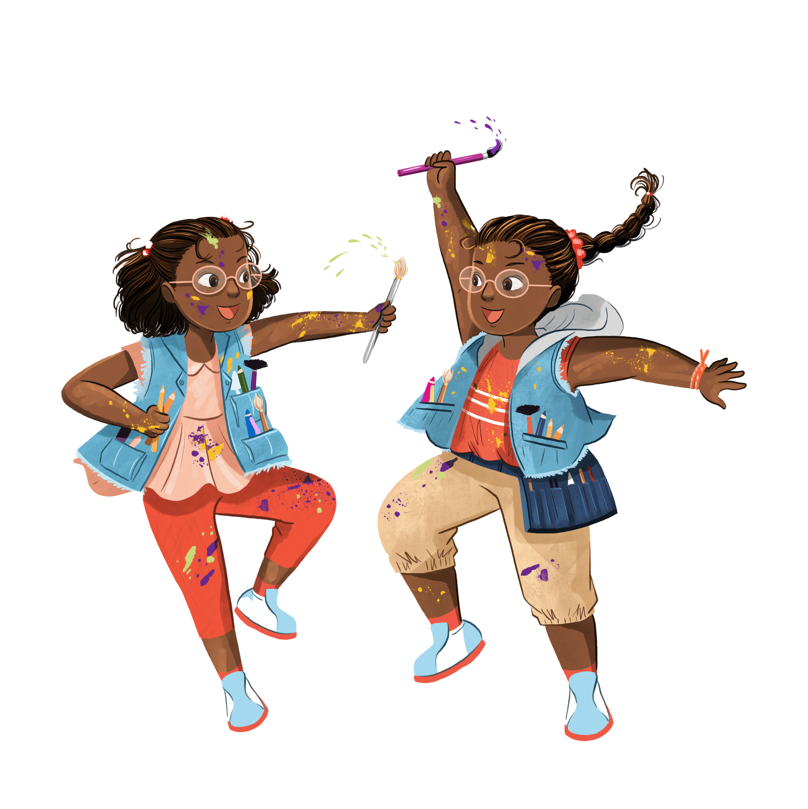
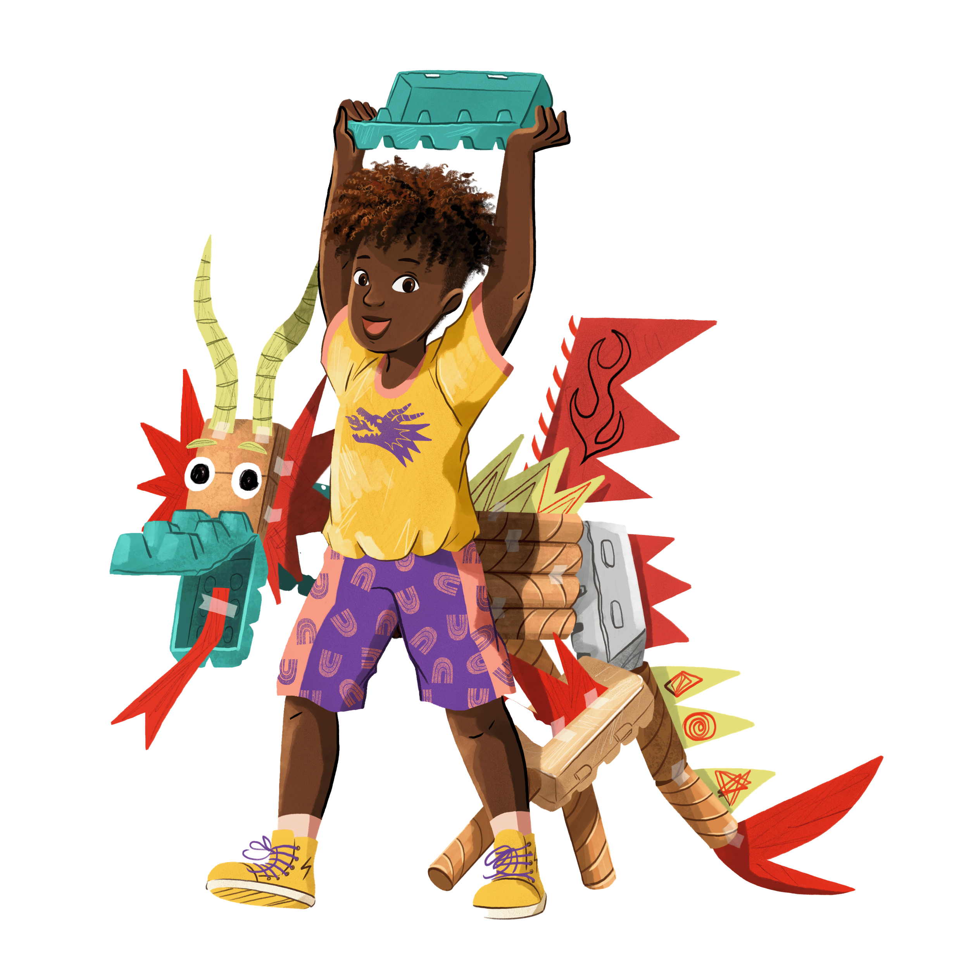
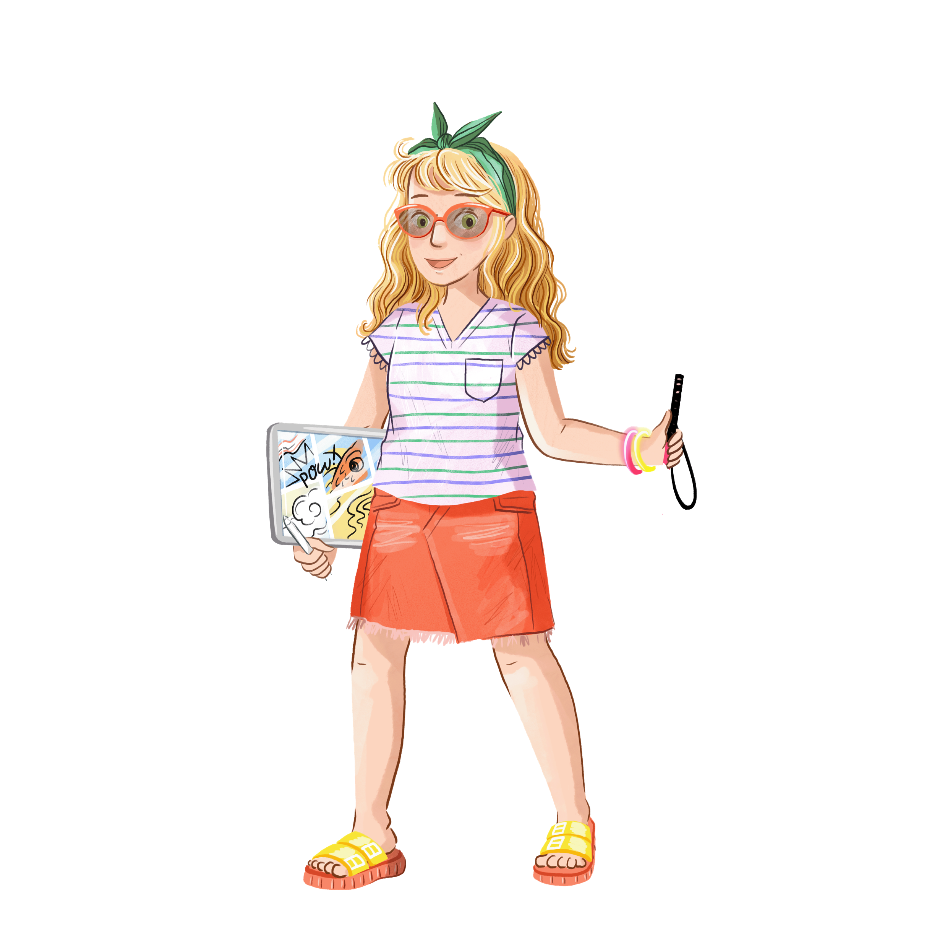
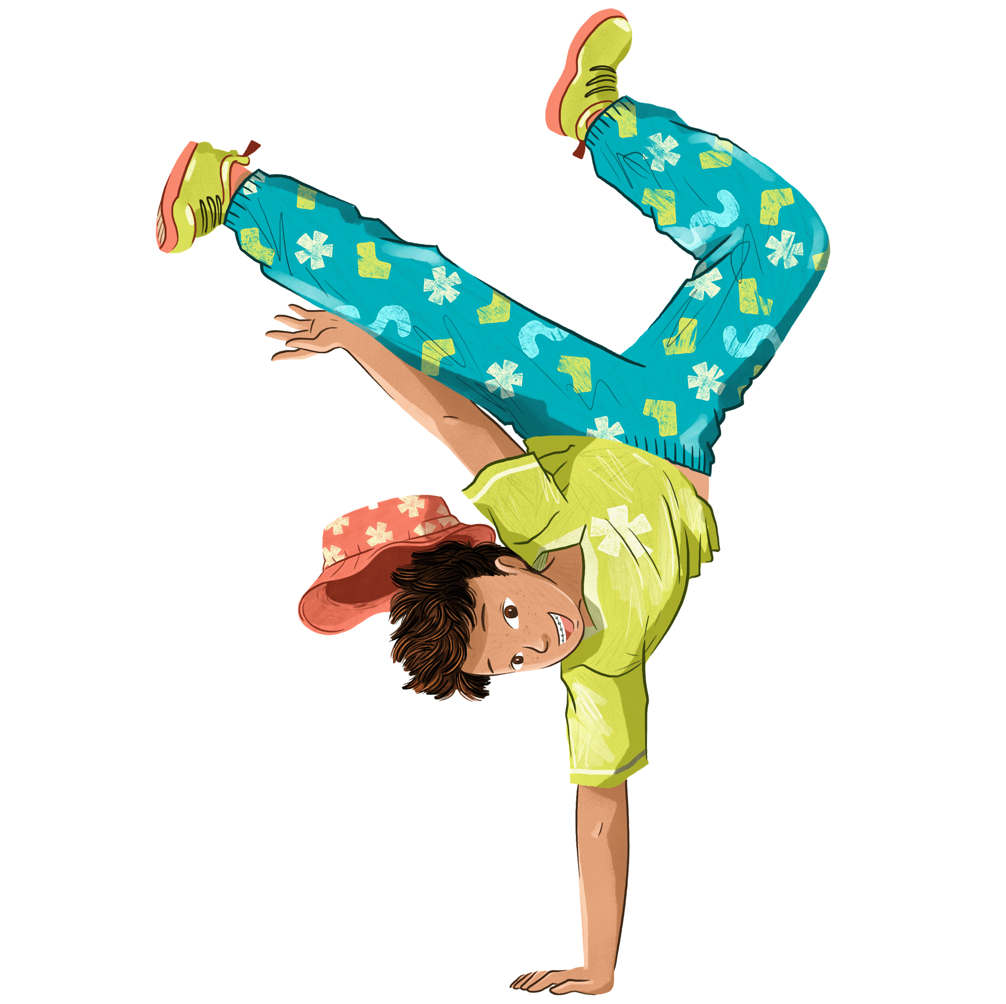
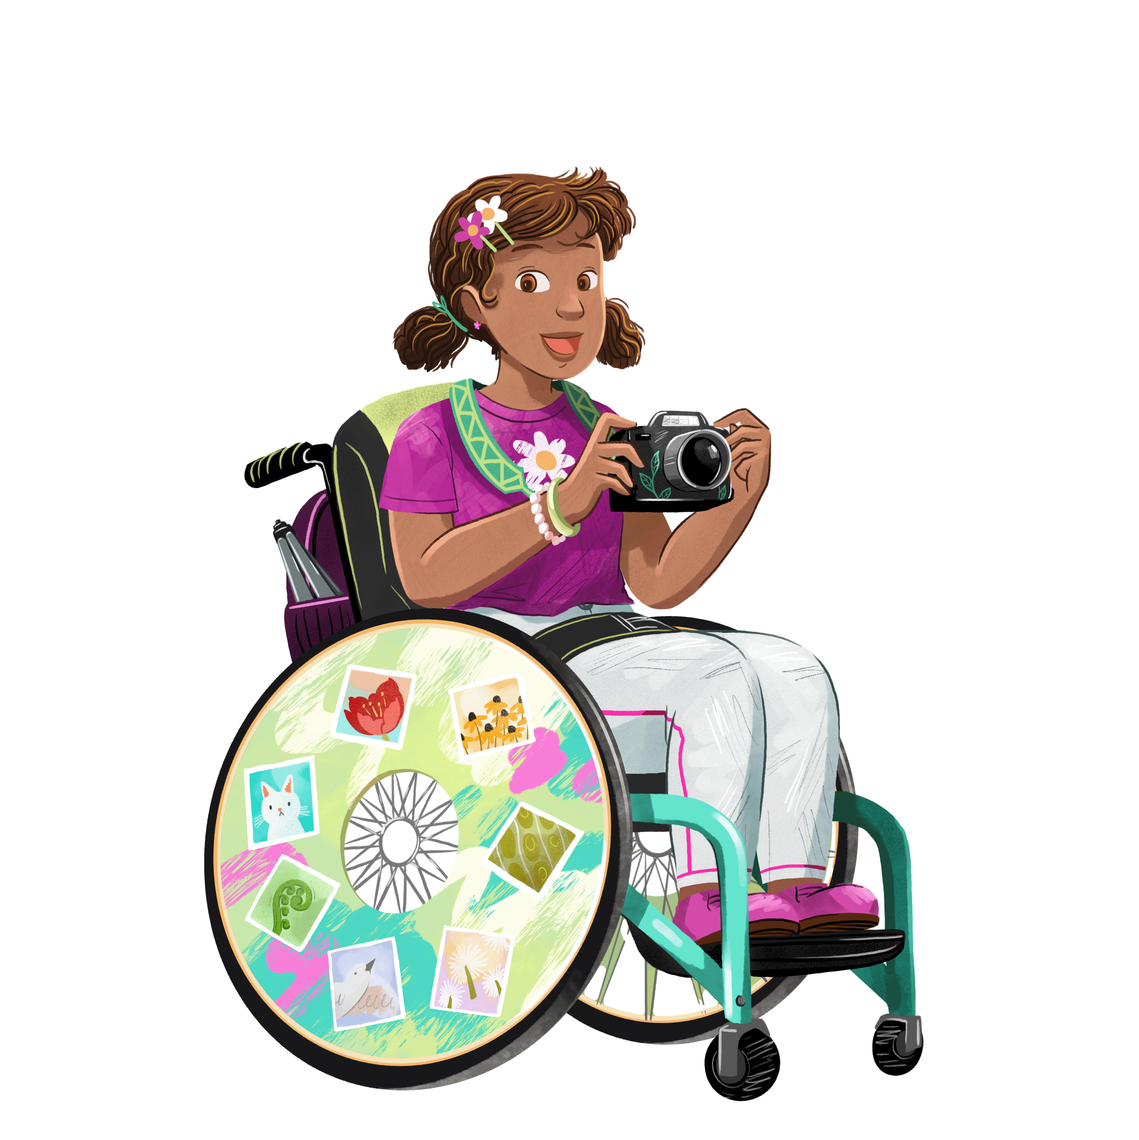
Laila and Yasmin
Charlie
Meet the characters!
Riley
and Rocky
Tails
Amelia
Maya
Bob
Kai
Notes:
Meet the Marvellous Makers. This year’s Summer Reading Challenge is all about being creative! The Marvellous Makers are all part of a creative club. They enjoy expressing themselves through different creative hobbies - from dance to drawing, photography to painting, junk modelling to music! And, of course, they love reading.
When you join the Challenge you’ll join them and help them solve a mystery involving Tails, a cheeky squirrel who seems to be hiding things...
As you read library books for the challenge you’ll help find one of the missing objects.

Slide 3
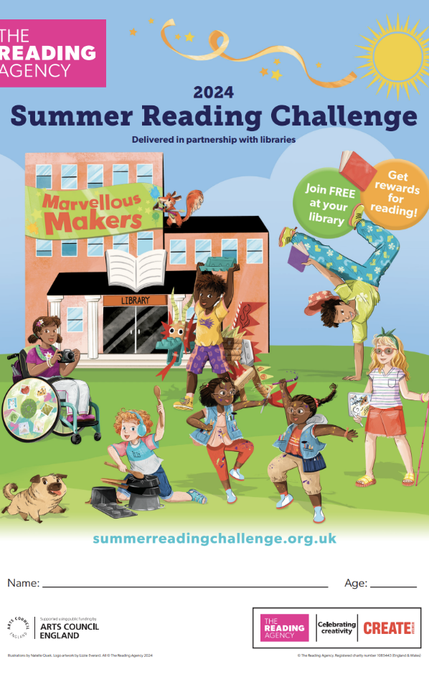
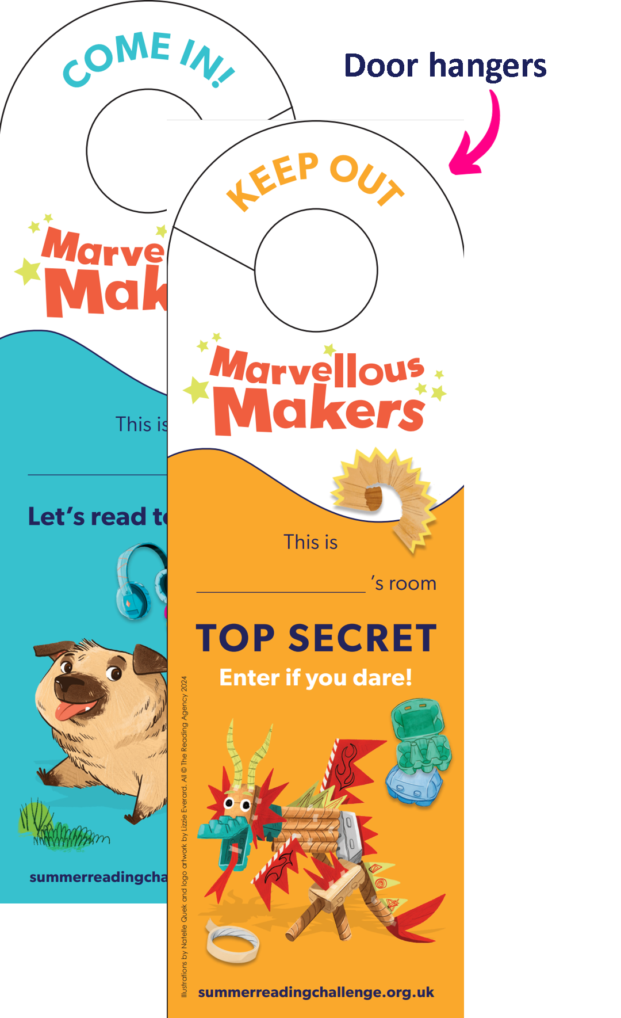

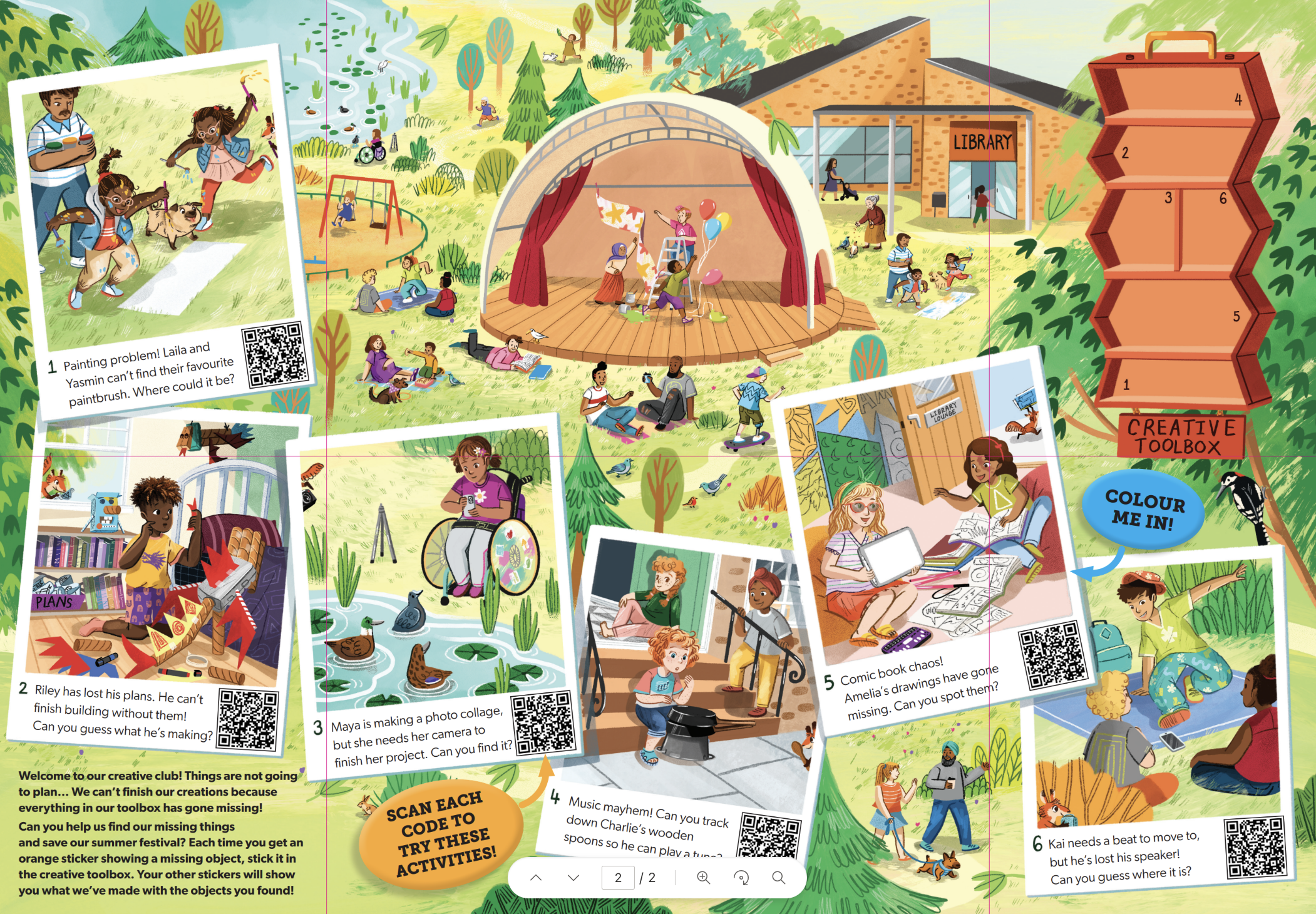
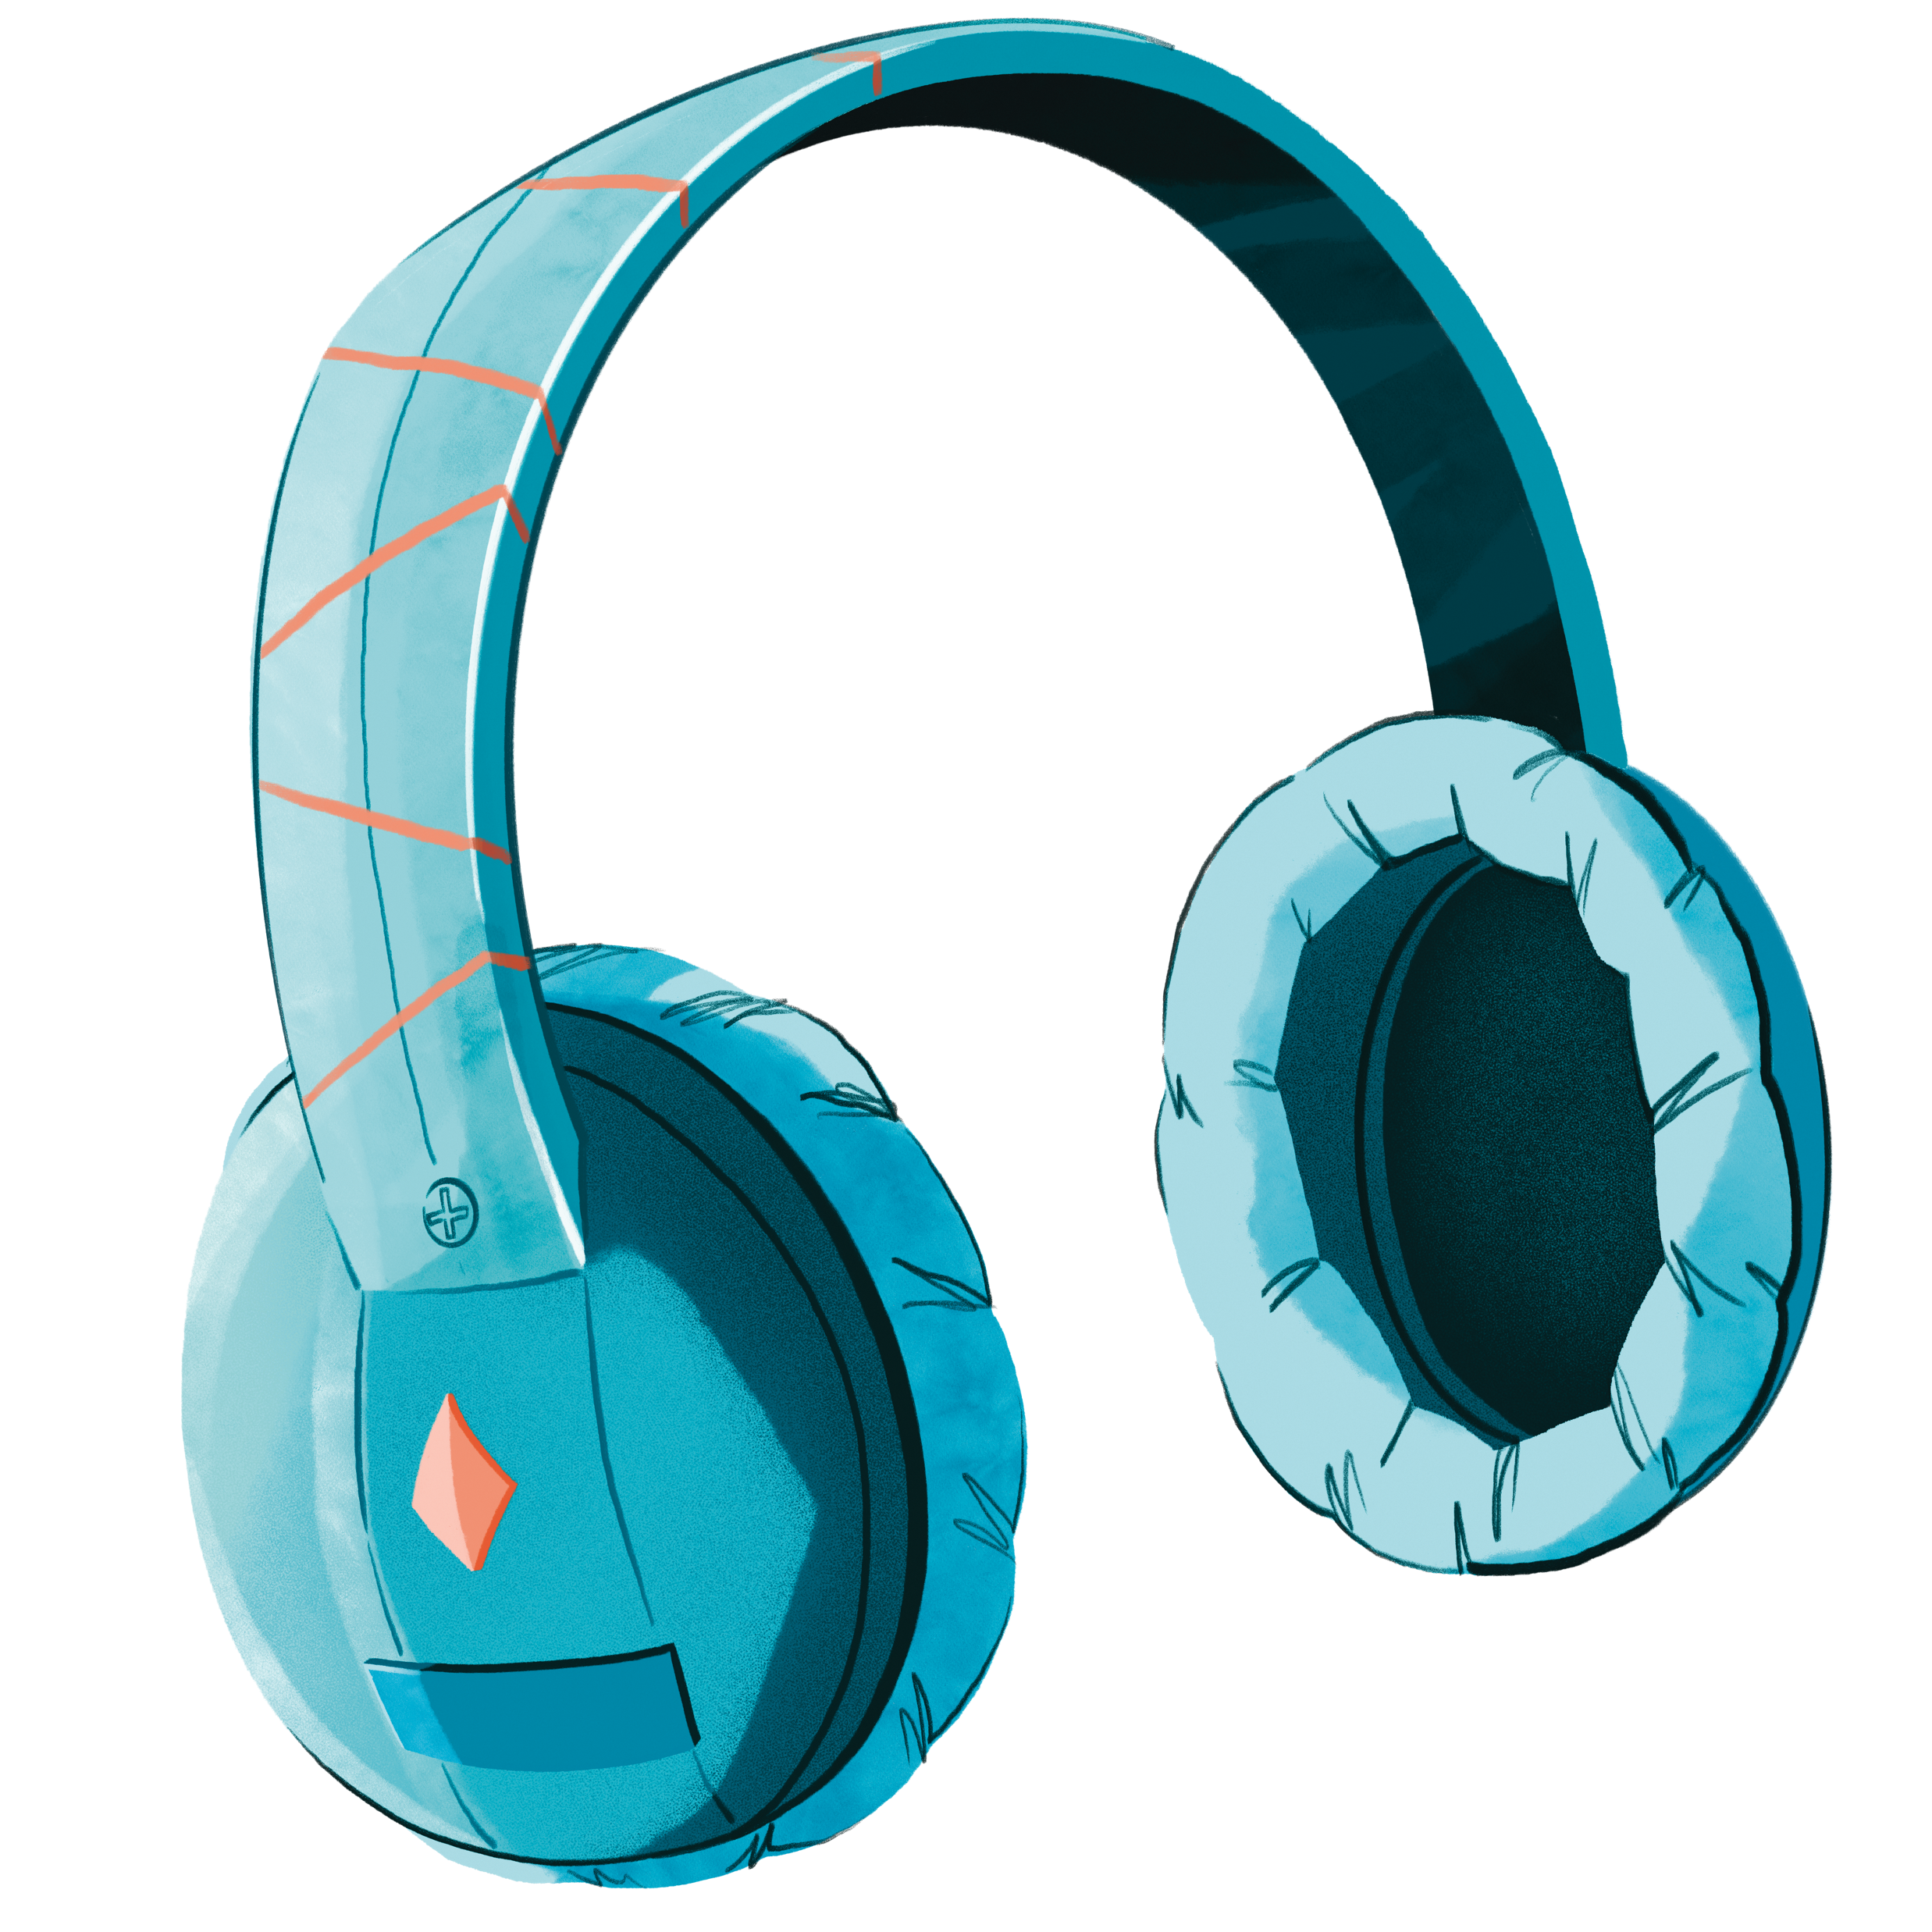

Here's how it works:
Go to your library this summer to sign up and get your Marvellous Makers collector’s foldout poster!​
Read books and collect stickers and other rewards for your reading (watch out for the smelly stickers…)​
Add the stickers to your poster to complete the Challenge
Remember, you can read ANYTHING you like. It could be a book, comic or magazine, eBook or audiobook – they all count!​
Notes:
Marvellous Makers is FREE to join at your local library.
Read any 6 books from your library from Saturday 6th July to Sunday 1st September
As you read your books you will receive stickers and other rewards. Some of the stickers are smelly!
After 3 books you’ll also get a doorhanger.
Teacher notes:
Children choose how they want to complete the challenge – they might read 1 book at a time or visit the library after every 2 they have read – or read all six and return to collect their incentives.
Children choose what they would like to read on the challenge - story book, fact books, poetry, jokes, graphic novels – as long as it is a library book all reading counts!
[The aim of the Summer Reading Challenge is to inspire a love of reading and encourage children to keep reading over the summer holidays. Library staff and volunteers will chat to children about the books they read for the Challenge]

Slide 4


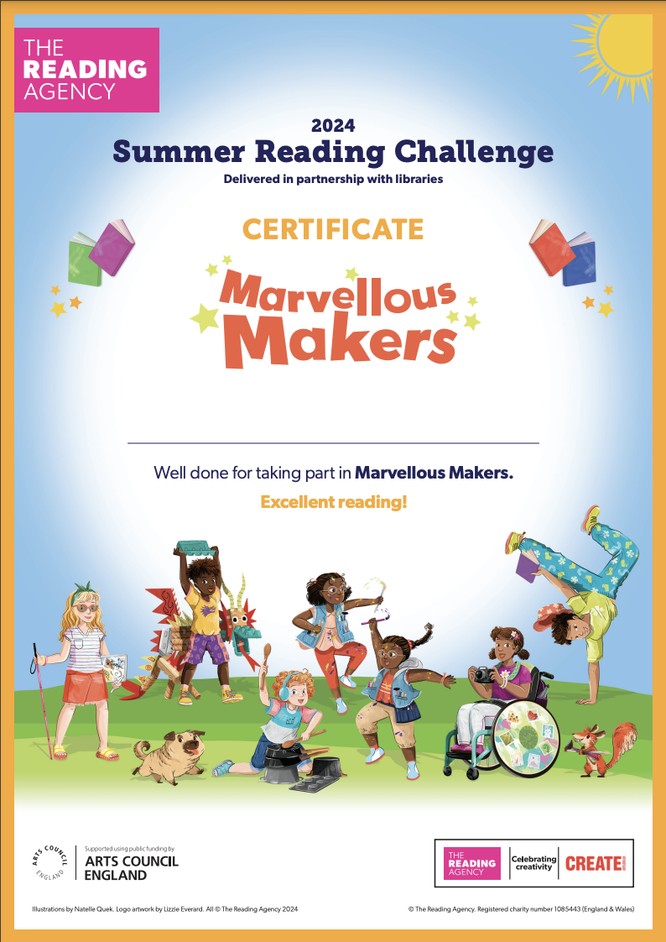
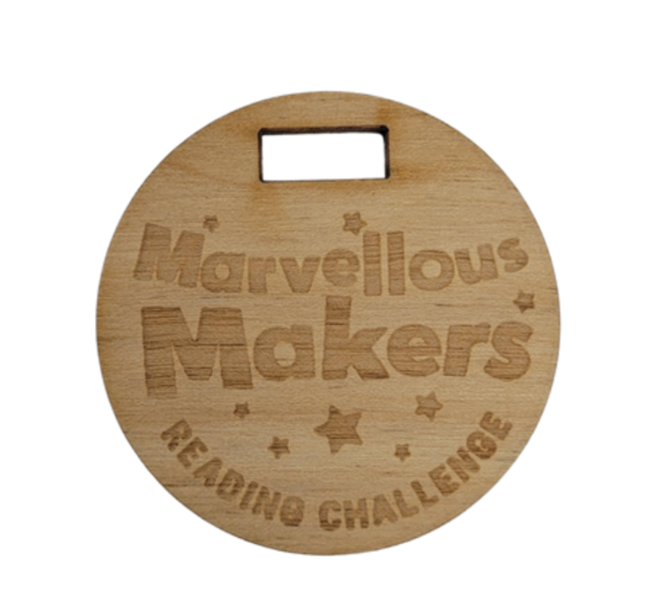
Complete the Challenge and earn your
certificate of achievement and medal!

Slide 5
Take part this summer!
Join in at any Nottinghamshire Inspire library.
It’s FREE!
Marvellous Makers starts on
Saturday 6 July
Notes:
Are you ready for Marvellous Makers!
Teacher notes: For more information of Summer Reading Challenge in Nottinghamshire go to www.inspireculture.org.uk/SummerReadingChallenge

Slide 6
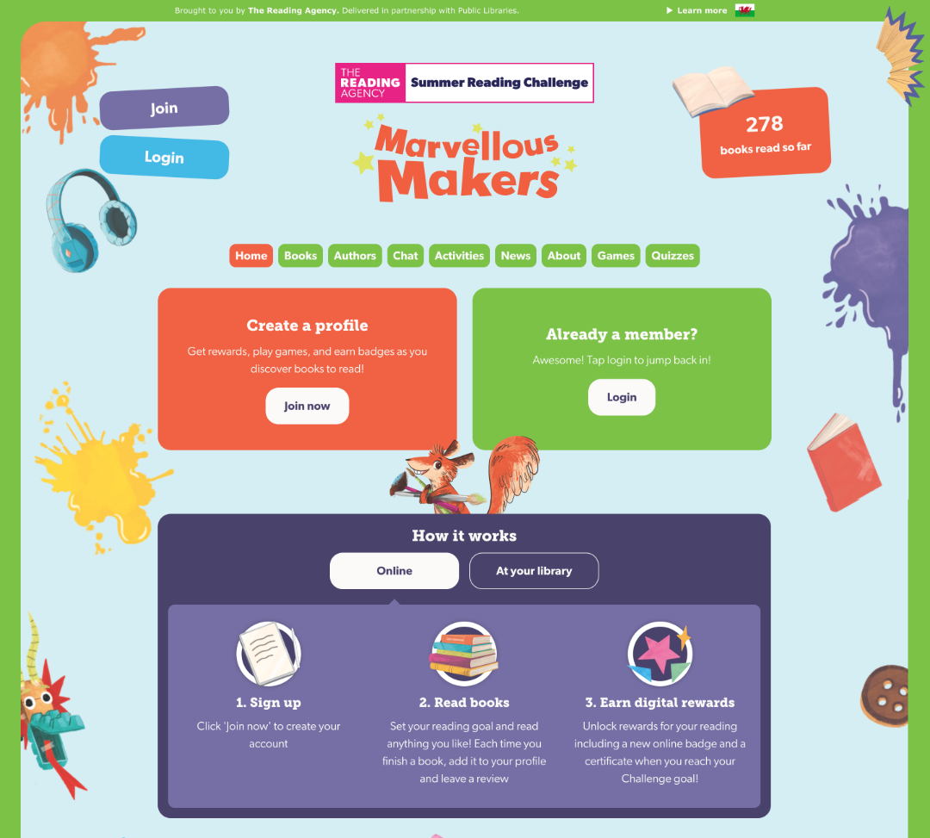

Take part online!
summerreadingchallenge.org.uk
Set your own summer reading goal
Rate and review your books to unlock badges
Play games and enter competitions
Use the Book Sorter to find books recommended by other children
Notes:
The fun continues at home too! Visit the Summer Reading Challenge website to play games, review your latest reads and enter competitions.
You can share your favourite books with other children taking part in the Challenge and unlock extra rewards for your reading and reviewing!
Teacher note: Children can join also the challenge online to earn digital rewards. To get hard copy resources folder, stckers, doorhanger, medal and certificate. Children need to join in person at the library.

Slide 7
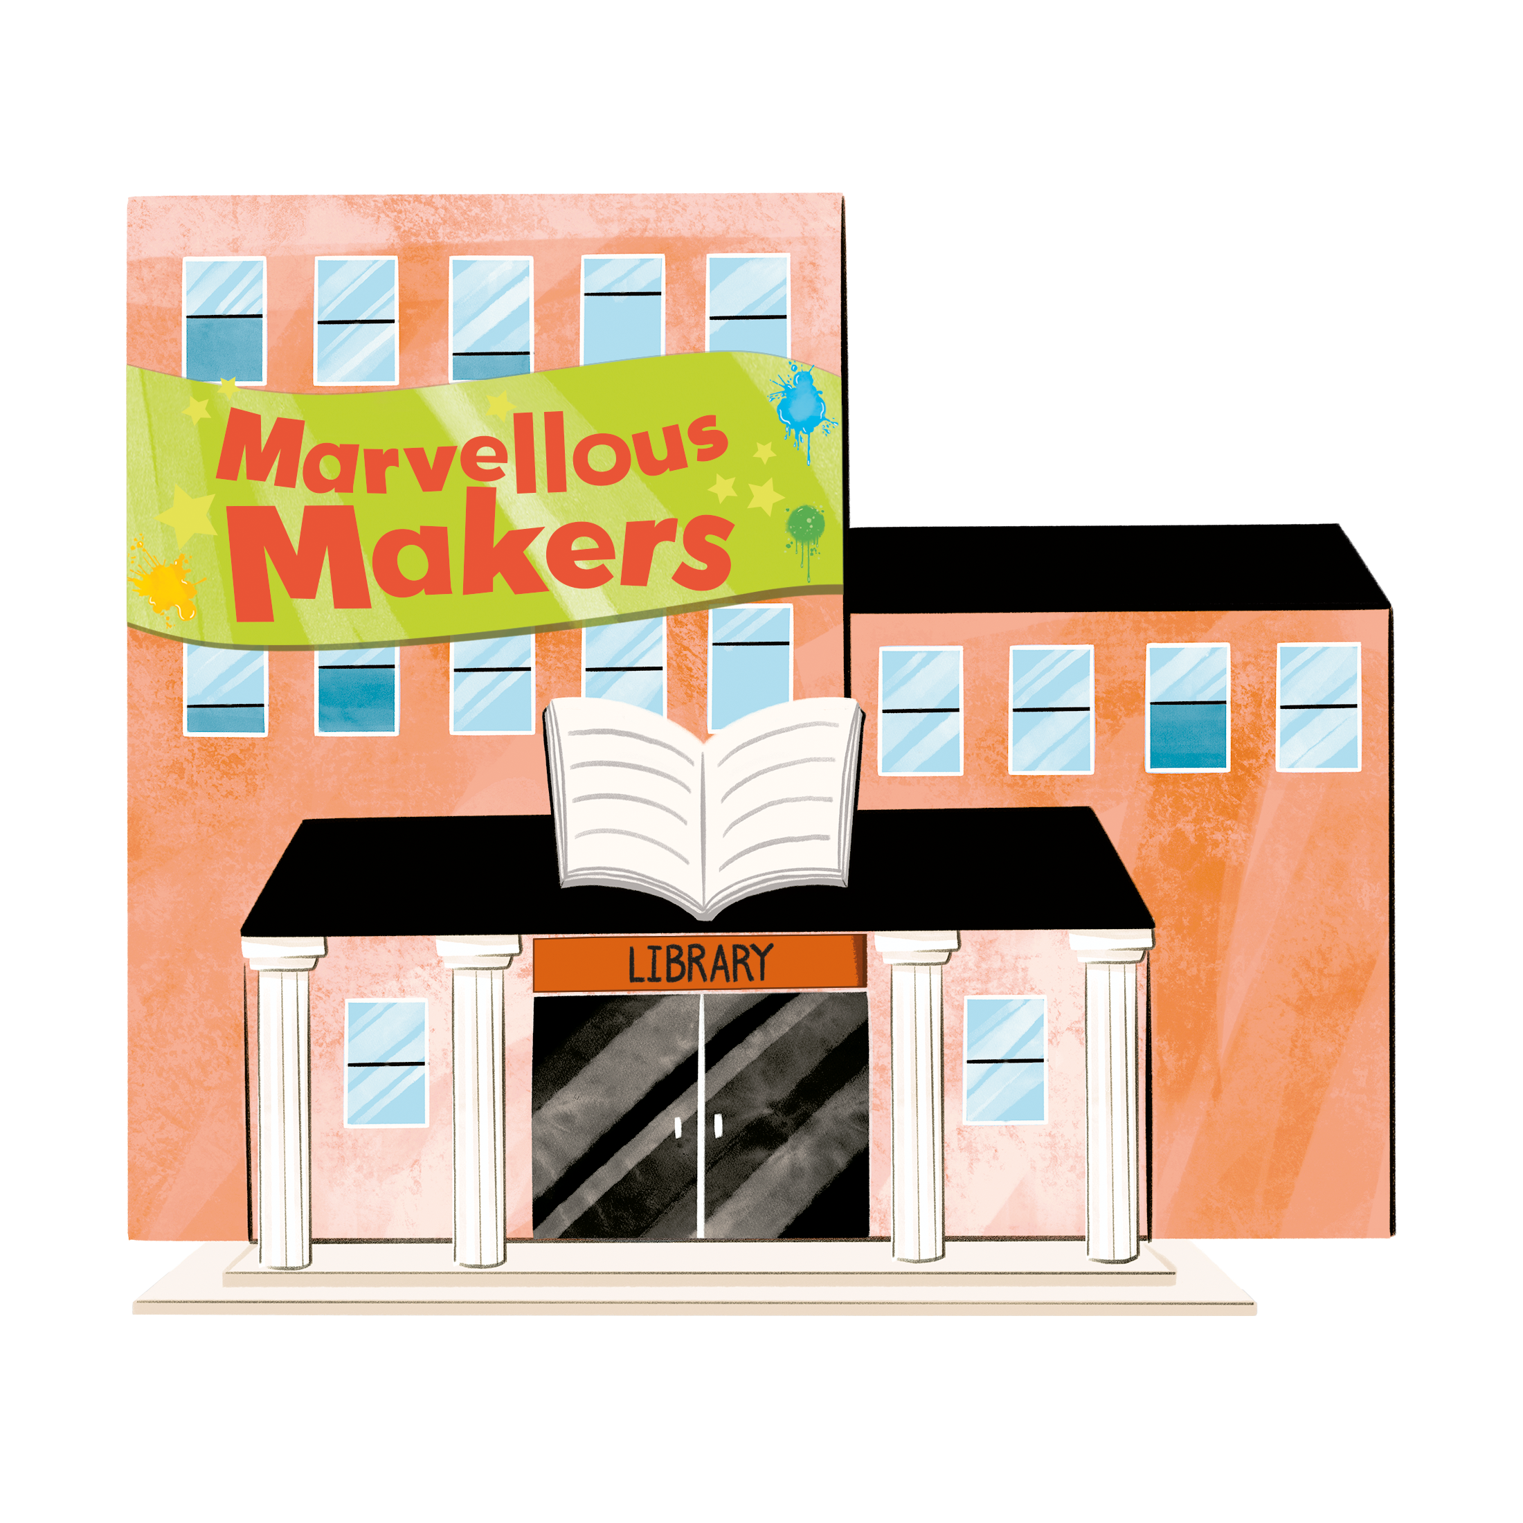

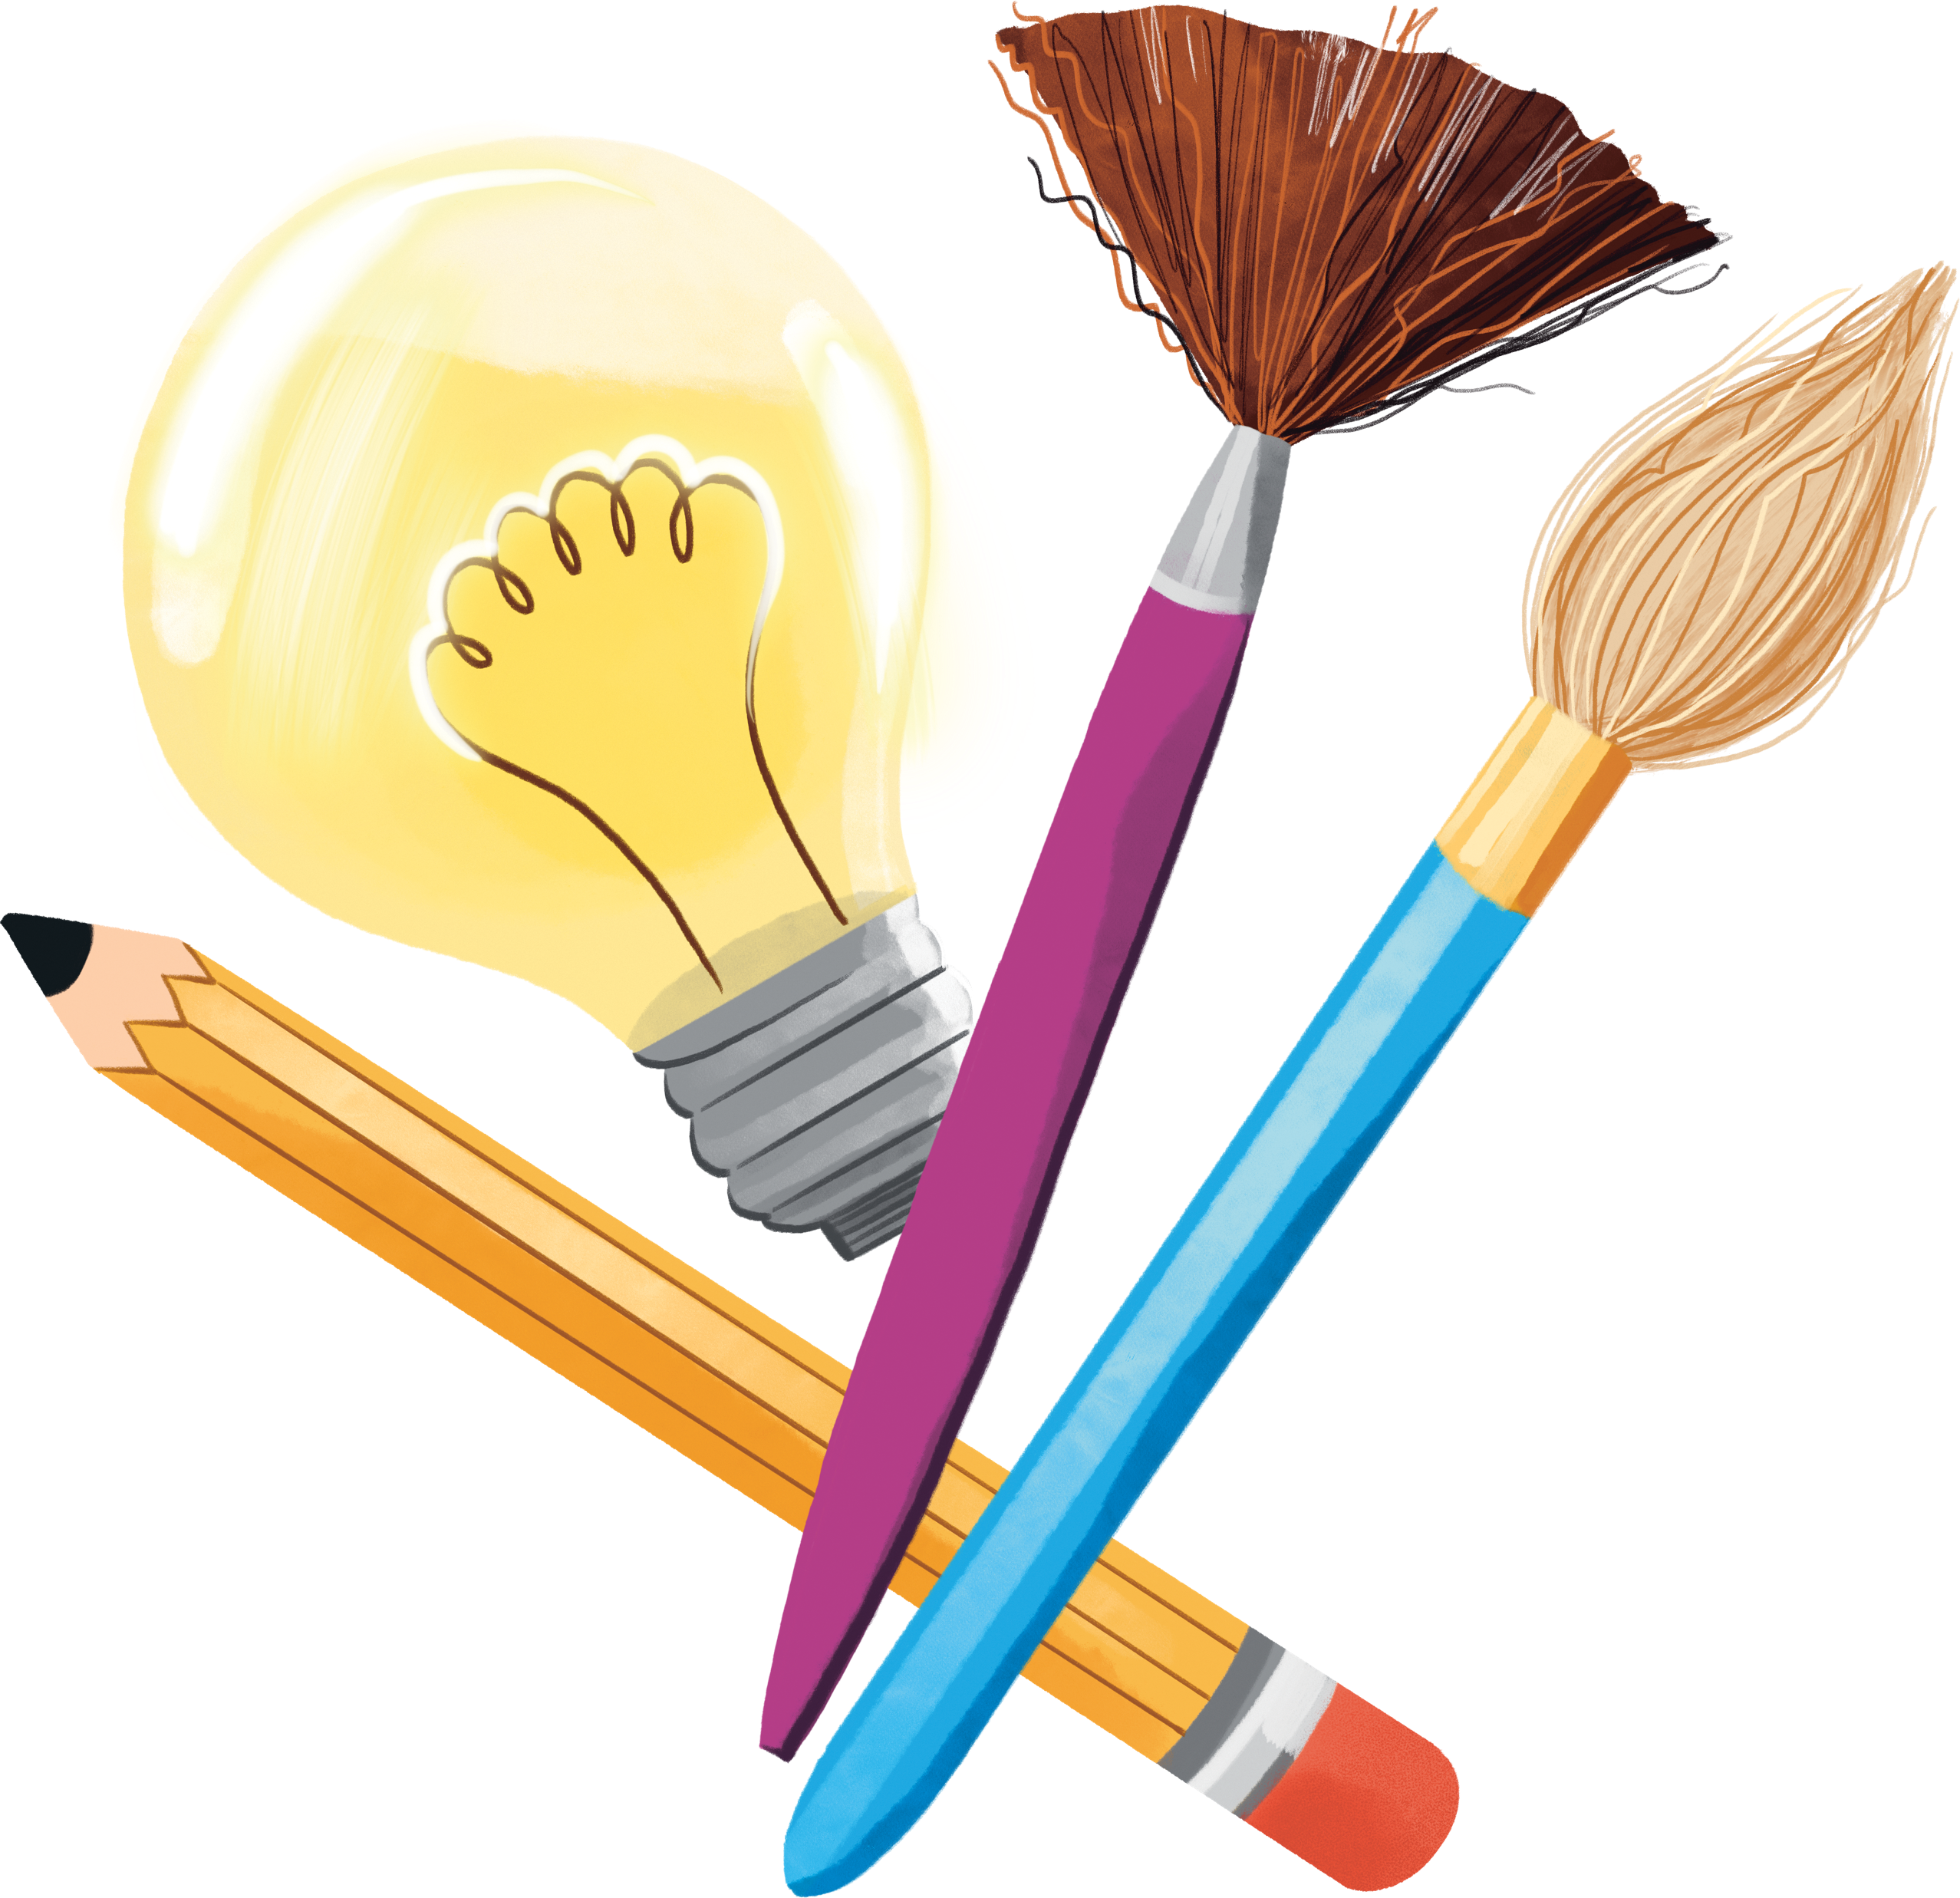
See you at the library!

