Slide 1
Notes:
Teacher Notes: This PowerPoint presentation explains Story Garden – the 2025 Summer Reading Challenge. It can be used in assembly or classrooms to let children know about the challenge. The Summer Reading Challenge happens in libraries across the country every year (it started in 1999). In 2024 over 8,000 children in Nottinghamshire joined in but we want even more to sign up this year. This year we will be celebrating nature and the great outdoors, exploring adventure, fantasy and the magical world of storytelling.
www.inspireculture.erg.uk/summerreadingchallenge
The Challenge has been proven to help encourage children to keep reading throughout the long summer break and prevent the tendency for children’s reading to dip.
Key facts:
Aimed at Children aged 4 – 11
Children are challenged to read 6 library books over the holidays [they choose the books – can be story, fact, joke, graphic novel – as long as it is library book all reading counts]
For every book read children receive a sticker plus other rewards.
Every child who completes by reading 6 books gets a medal and certificate (children come back to the library to let us know a bit about the book they have read)

Slide 2
Magical Nature Theme
Notes:
This year’s Challenge is called Story Garden, and it’s all about nature, exploring the outdoors, exploring magical spaces, storytelling - and reading! Your library can help you find new books to enjoy and we’ll be hosting lots of events and activities connected to nature and wildlife, that will be sure to inspire your next story adventure.
Explore the magical connection between nature and reading with our Story Garden characters! You'll meet them inside your collector’s sticker booklet and spot amazing fantastical creatures and plants dotted around the garden.

Slide 3
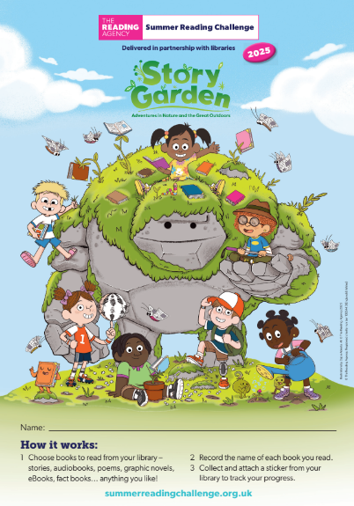
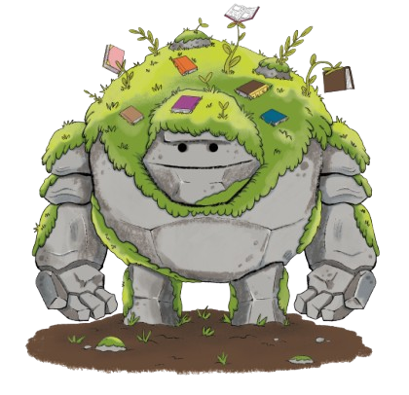
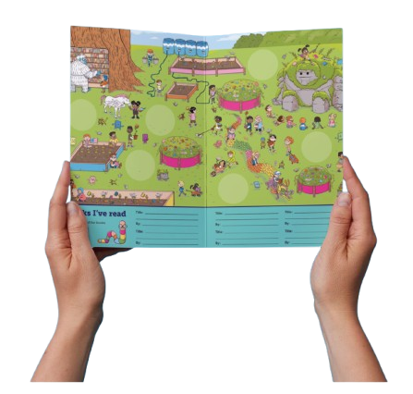
Take on the Challenge!
Go to your library this summer to sign up and get your Story Garden sticker booklet…
Read books and collect stickers and other rewards for your reading.
Add the stickers to your poster to complete the Challenge
Remember, you can read ANYTHING you like. It could be a book, comic or magazine, eBook or audiobook – they all count!​
Notes:
Story Garden is FREE to join at your local library.
Read any 6 books from your library from Saturday 5th July to Sunday 31st August
As you read your books you will receive stickers and other rewards.
After 3 books you’ll also get a bookmark.
Teacher notes:
Children choose how they want to complete the challenge – they might read 1 book at a time or visit the library after every 2 they have read – or read all six and return to collect their incentives.
Children choose what they would like to read on the challenge - story book, fact books, poetry, jokes, graphic novels – as long as it is a library book all reading counts!
[The aim of the Summer Reading Challenge is to inspire a love of reading and encourage children to keep reading over the summer holidays. Library staff and volunteers will chat to children about the books they read for the Challenge]

Slide 4
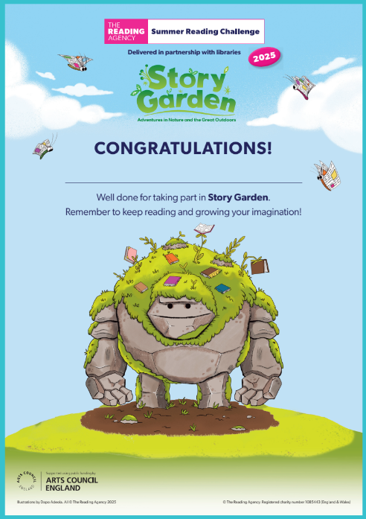
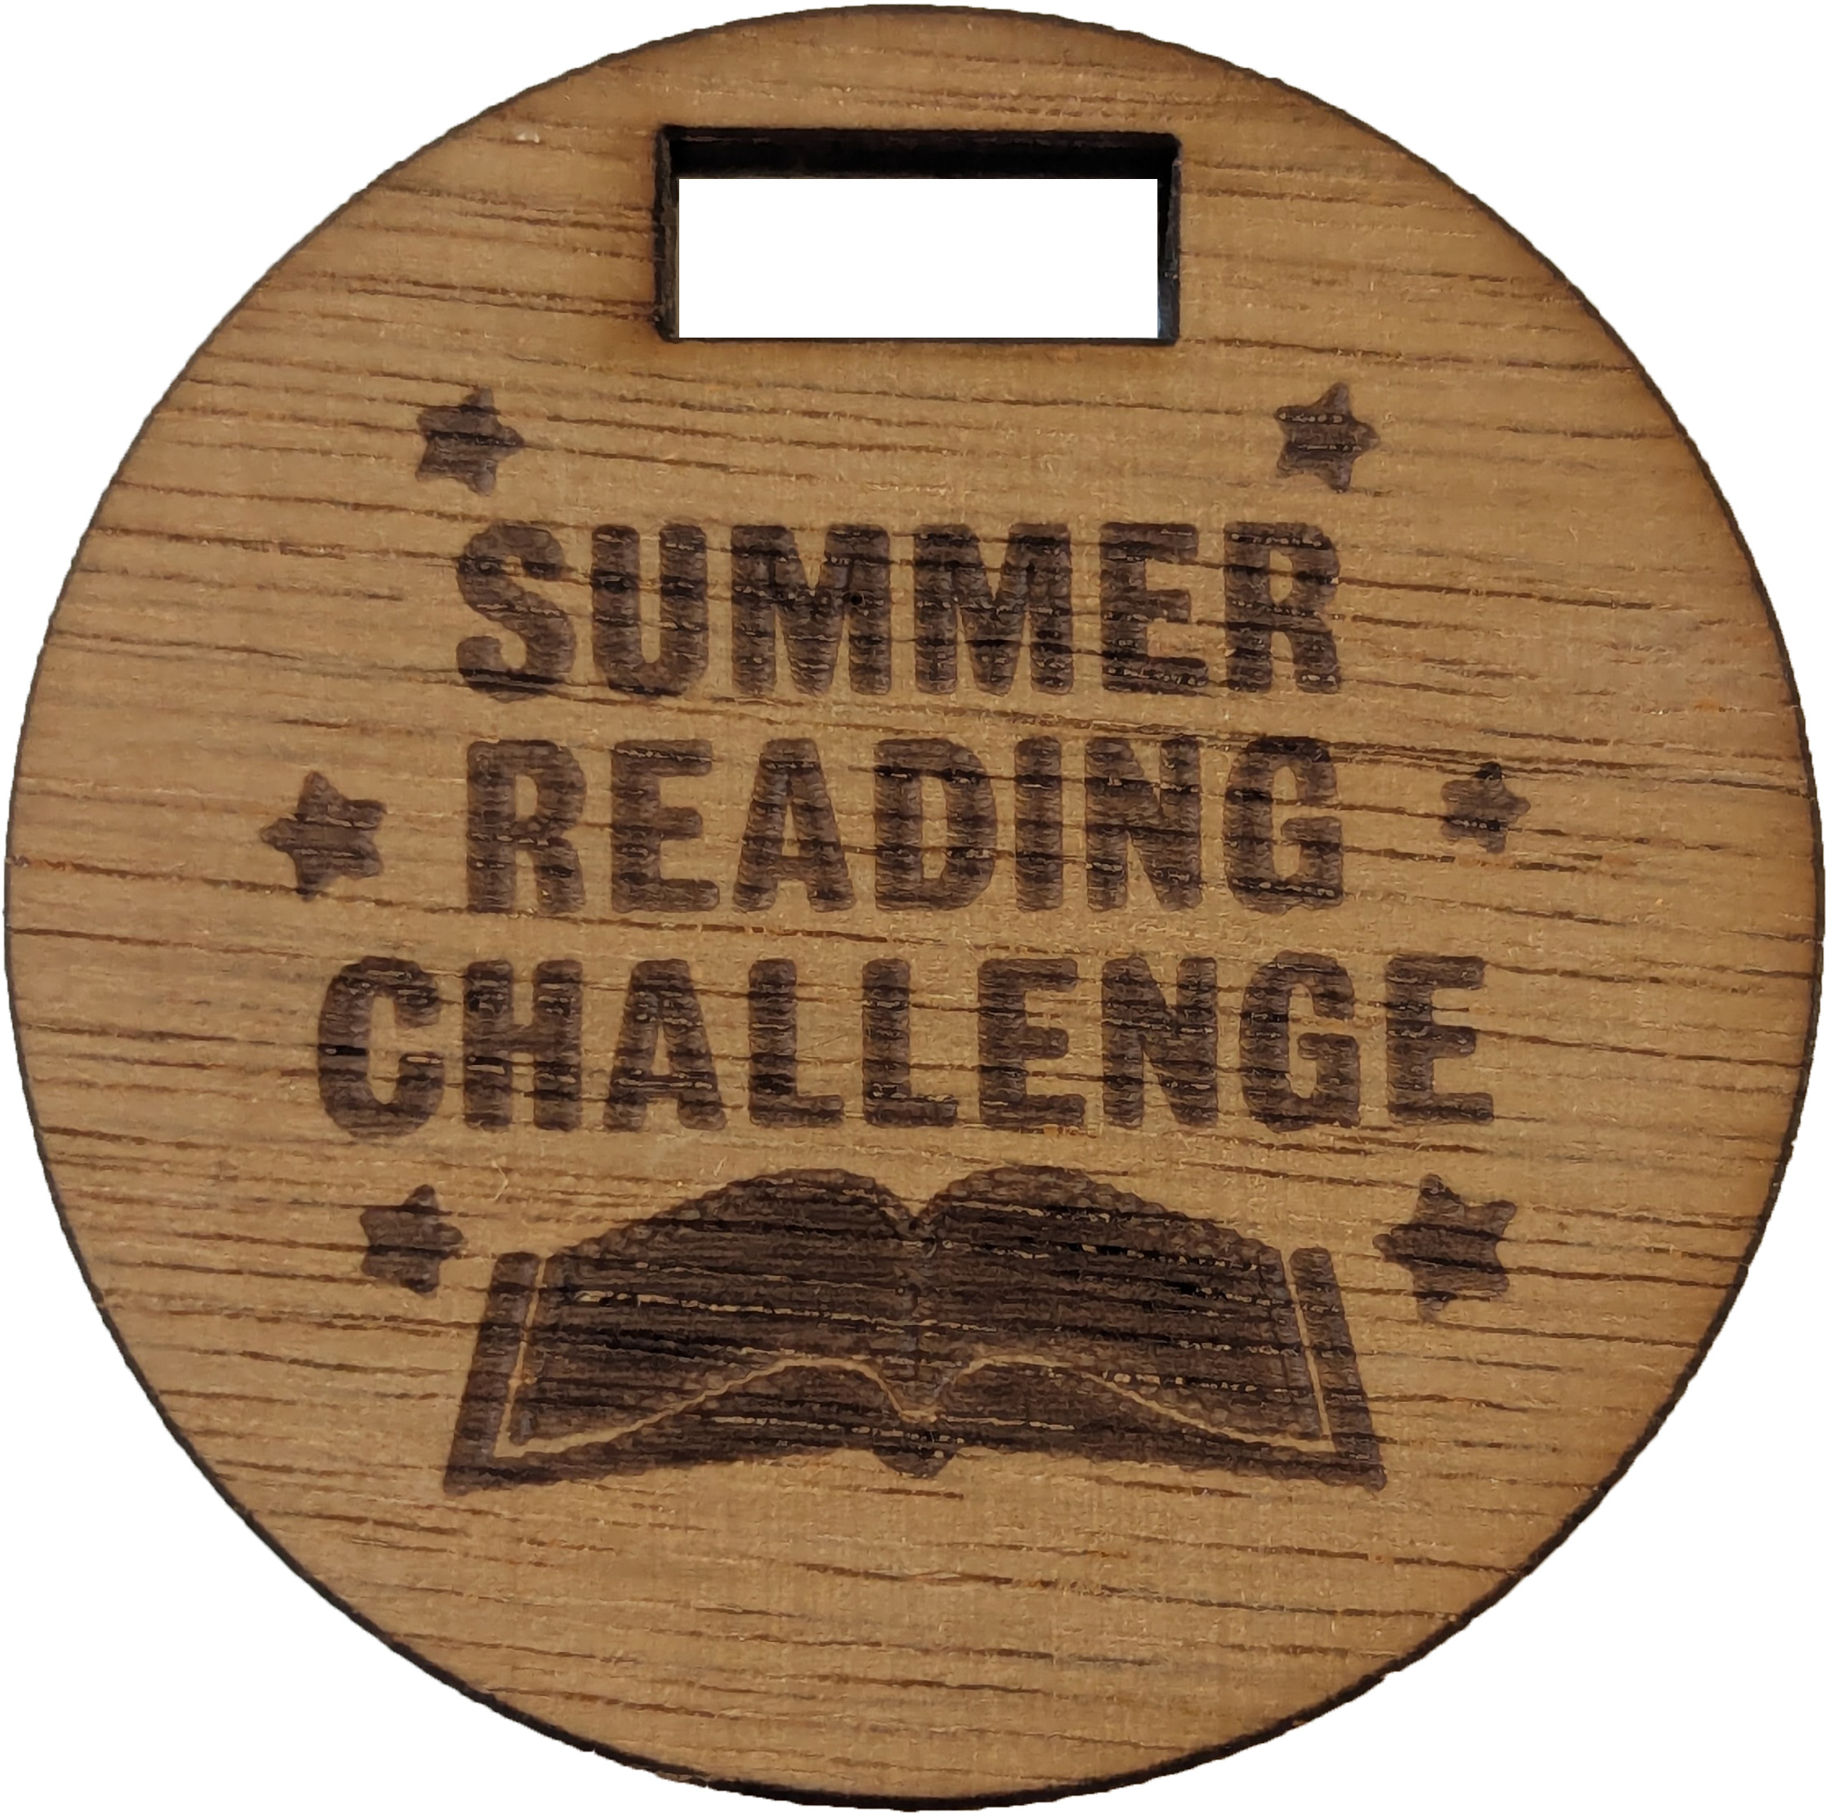
Complete the Challenge to be awarded your certificate of achievement and medal!

Slide 5
Take part this summer!
​Join in at any Nottinghamshire Inspire library.
It’s FREE!
Story Garden starts on
Saturday 5 July
Notes:
Are you ready for Story Garden Summer Reading Challenge 2025!
Teacher notes: For more information on the Summer Reading Challenge in Nottinghamshire go to www.inspireculture.org.uk/SummerReadingChallenge

Slide 6
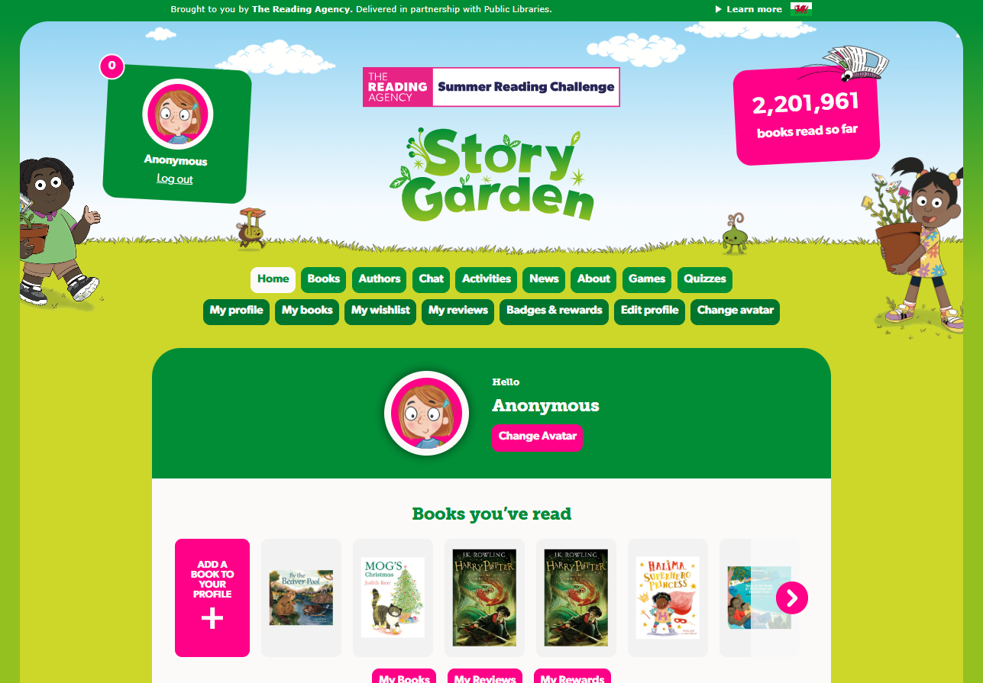
You can take part online!
✰ Set your own summer reading goal
✰ Rate and review your books to unlock badges
✰ Play games and enter competitions
✰ Use the Book Sorter to find books recommended by other children
summerreadingchallenge.org.uk
Notes:
The fun continues at home too! Visit the Summer Reading Challenge website to play games, review your latest reads and enter competitions.
You can share your favourite books with other children taking part in the Challenge and unlock extra rewards for your reading and reviewing!
Teacher note: Children can join also the challenge online to earn digital rewards. To get hard copy resources folder, stickers, bookmark, medal and certificate. Children need to join in person at the library.

Slide 7
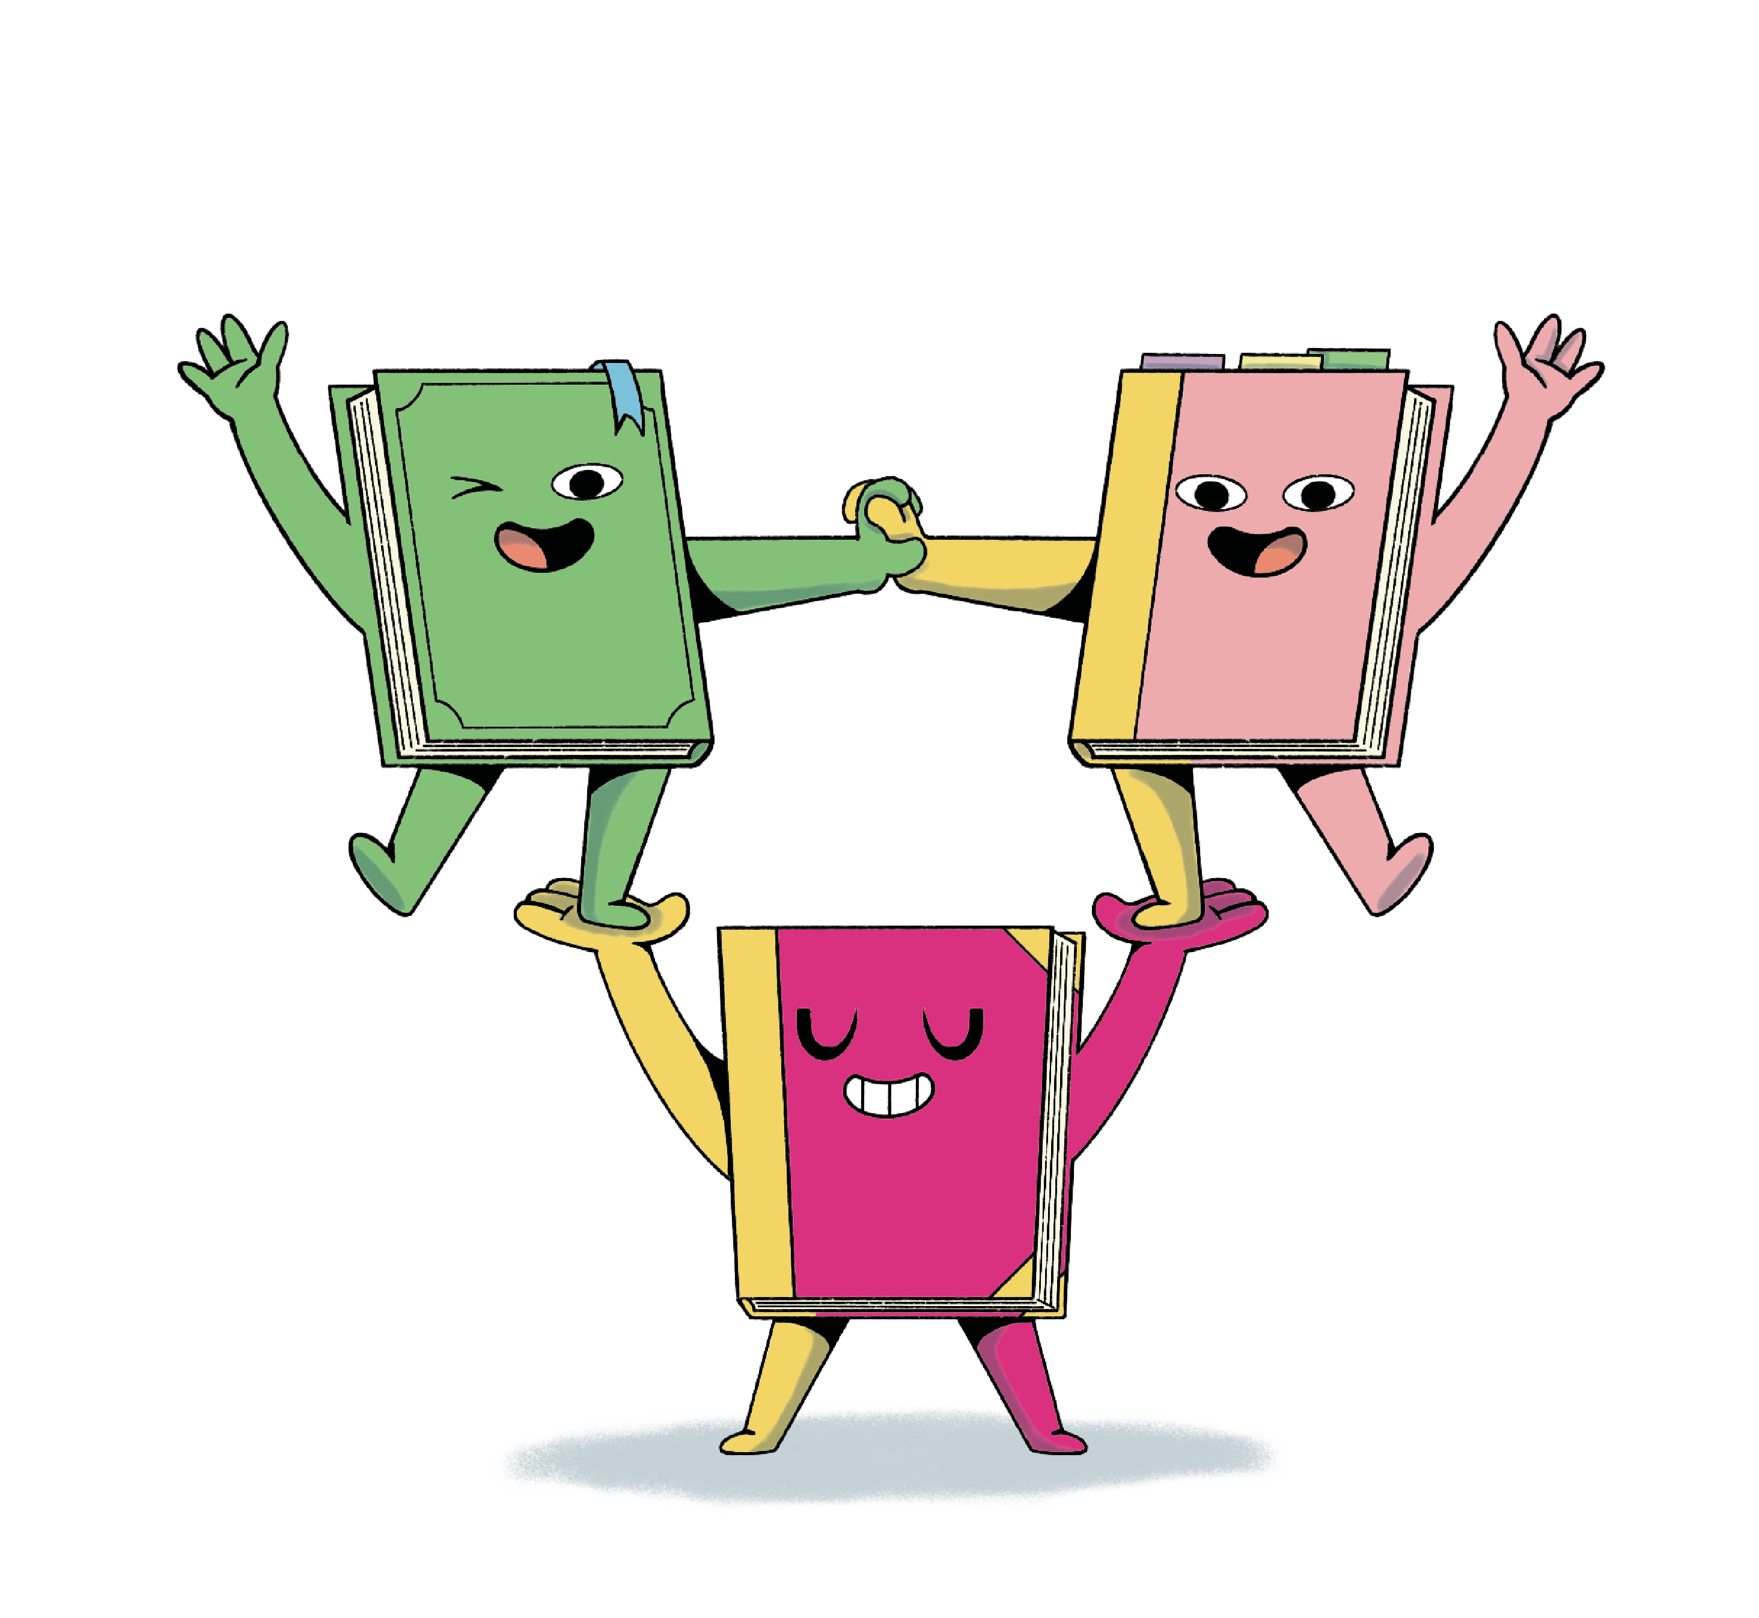
See you at the library!

