Slide 1
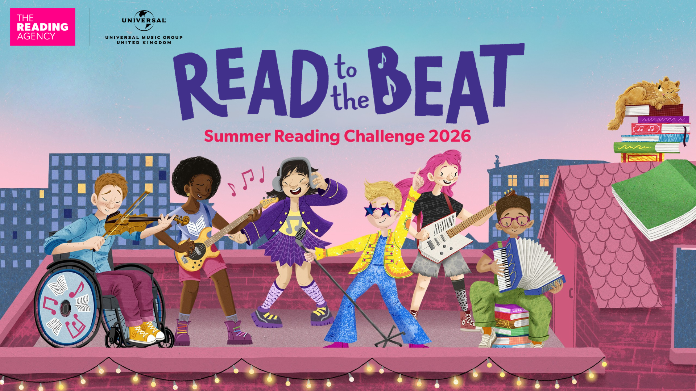
Illustrations © Harry Woodgate 2026. Read to the Beat © The Reading Agency 2026, registered charity number 1085443 England and Wales
Illustrations © Harry Woodgate 2026. Read to the Beat © The Reading Agency 2026, registered charity number 1085443 England and Wale
Notes:
Teacher Notes: This PowerPoint presentation explains Read to the Beat – the 2026 Summer Reading Challenge. It can be used in assembly or classrooms to let children know about the challenge.
The Summer Reading Challenge happens in libraries across the country every year (it started in 1999). In 2025 nearly 8,000 children in Nottinghamshire joined in but we want even more to sign up this year.
This year we will be celebrating music and sound – exploring how music and storytelling unite.
www.inspireculture.org.uk/summerreadingchallenge
The Challenge has been shown to help encourage children to keep reading throughout the long summer break and prevent the tendency for children’s reading to dip.
Key facts:
Aimed at Children aged 4 – 11
Children are challenged to borrow and read books from the library - setting themselves personal reading goals [they choose the books – can be story, fact, joke, graphic novel – as long as it is library book all reading counts]
For every goal completed children receive a sticker and collect character cards (there are 6 in total)
Every child who completes by achieving their 6 reading goals can claim a medal and certificate (children come back to the library to let us know a bit about the books they have read/goals they have achieved).

Slide 2



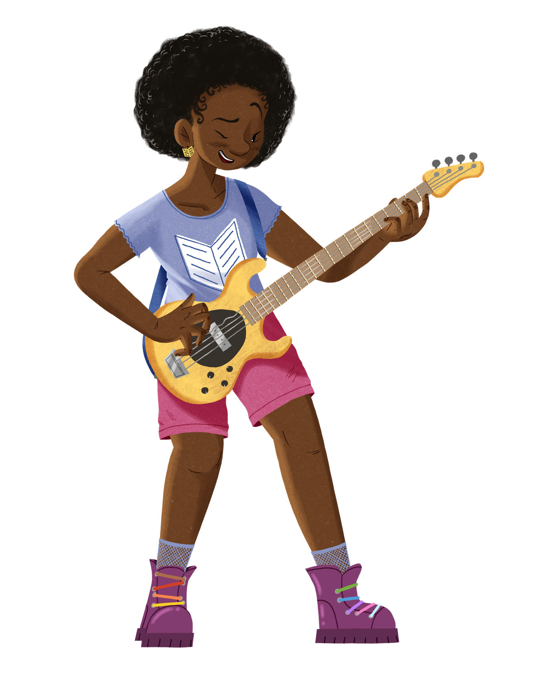
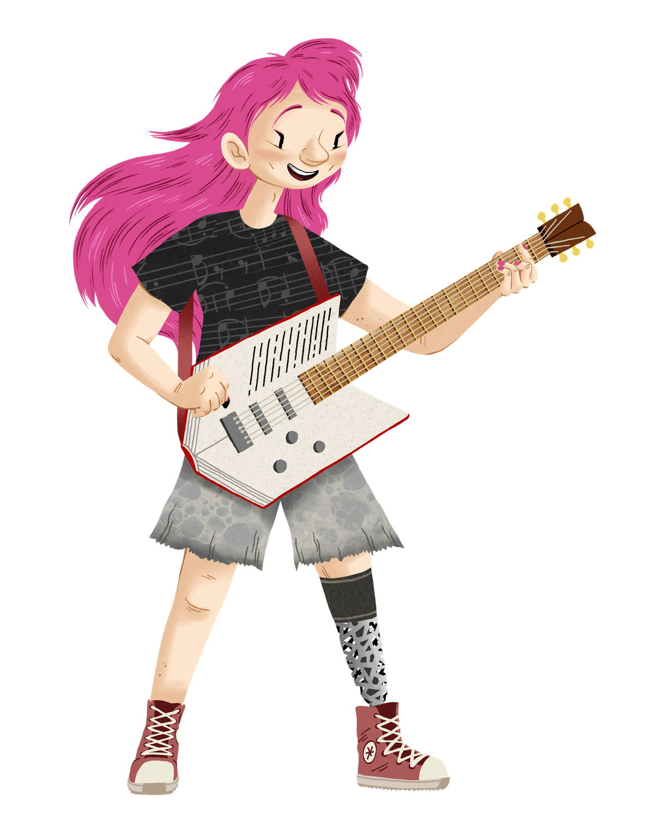
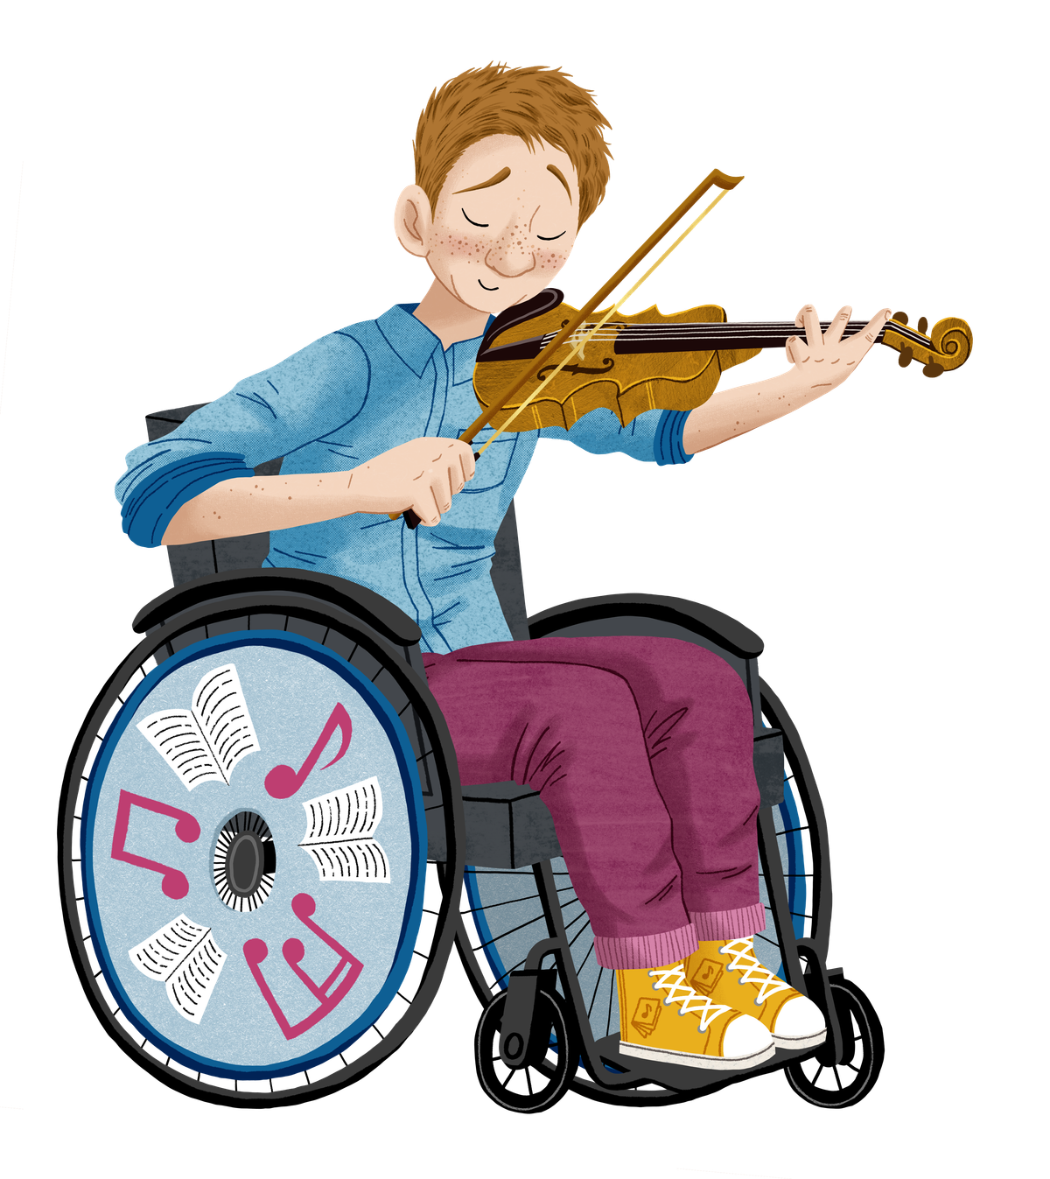
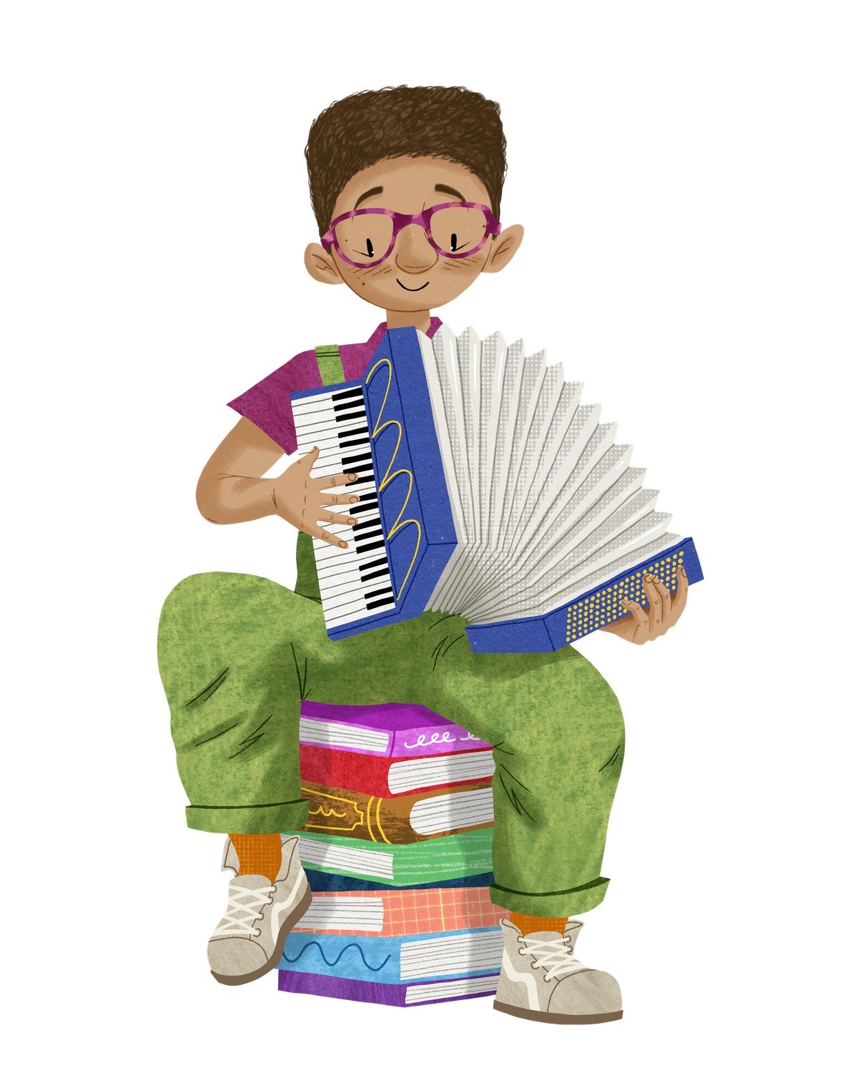


Join the band
Illustrations © Harry Woodgate 2026. Read to the Beat © The Reading Agency 2026, registered charity number 1085443 England and Wales
Notes:
2:
Sing from the rooftops! The theme for the Summer Reading Challenge 2026 is all about music and is called Read to the Beat! Celebrating music and storytelling
We want you to join the band and find your own reading rhythm.
Through the Challenge you’ll meet the Read to the Beat characters and discover more about their love of music and reading.
The library will help you find new books to enjoy and we’ll be hosting lots of events and activities in our libraries this summer.

Slide 3
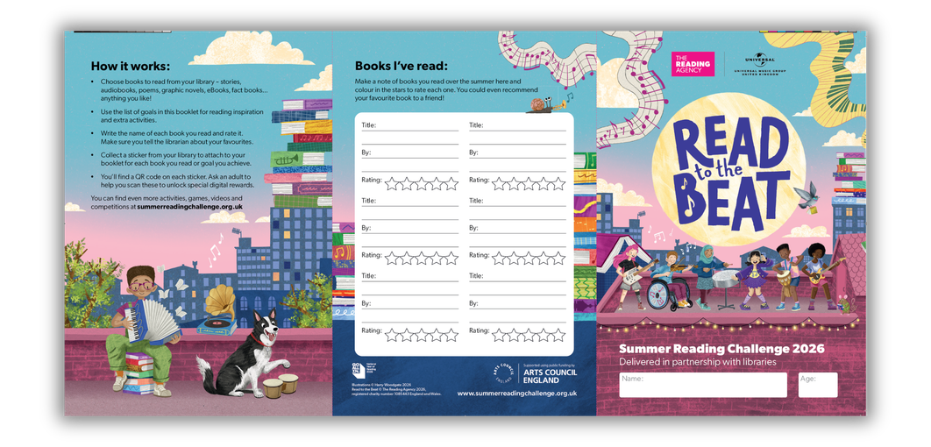
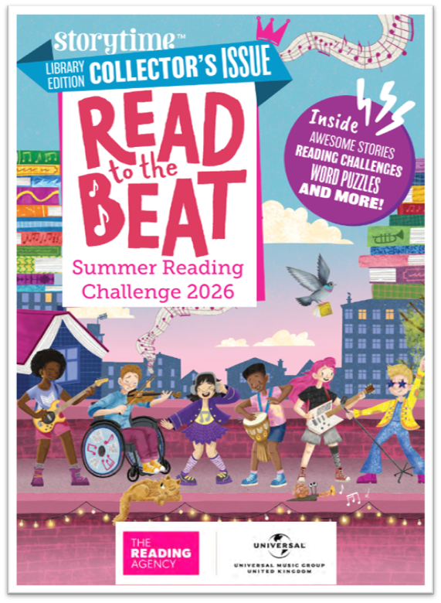
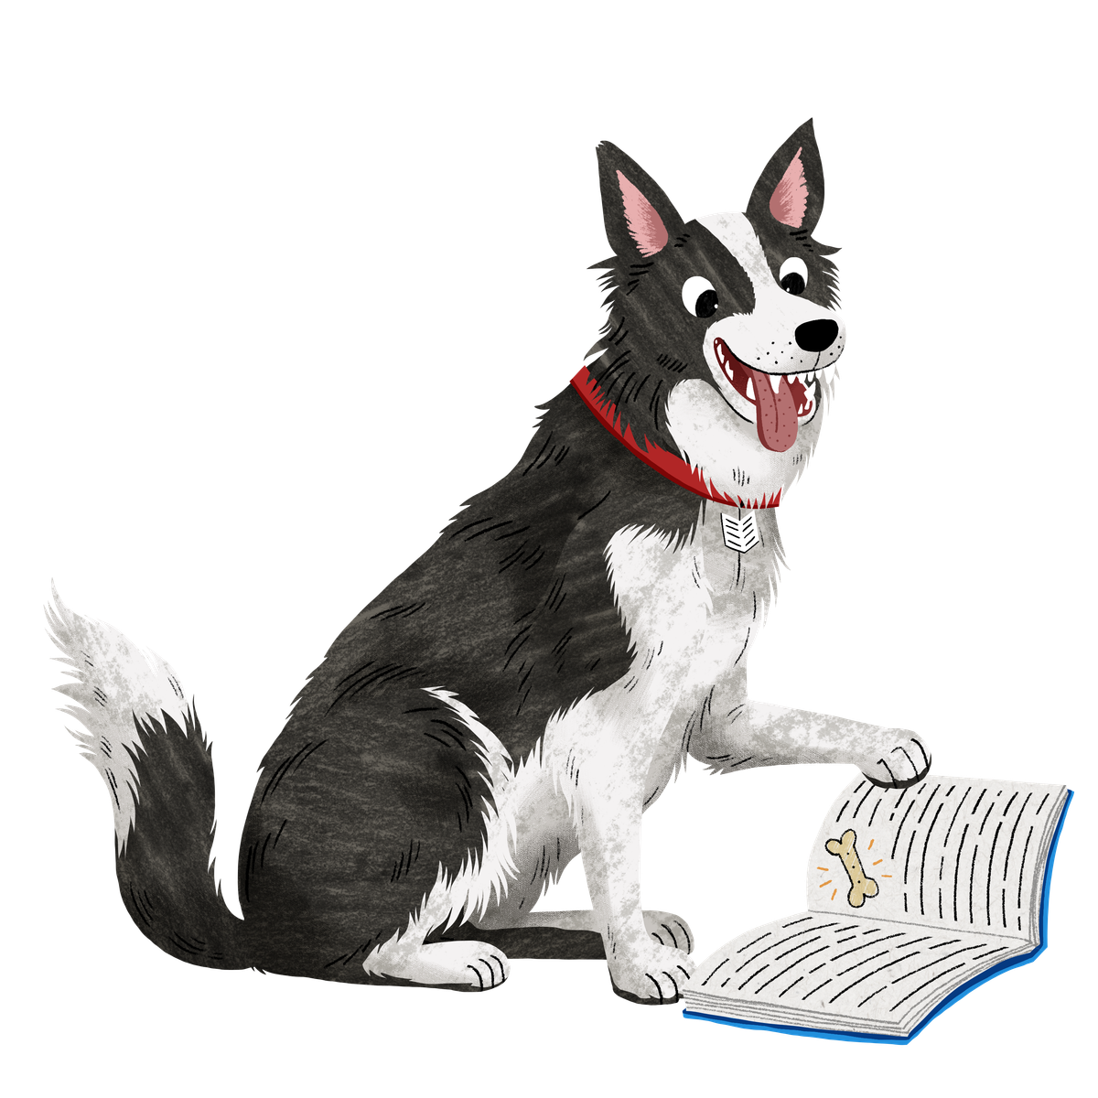
Take on the Challenge!
  Sign up at the library and get your
  Read to the Beat sticker booklet… AND
  Bookmark … AND
  Storytime Magazine
  Read ANYTHING you like – you are in charge!
  Collect stickers from your library and add them to your sticker booklet.
  Plus collect character cards (there are 6 in total).
Illustrations © Harry Woodgate 2026. Read to the Beat © The Reading Agency 2026, registered charity number 1085443 England and Wales
Notes:
3:
Read to the Beat is FREE to join at your local library.
Sign up at any Inspire Nottinghamshire library to get your starter pack of a sticker booklet, bookmark, and a free copy of Storytime magazine
The sticker booklet has a list of reading goals to choose from – these might give you reading inspiration eg read a book recommended by a friend or it might be to read for 20 mins every day for a week. Choose the goals that sound good to you.
As you read books and start to complete your reading goals by you will receive a sticker and character collector cards for every goal you tick off.
Aim for 6 reading goals between Saturday 4th July to Sunday 6th September
Teacher notes:
Children choose what they would like to read on the challenge - story book, fact books, poetry, jokes, graphic novels – as long as it is a library book all reading counts!
[The aim of the Summer Reading Challenge is to inspire a love of reading and encourage children to keep reading over the summer holidays. Library staff and volunteers will chat to children about the books they read for the Challenge]. The reading goals offer more flexibility in how children complete the challenge.

Slide 4
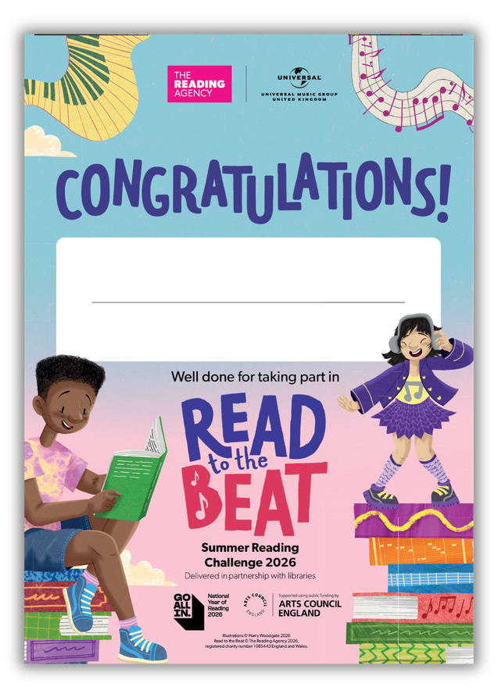

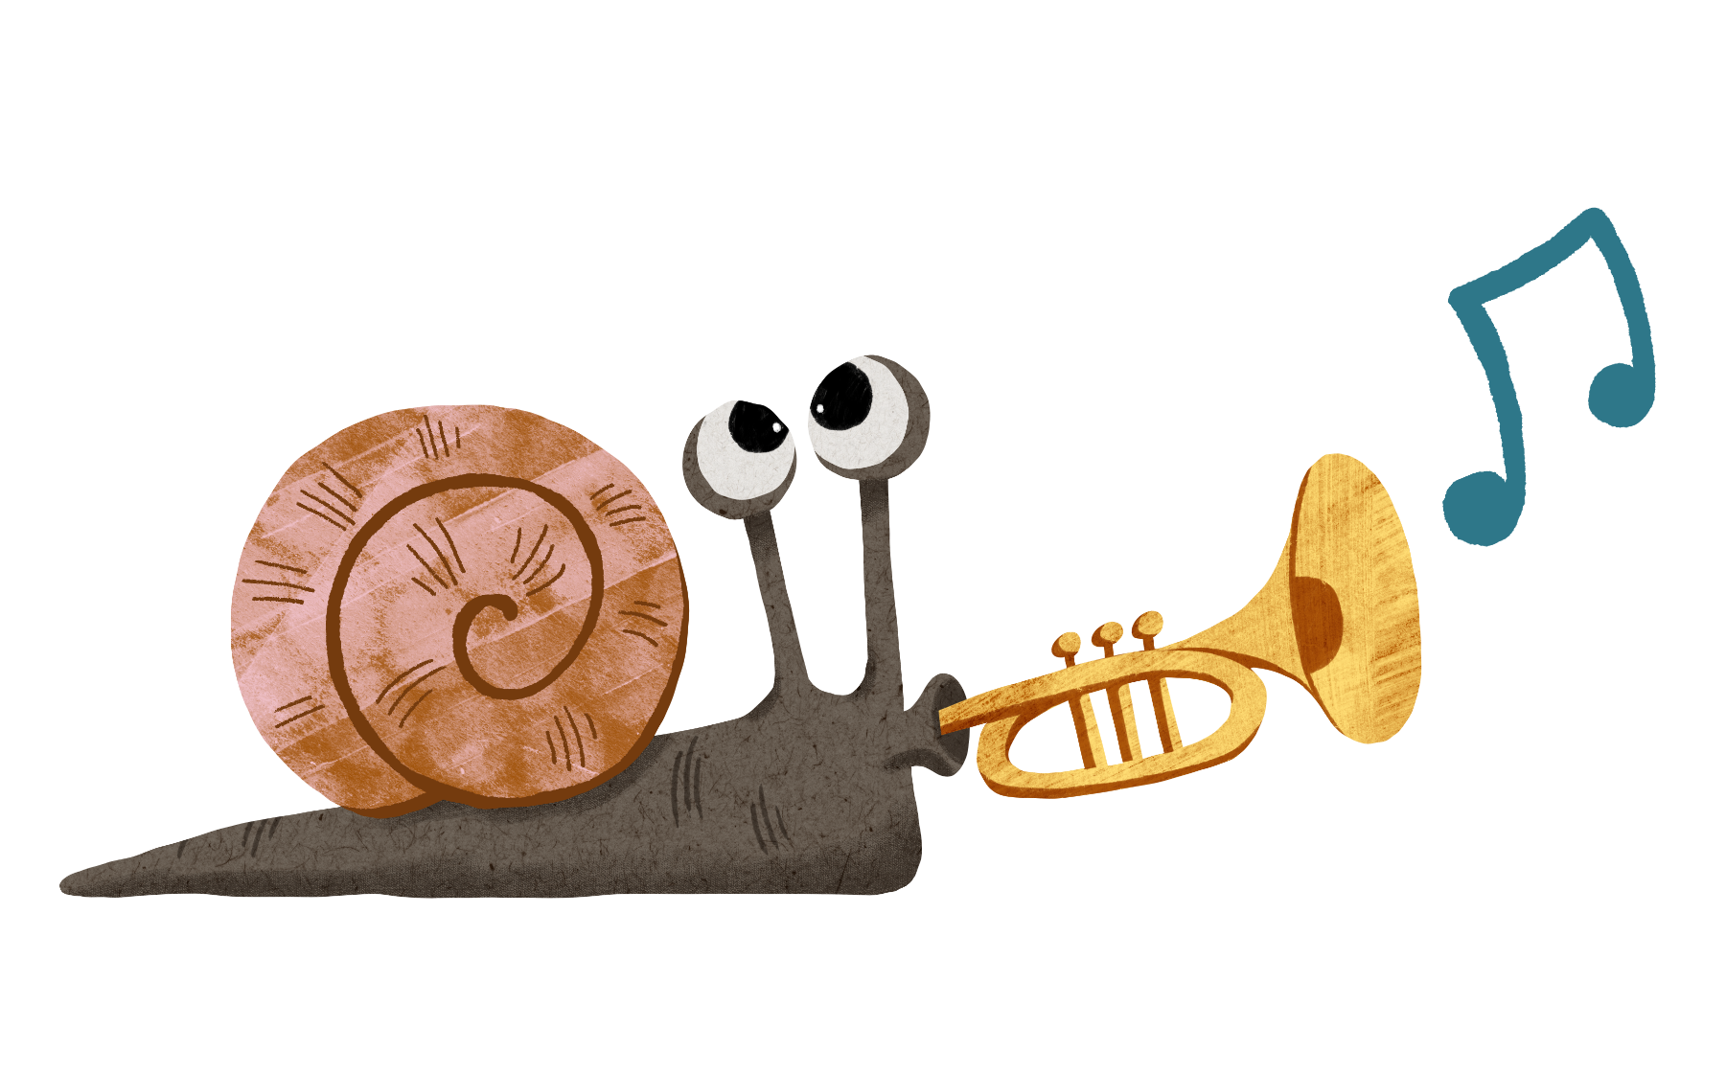

Why not challenge your friends to take part too and compare your favourite books?
Complete 6 reading goals to claim a certificate and medal!
Illustrations © Harry Woodgate 2026. Read to the Beat © The Reading Agency 2026, registered charity number 1085443 England and Wales
Notes:
4:
If you complete 6 reading goals you can claim your certificate and medal

Slide 5
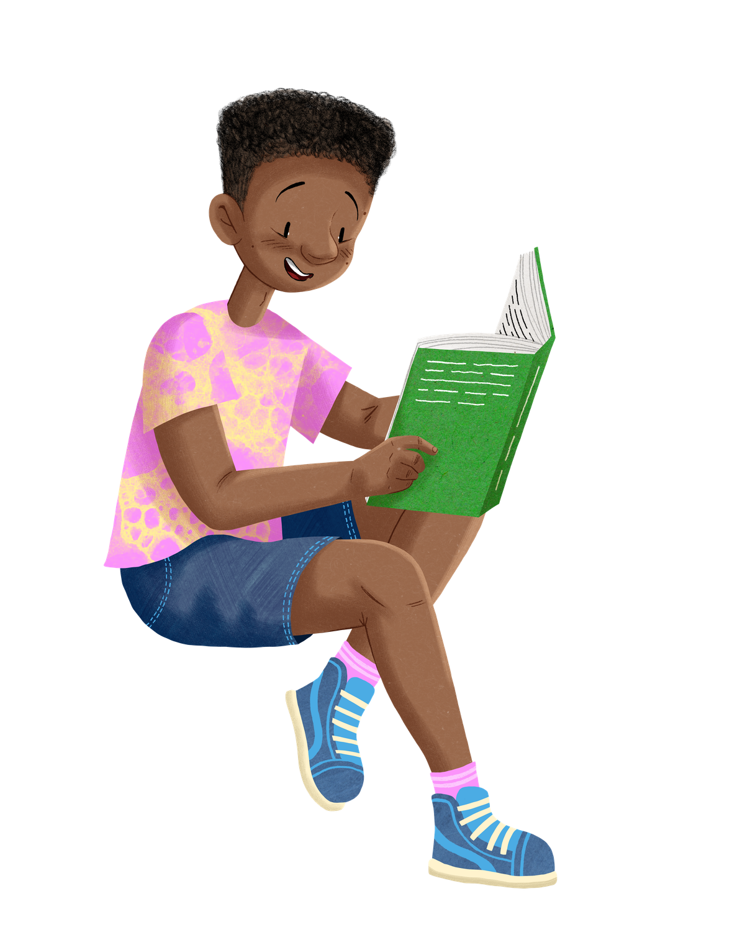
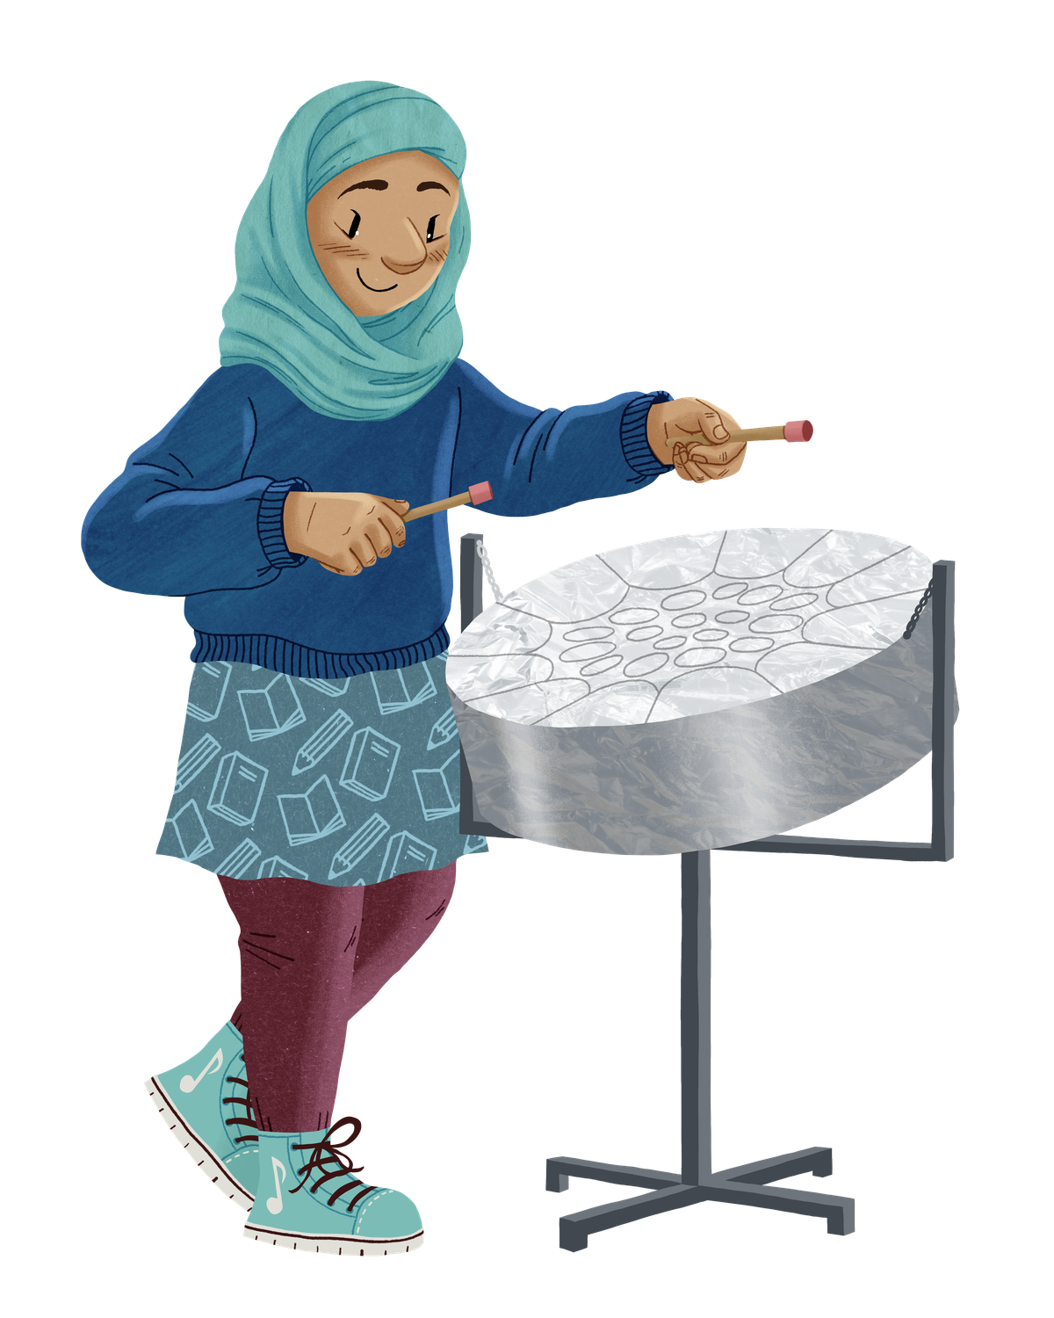

Join in at any Nottinghamshire Inspire library.
It’s FREE!
Starts: Saturday 4th July
Ends: Sunday 6th September
Illustrations © Harry Woodgate 2026. Read to the Beat © The Reading Agency 2026, registered charity number 1085443 England and Wales
Notes:
5: the Challenge start on Saturday 4 July - and runs all the way until you return to school.
Teacher notes: For more information on the Summer Reading Challenge in Nottinghamshire go to www.inspireculture.org.uk/SummerReadingChallenge

Slide 6
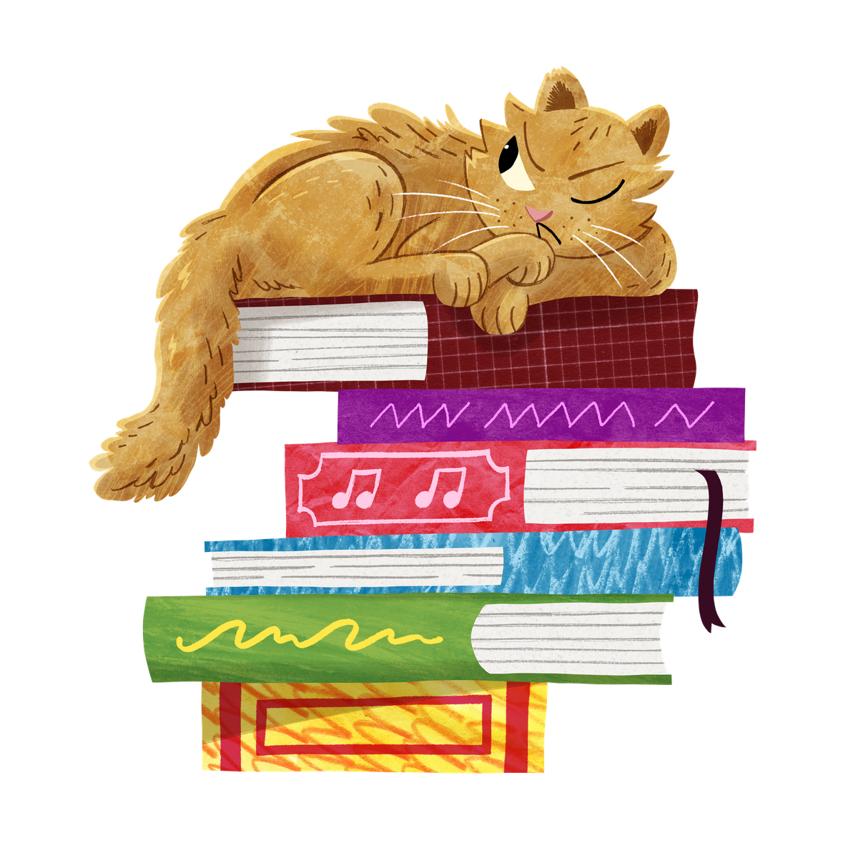
You can take part online!
✰ Set your own summer reading goal
✰ Rate and review your books to unlock badges
✰ Play games and enter competitions
✰ Use the Book Sorter to find books recommended by other children
summerreadingchallenge.org.uk
Illustrations © Harry Woodgate 2026. Read to the Beat © The Reading Agency 2026, registered charity number 1085443 England and Wales
Notes:
6:
The fun continues at home too! Visit the Summer Reading Challenge website www.summerreadingchallenge.org.uk to play games, review your latest reads and enter competitions.
You can share your favourite books with other children taking part in the Challenge and unlock extra rewards for your reading and reviewing!
Teacher note: Children can join the challenge online to earn digital rewards. To get hard copy resources folder, stickers, bookmark, medal and certificate. Children need to join in person at the library.

Slide 7
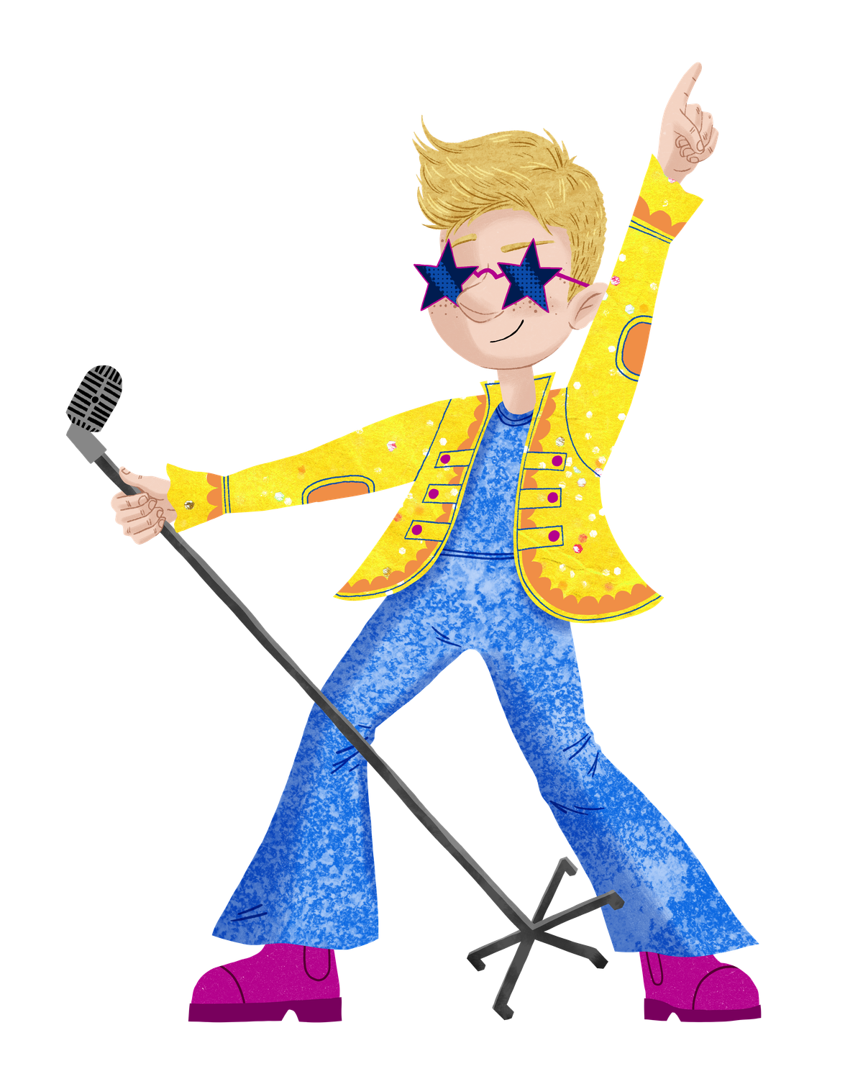
See you at the library!
Illustrations © Harry Woodgate 2026. Read to the Beat © The Reading Agency 2026, registered charity number 1085443 England and Wales

